Slide 1




Custom Design to Drive Conversion
We bring countless hours of design experience to each website we build and will create a gorgeous layout that drives the types of customer actions you value most — whatever those actions may be.
Cutting-Edge Technology
YOUR LOGO
Our agency offers the most innovative tools in web design, real-time site personalization, eCommerce, Progressive Web Apps, and more to guarantee your site produces great results now and well into the future.
Capture More Customers
with a Smart & Beautiful Website
Lightning-Fast Loading
Your customers are searching for you online and a professional, conversion-driving website is the best tool to help them find and engage with your business. Here is how we create yours...
Every website built by our team is optimized to load at breakneck speed according to Google’s best practices. This improves your search ranking and ensures potential customers get the information they need as quickly as possible.
Ironclad Security & Hosting
All of our websites are hosted on Amazon Web Services (AWS) and maintain a 99.9% uptime. We also offer HTTPS encryption via SSL certificates for an added layer of security for you and your online customers.
Business Name
yourmail@yourmail.com
www.yoursite.com
+123 456 7890

Slide 2
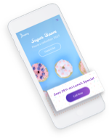
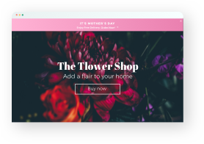
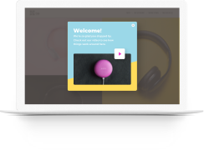
Real-World Examples
Visit Store
Trigger: Visitor arrives on site from a mobile device
Action: Save 25% on lunch specials
Value: Visitor comes directly to business
YOUR LOGO
Create 1-to-1, Customer
Converting Experiences
Order Online
Trigger: Visitor arrives on site on Mother’s Day
Action: Banner promoting free delivery
Value: Visitor has incentive to order flowers
A personalized experience online is what has made Amazon so successful. So to help skyrocket your revenue, we employ real-time website personalization technology that delivers individualized user experiences based on date, time of day, number of previous visits, visitor geo-location and more.
Flash Sale
Trigger: Third time visitor goes to the site
Action: Popup for buy one, get one free
Value: Return visitor is encouraged to buy
Business Name
yourmail@yourmail.com
www.yoursite.com
+123 456 7890

