Slide 1
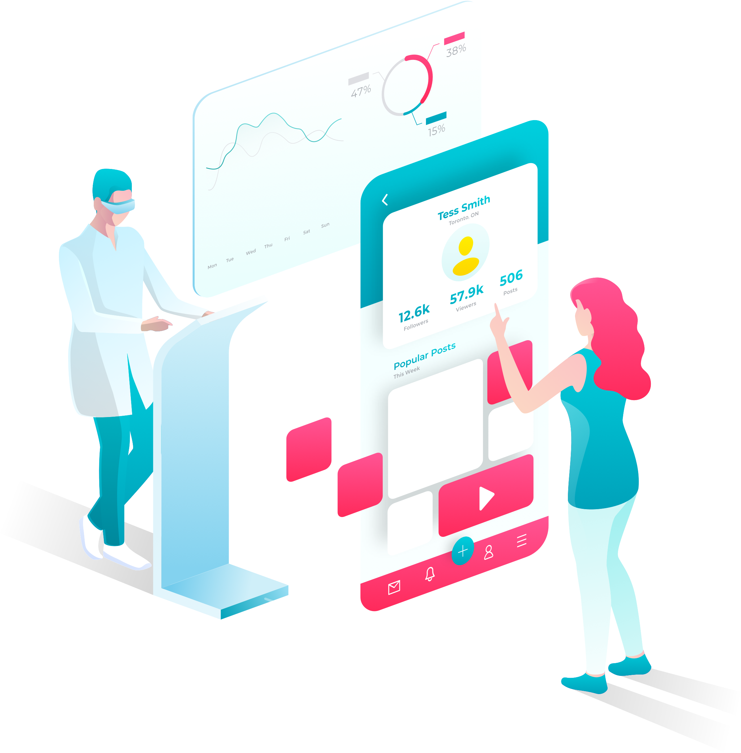
YOUR LOGO
Website Personalization
Increase Conversions with Customized Experiences

Slide 2







Agenda
What is Website Personalization?
Your Competitive Edge
Examples of Personalization in Action
Rock your
ROI
Why Personalization Matters
Let’s
Start
Site Personalizations Work
YOUR LOGO
www.yourwebsite.com
(201) 555-5555

Slide 3



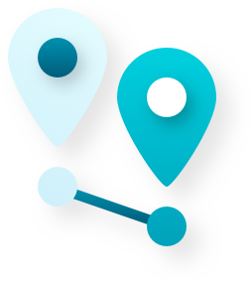
What is Website Personalization?
Personalization is accomplished by changing site messaging, content and some design aspects based on:
Number of previous visits
And more
Time of day
Visitor’s physical location
YOUR LOGO
www.yourwebsite.com
(201) 555-5555

Slide 4
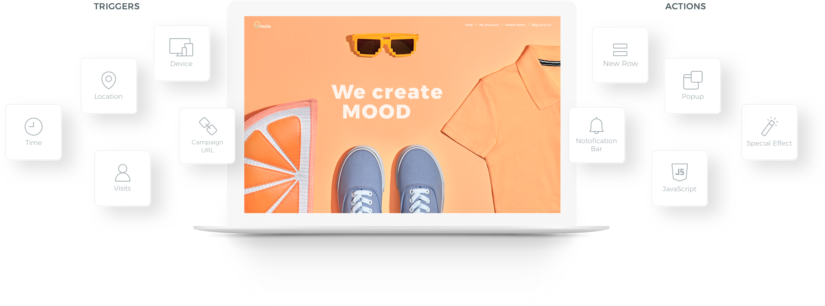
Website Personalization creates an experience that relates directly to a visitor’s unique situation.
YOUR LOGO
www.yourwebsite.com
(201) 555-5555

Slide 5
Examples of Real-World Customizations that Work
YOUR LOGO
www.yourwebsite.com
(201) 555-5555
Notes:
Uber image

Slide 6
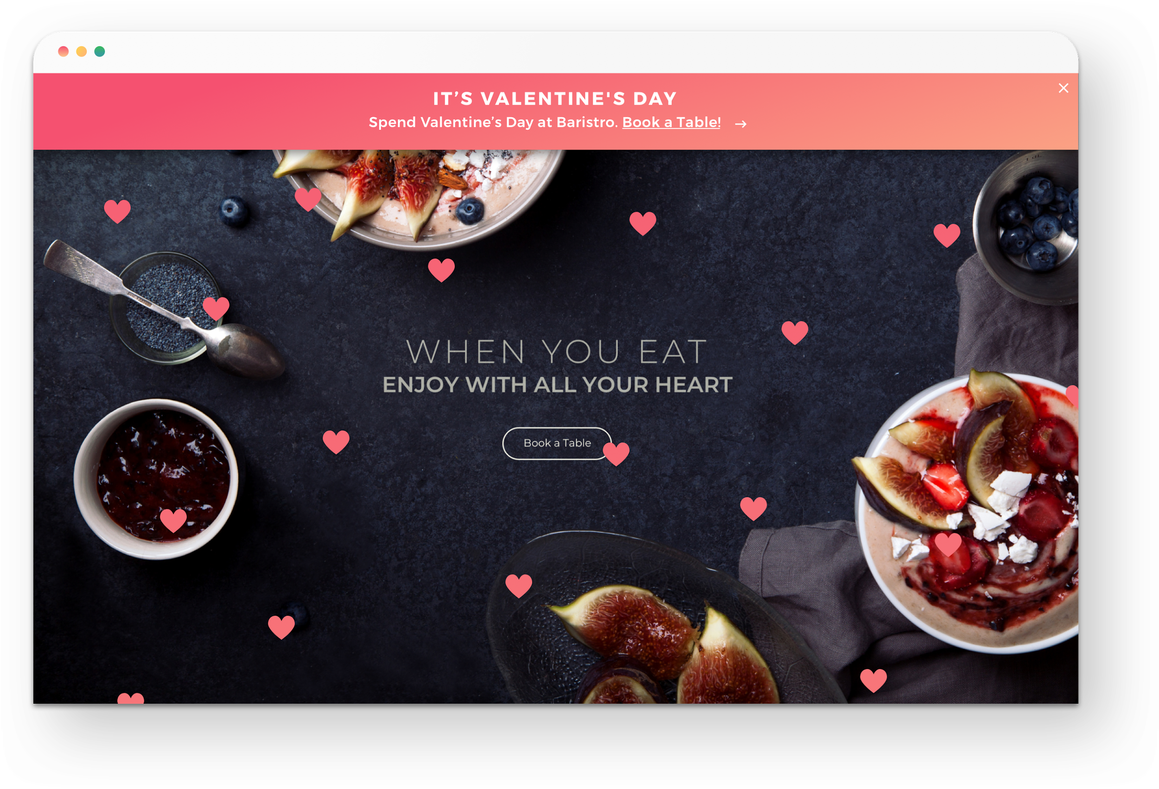
Holiday customizations
A restaurant sprinkles its site with special effects for different holidays.
YOUR LOGO
www.yourwebsite.com
(201) 555-5555
Notes:
Uber image

Slide 7
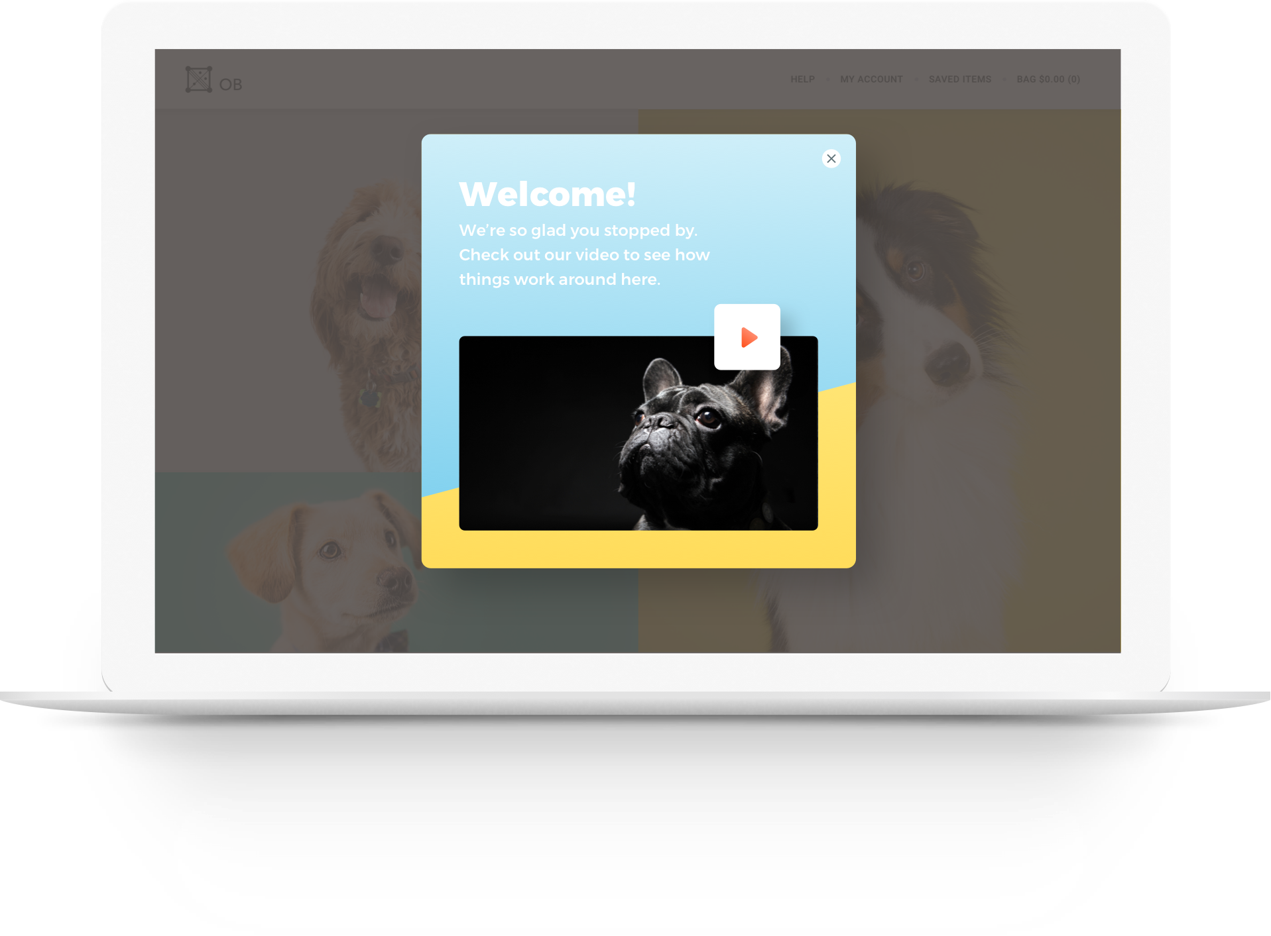
First-time visitor customizations
A kennel shows first-time visitors a video of their facilities.
YOUR LOGO
www.yourwebsite.com
(201) 555-5555
Notes:
Uber image

Slide 8
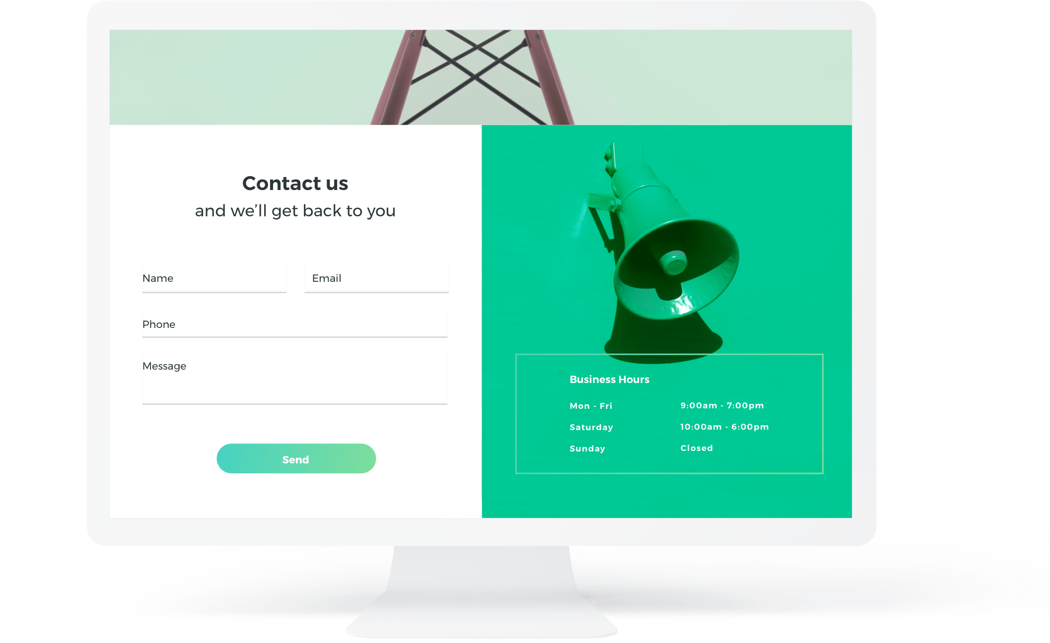
After-hours customizations
A photographer’s site displays a contact form to visitors who arrive after 5 pm so they can leave contact information.
YOUR LOGO
www.yourwebsite.com
(201) 555-5555
Notes:
Uber image

Slide 9
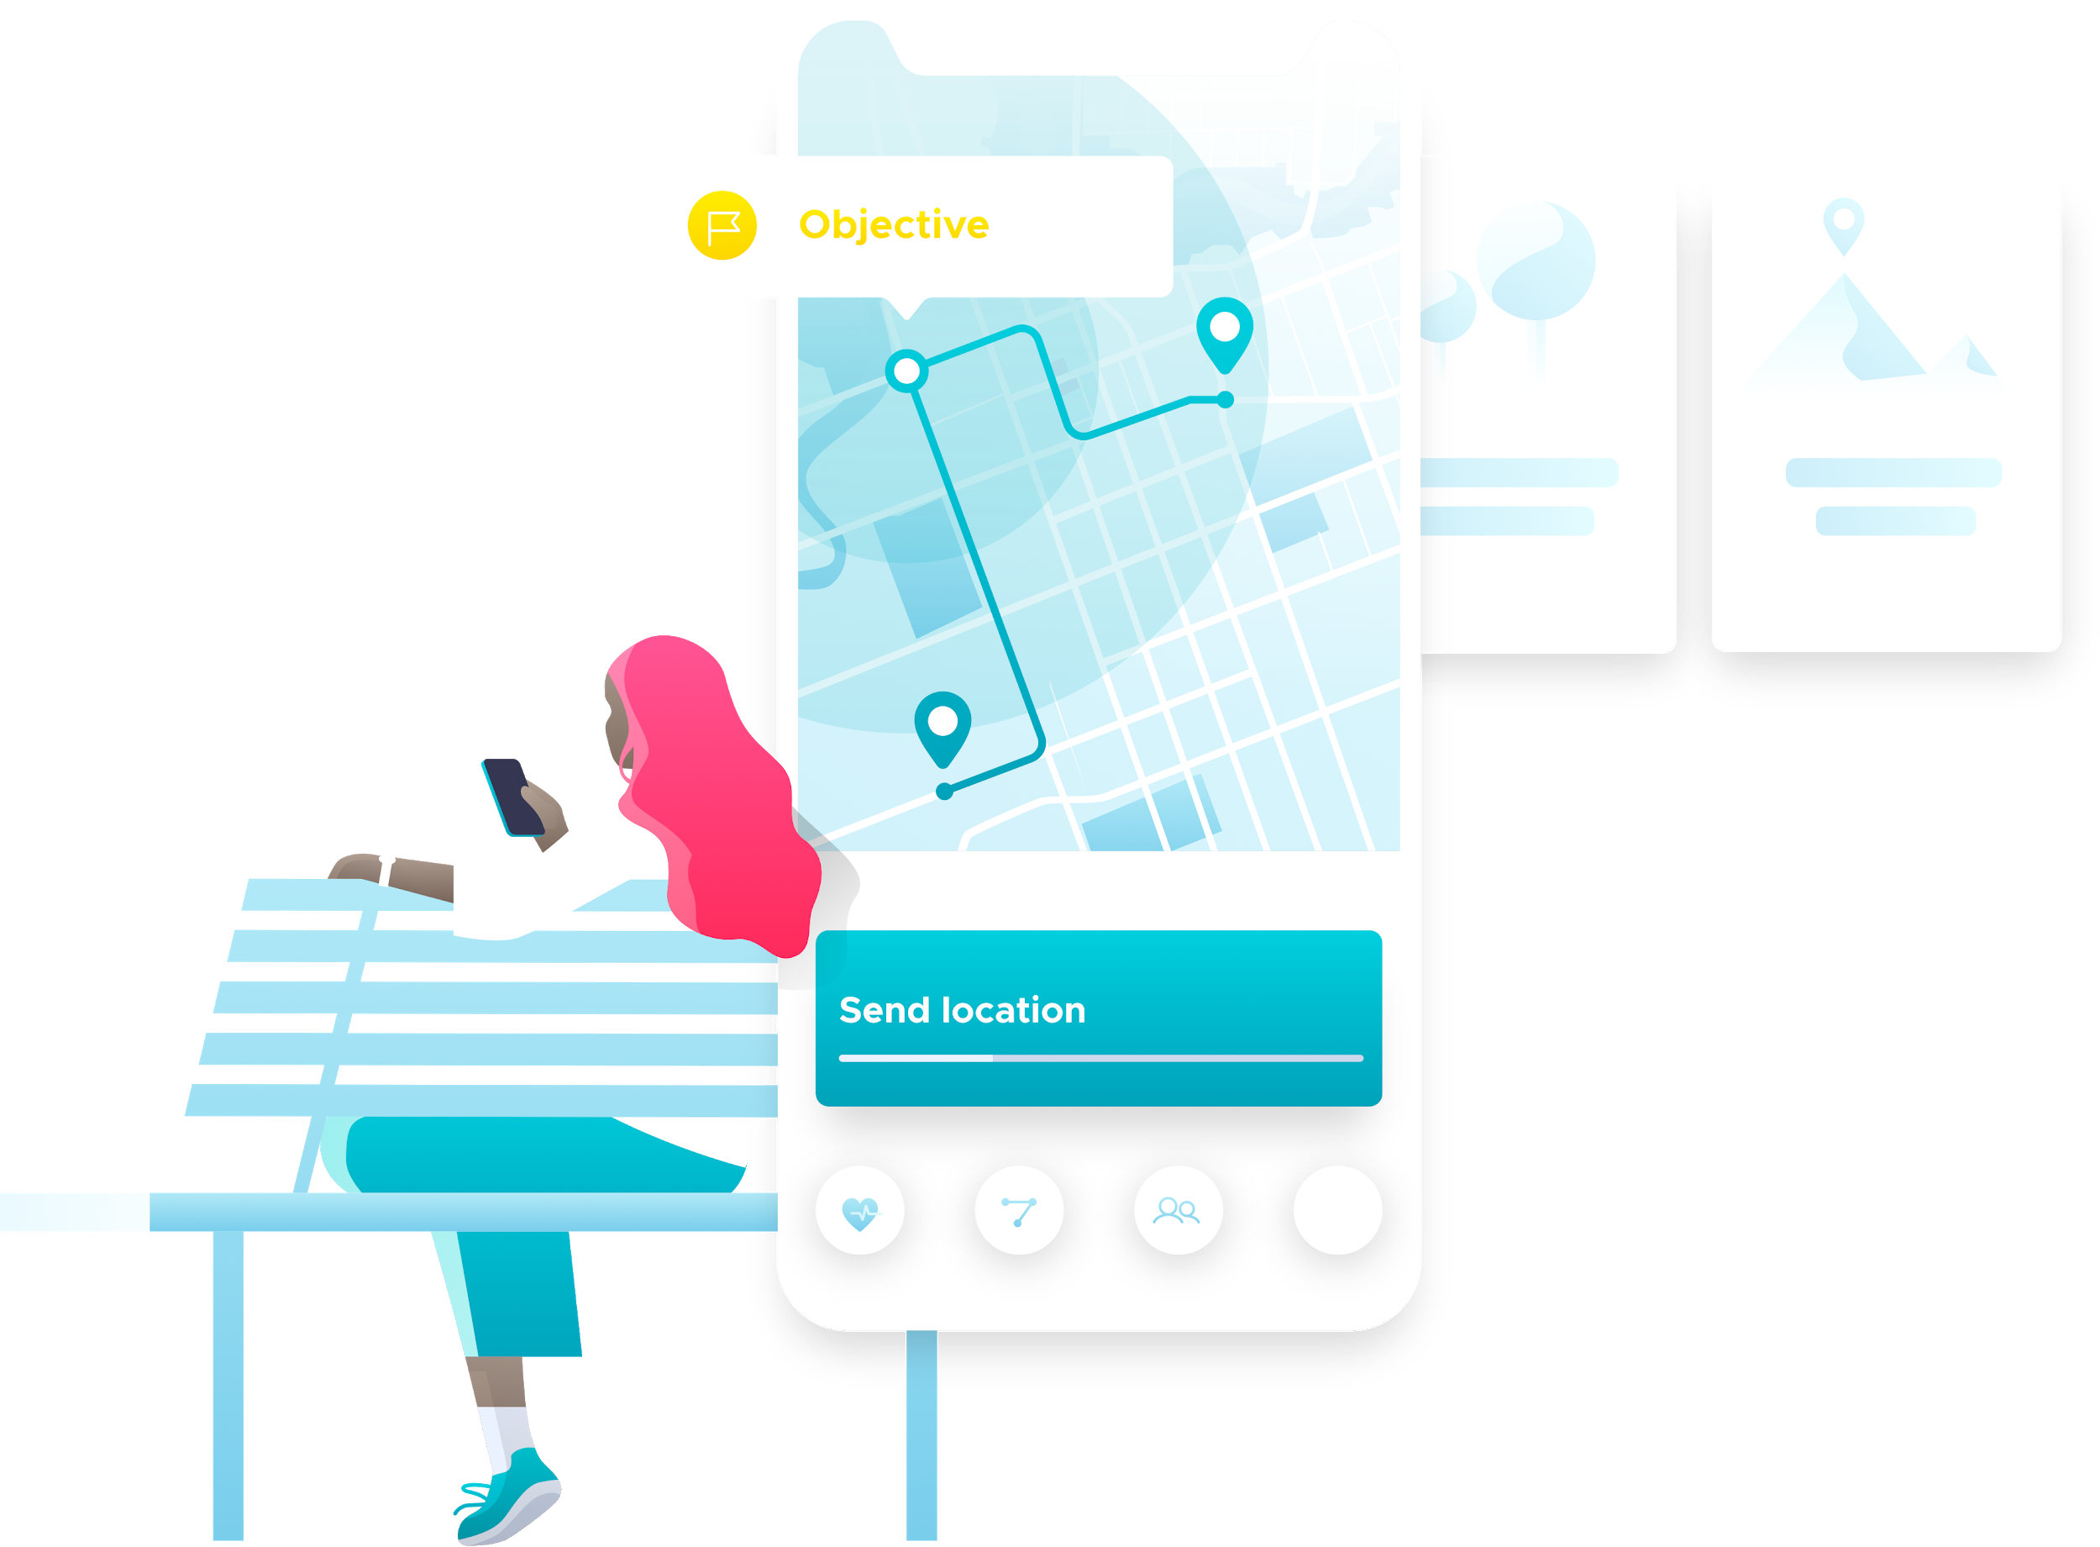
Why Personalization Matters
Site visitors have short attention spans
Attracting their attention quickly is important
Visitors want the information they are looking for right away
YOUR LOGO
www.yourwebsite.com
(201) 555-5555

Slide 10
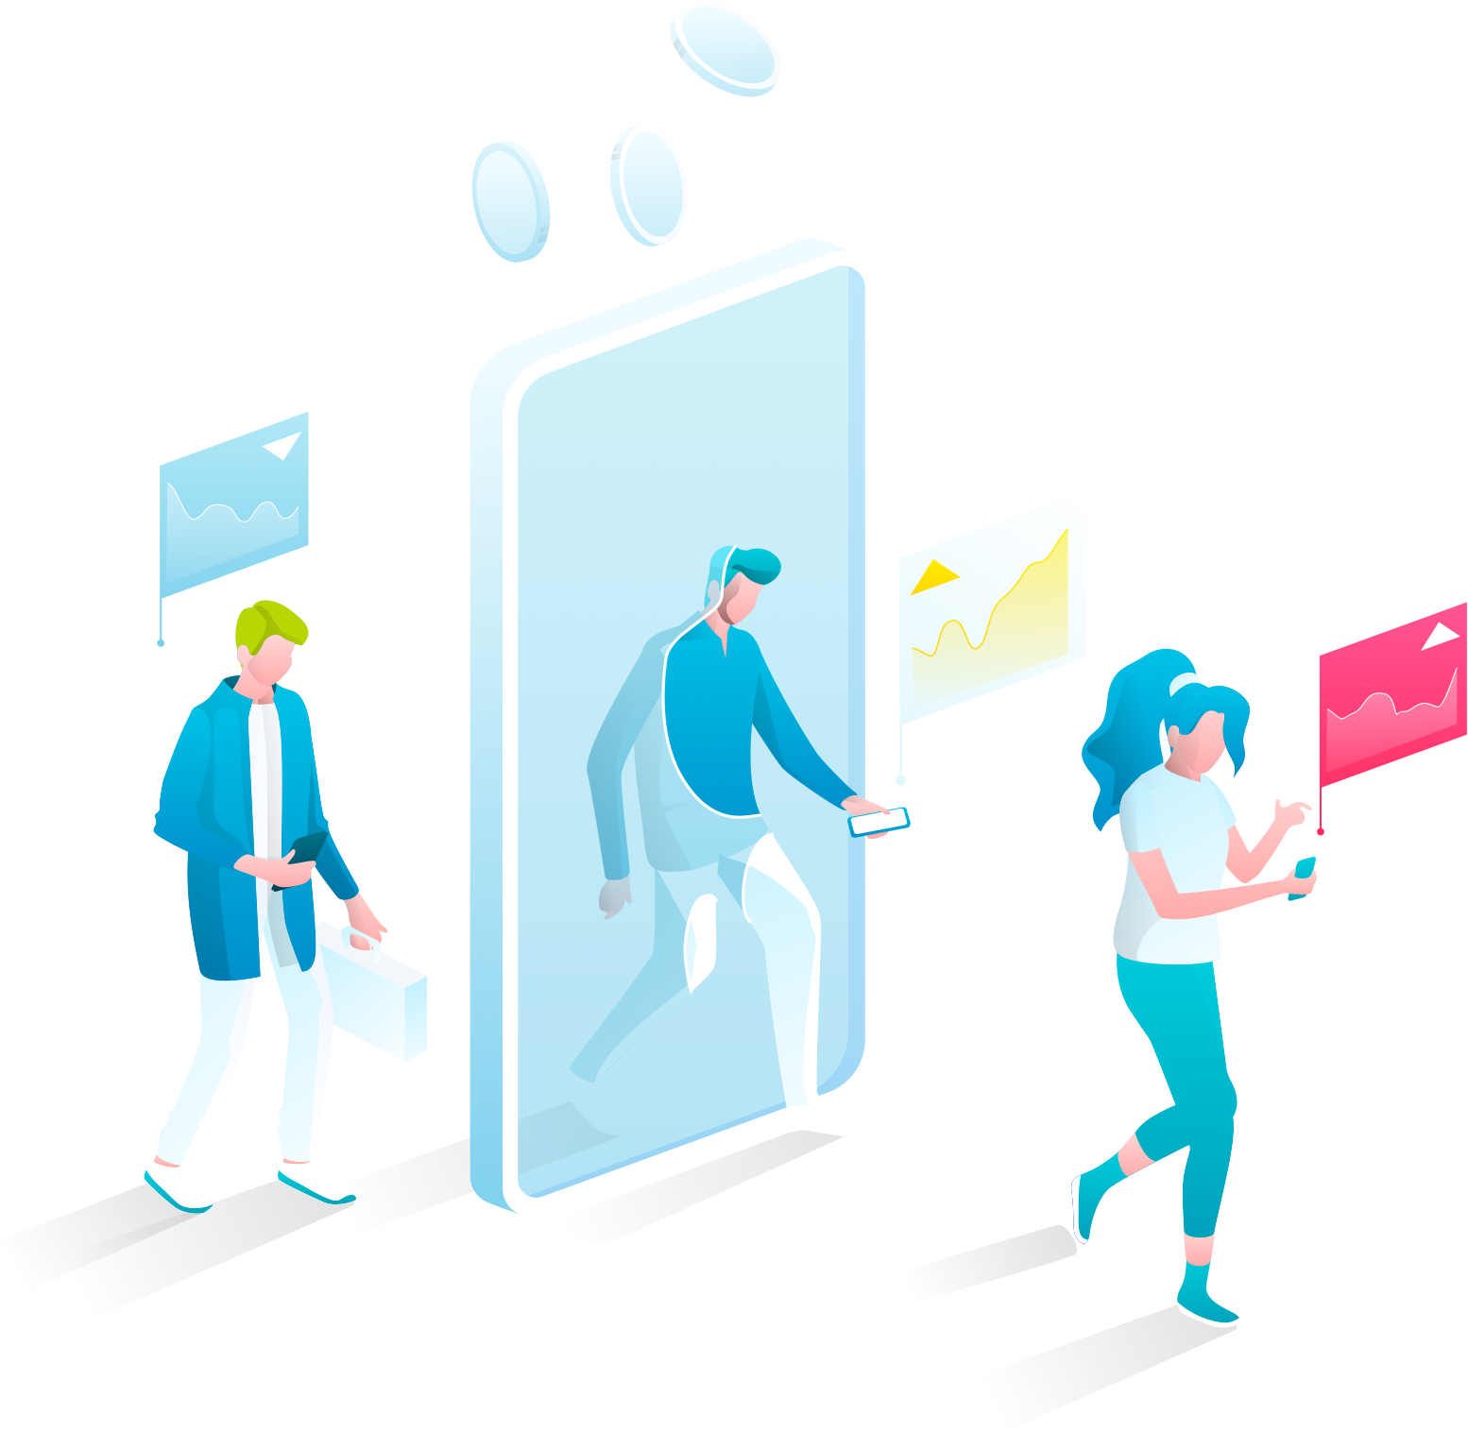
Site Personalization Works
80% of people say they are more likely to do business with companies that offer personalized experiences⁽¹⁾
59% of companies plan to use personalization (but aren’t using it yet!)⁽²⁾
Personalized Calls-to-Action (CTAs) perform 202% better than other CTAs⁽³⁾
1. Epsilon 2018 2. Econsultancy 2017 3. Hubspot 2018
YOUR LOGO
www.yourwebsite.com
(201) 555-5555

Slide 11



And Gives You a Competitive Edge
With personalization, you can push highly relevant products and offers front and center.
Boost conversions among site visitors that are on your site
Give yourself an edge with highly relevant offers
Make sales and promotions more dynamic and engaging
YOUR LOGO
www.yourwebsite.com
(201) 555-5555

Slide 12

Ready to Skyrocket Your ROI?
We’ll work with you to create a comprehensive personalization strategy to maximize conversions.
Track personalization successes
Revise & optimize
YOUR LOGO
www.yourwebsite.com
(201) 555-5555

Slide 13
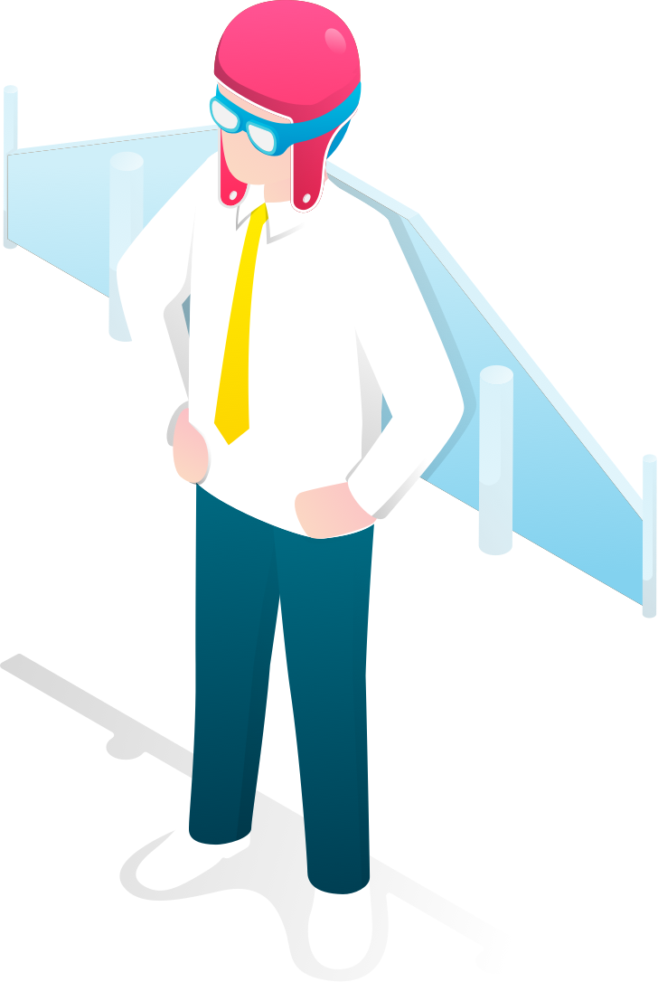
YOUR LOGO
Ready to start?
Contact Name | Email
Phone number
WWW.YOURSITE.COM
Notes:
Uber image

