Slide 1



Your Logo
You Deserve Better.
You could have your website built on WordPress, but it wouldn’t be worth it.
WordPress was built for blogs, not small businesses. A good small business website can’t be built on WordPress without the use of unstable plugins that will break your website every time WordPress runs an update. We are a better choice because small businesses are our specialty.
Better SEO
Right from the start, our websites’ innovative, built in architecture improves SEO automatically. Our entire platform is aligned with Google protocol to raise your website’s Google ranking.
Better Performance
We optimize our websites to load faster
and score higher on the Google PageSpeed test. On WordPress, your website’s content will be slowed down by numerous code and software bloats.

Slide 2

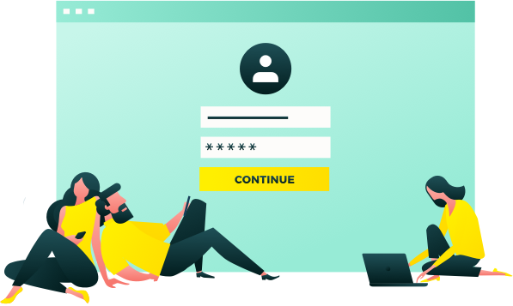


Better User Experience
Our natively-responsive websites provide a better user experience across all devices. Turn more visitors into customers with up to 70% higher conversion rates than industry averages.
Better Security
We’ll keep your website safe and secure with free encryption and auto-renewing SSL certificates. On WordPress, you’ll have to pay for manual installation and all security updates.
Better Build Times
Our natively-responsive websites provide a better user experience across all devices. Turn more visitors into customers with up to 70% higher conversion rates than industry averages.
Good is Good,
But Better is Better.
Don’t just make a good choice; make a better choice. Let us build you a better website today.
Business Name | +123 456 7890 | yourmail@yourmail.com | www.yoursite.com

