Slide 1

Local Business Survival Kit
Presented by: YOUR NAME

Slide 2

Today’s webinar:
What’s changed?
Today’s Customer Journey
Demo of how I do it
The Local Business Online Toolkit
Notes:
Thank you for joining and welcome to this special webinar, I am so excited to be able to help
Now, COVID-19 has had a massive impact on local economies, and we feel it’s important to address. While local is hard, There is a way to survive and I am here to help.
If you have any questions throughout, don’t worry about holding them until the end! Just pop them in the chat and I will work through them with you, I love it when webinars are interactive.
How does this look to you?

Slide 3
What’s Changed?
Notes:
The way of the industry when it’s come to sales has changed from what we knew.

Slide 4


ABC of Sales
“Always Be Closing?”
1992 David Mamet-scripted film "Glengarry Glen Ross,"
Notes:
So let’s go back a bit. Raise your hand, give me a wave if you are in Sales, or responsible for the revenue for your business?
Ah great, so really we all are, and if you have any other sales team members or front line members not here today, I will send you the recording so you can pass on to them, as it is super valuable information.
So… What Is Always Be Closing—ABC?
Always Be Closing (ABC) is a motivational phrase used to describe a sales strategy. It implies that a salesperson following the regimen should continuously look for new prospects, pitch products or services to those prospects, and ultimately complete a sale. If you are not familiar with it, it came from the 1992 David Mamet-scripted film "Glengarry Glen Ross,"
If you haven’t watched the movie check it out.
Now the elephant in the room, the big question… is this the right approach? for your business right now?

Slide 5
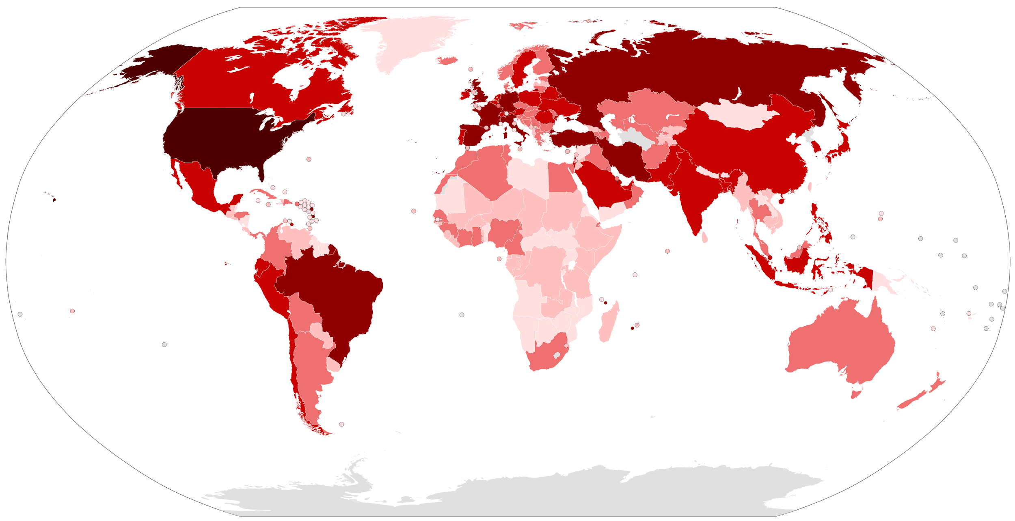
The world has changed.
Today... it’s about the 3 Cs
Notes:
Short answer is NO, not now..
There is something that works better today, because the world has changed.
Business has changed…
Local is Hard
And you need to survive, and I can help, today is all about the Three C’s
Always be Communicating
Always be in Control
Always be ready to Close… yes while it isn’t the only thing or the first thing, it is Always a part of your success.
Let me show you what I mean.

Slide 6



Always Be Communicating
Always Be in Control
Always Be ready to Close
Communication
Always be Communicating the Value of what you do for your customers.
In Times Like These you want to ensure your Brand / Business is not forgotten.
Control
Always be in Control of the performance of your digital assets and activity.
Now is the time to ensure you have a 100% Digital Solution to support your business.
Close
Not all of your customers are in a position to buy now, but you should always be ready.
Get back to Closing, there are many ways you can use digital to improve your strike rate along the customer journey, If you don’t your competitors will.
Notes:
1: Always be communicating, in times like these it is vital that all the good things you do as a business are not forgotten! it is vital your business and brand is not forgotten! in times like these it is those businesses which continue to communicate value that succeed.
2: You should always be in control over not just the performance but the activity on what’s happening with your digital presence. 100% of word of mouth for some businesses is on line right now. And 100% of businesses need to have a solid digital solution.. I can help
3. An yes I am here to help you make money, yes closing is still important but how do you equip your business with the best opportunity to ensure you get them? Sales for some is now and for others are later, but everyone must protect their pipeline.
Some great news!
Today in this webinar I am going to show you how your business can better connect with your community to drive revenue and ensure your brand story is getting to your customers.
Today in the next 45 mins I will demo end to end how we can help you be set up for success instantly.

Slide 7
Customer Journey
Notes:
Now that we understand the 3 C’s and what’s expected of us as business owners, let’s look at how your customers are buying.

Slide 8

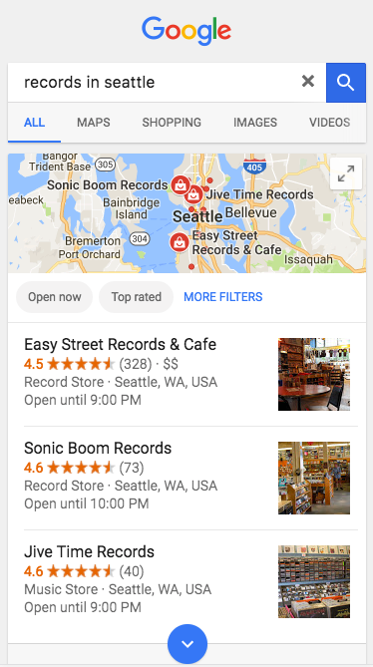
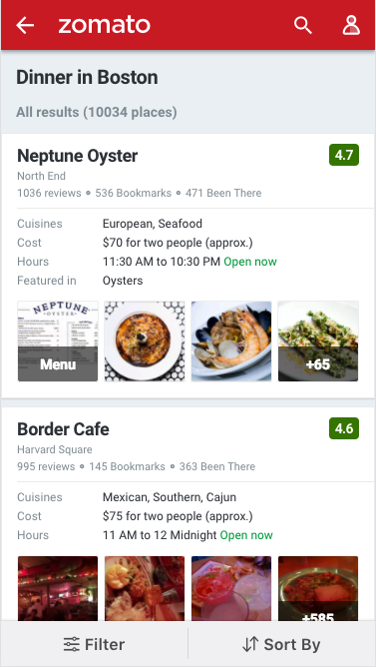
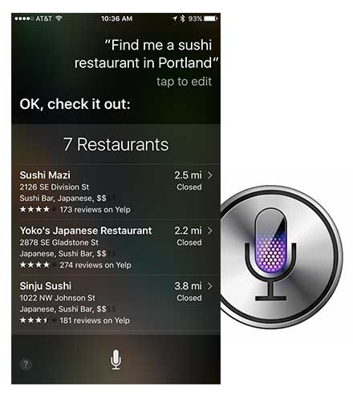
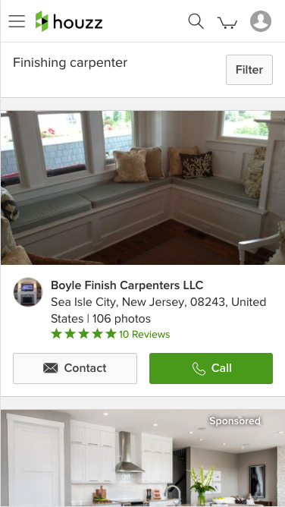
Do you stand out?
Do you stand out where people are making decisions?
93%
Shoppers say they've used online resources
Notes:
First things first:
Since 93% of shoppers say they use online resources and buying decisions are made at the Zero Moment of Truth, how is your marketing performing right now?
How is business for you right now?
You don’t need to answer right now, it is a difficult time for us all.
The key is while the world has changed, people have changed the way the purchase. But the decision process or path is the same. And I can help.

Slide 9


Customer Journey
Notes:
The typical customer journey looks like this...

Slide 10


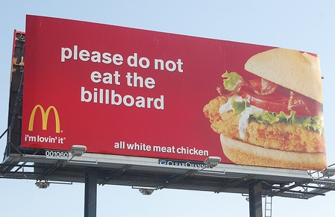
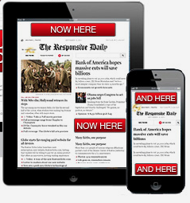

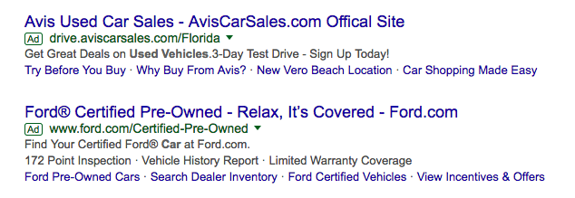
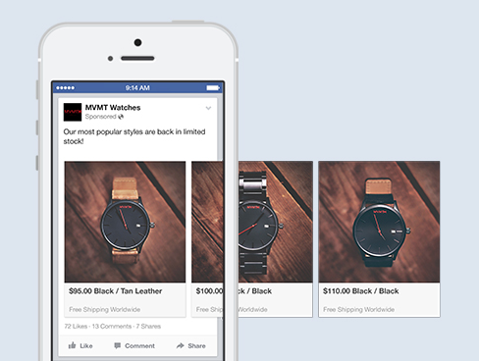
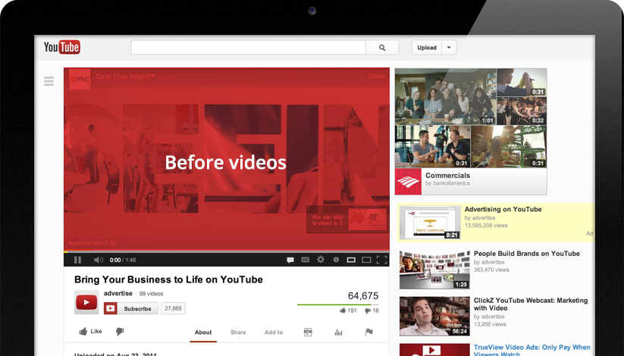
Customer Journey
Generate Interest
Awareness
I’d like to have that.
That looks cool.
I want to know more.
I needed one of those!
Interest & Awareness
Social / Search Advertising
Email / Text Marketing
Loyalty programs
YouTube / Video Ads
Television
Billboard
Online display advertising
Newspaper / Magazine
Radio
Word of mouth
Notes:
It still starts with Interest & Awareness. Television, radio ads, billboard aren’t going away completely… well in some cases they have temporarily.
Either way They are absolutely 100% being supplemented by digital stimulus. Things like online advertising, email & text marketing, and YouTube video ads.
Question: What things are you currently doing to generate awareness and interest from new & existing clients?

Slide 11

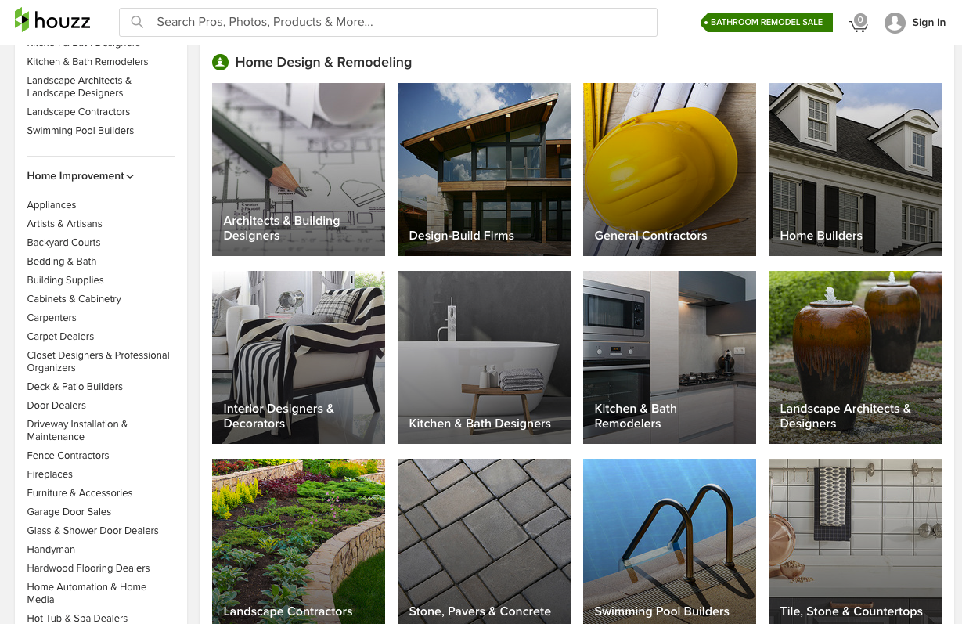
Customer Journey
Be Found & Stand Out
Awareness
Findability
“best tacos boston”
“family lawyers in austin”
“record store near me”
“top home builders”
Search
Organic Search
PPC
Maps
Directories
Apps
“Near me”
Notes:
After becoming aware of your business, consumers start discovering more with search.
There are more places than EVER where people are searching for businesses. It’s not just Google either. There are apps, directories, voice search, GPS… lots of places.
Question: Do you know how findable your business is online? What places are you aware of?

Slide 12

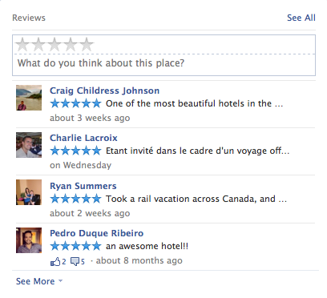
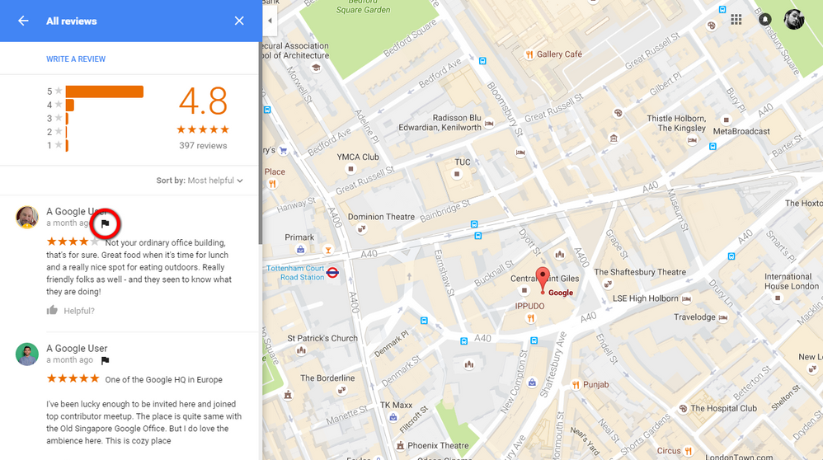
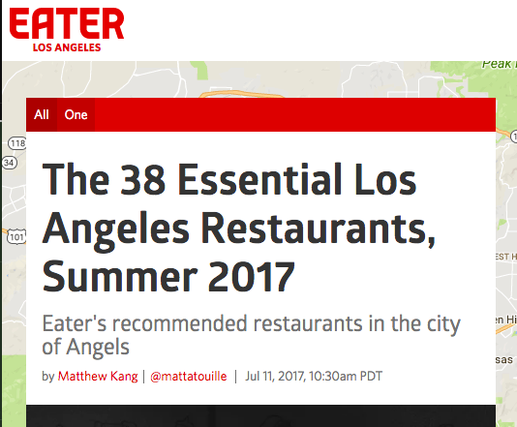
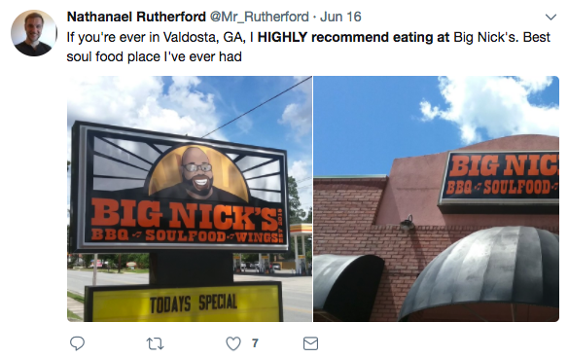
Customer Journey
ZMOT
Be Chosen
Awareness
Findability
Reputation
Research
Blogs & Articles
Reviews
Social Media
Friends and family
This business is popular! They have a lot of reviews, from mostly satisfied customers
Notes:
After finding your business, consumers see your reviews. In fact, it’s often the first thing showcased in Google search result.
When a consumer uses ratings, reviews, and recommendations to help them compare choices, this affects the Zero Moment of Truth – where they choose which business they're going to buy from.
Question: What’s your average review score? Do you have any negative reviews that you’re aware of? How have you taken care of them?

Slide 13
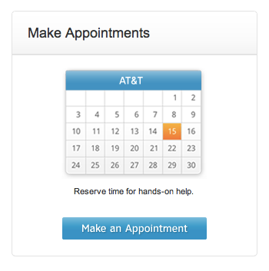
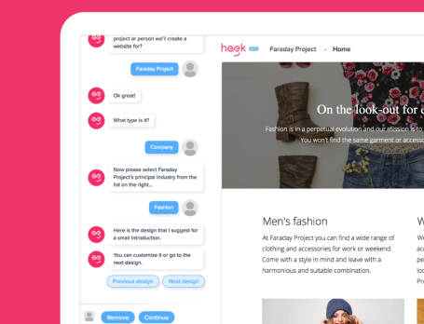
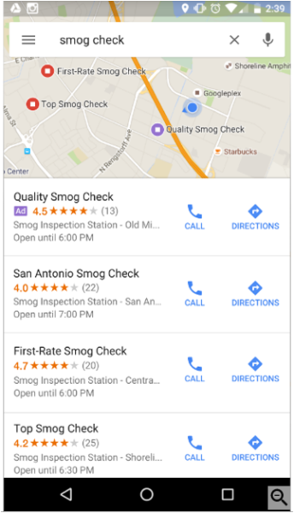
Customer Journey
Make the Sale
Awareness
Findability
Reputation
Conversion
Purchase
Website
App
Online booking
Phone Call
In-store purchase
It’s really easy to book an appointment
Notes:
Next step in the consumer’s journey is finally connecting with your business. Consumers are looking for quick, easy ways to make a booking, make an order, make an appointment, etc.
Question: Is your website making it really easy to convert and for people to become your customer?
Question: Do you have a way to transact online at the moment?

Slide 14

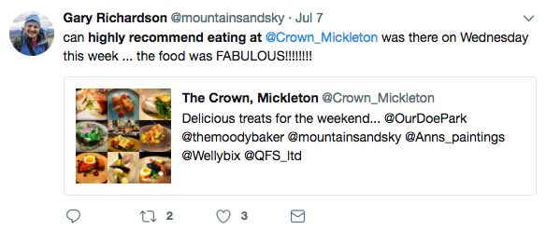
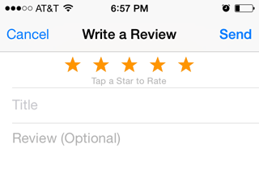

Customer Journey
Be Talked About
Awareness
Findability
Reputation
Conversion
Advocacy
Experience
Post-purchase expectations vs. reality
Social Post
Write a Review
Discuss with friends
Blog
Quick, skilled service. You should really check them out.
Notes:
Finally, it’s important to do everything you can to encourage happy customers to return again, and tell other about you.
Let them know to write you a review, post on social media, and of course, invite them back.

Slide 15
Channels impacting your Customer’s Journey
Contributes to next person’s decision
Awareness
Findability
Reputation
Conversion
Advocacy
Stimulus
Social / search advertising
Email / text marketing
Loyalty programs
YouTube / Video ads
Television
Billboard
Online display advertising
Newspaper / Magazine
Radio
Word of mouth
Search
Organic Search
PPC
Maps
Directories
Apps
“Near me”
GPS
Research
Blogs & Articles
Reviews
Social Media
Word of mouth
Purchase
Website
Online booking
Purchase via app
In-store purchase
Salesperson
Marketing Materials
Experience
Post-purchase expectations vs. reality
Social Post
Write a Review
Blog
Word of mouth
Notes:
So here are all the channels, both traditional and digital, that can influence potential customers… [NEXT SLIDE]

Slide 16
Win each stage
It’s important to win in each stage.
Notes:
… and, it’s important to win in each stage.

Slide 17
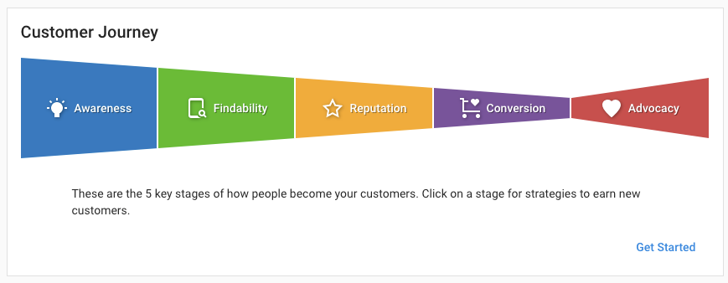
Demo Time!
Notes:
So I just want to show you a super quick demo, because what I am telling you is what I myself use for my business on a daily basis. And how easy it is to stay on top of each stage.
I log in and manage my whole digital presence, aligned to the Customer Journey, you can see I have these tools which pull in and give me the Control i need to be successful. [QUICK 20 Second Visual Demo of PARTNER (Your Version) of business center to demonstrate credibility]
Let me show you more about this survival toolkit which we call the Local Business Online Toolkit.

Slide 18
The Local Business Online Toolkit

Slide 19
Local matters.
Local matters.
Local businesses fuel our economy
They invest in our communities
They employ ~50% of our entire workforce
They create the majority of new jobs
Notes:
We do what we do because local matters a lot to us.
[CLICK] Local business owners fuel the world's economies. They invest in our communities... they unlock economic opportunities, create jobs and grow the middle class.
And we believe we make our communities worth living in. As we are all local businesses.
Sources:
https://www.smallbizgenius.net/by-the-numbers/small-business-statistics/#gref
https://www.fundera.com/blog/small-businesses-job-creation

Slide 20

84% of businesses were
optimistic about the future.
Notes:
For awhile, things we’re looking good for local.
As recent as October of 2019, 84% of small business owners indicated that they were feeling optimistic about the future of their companies.
Source: https://www.smallbizgenius.net/by-the-numbers/small-business-statistics/#gref

Slide 21
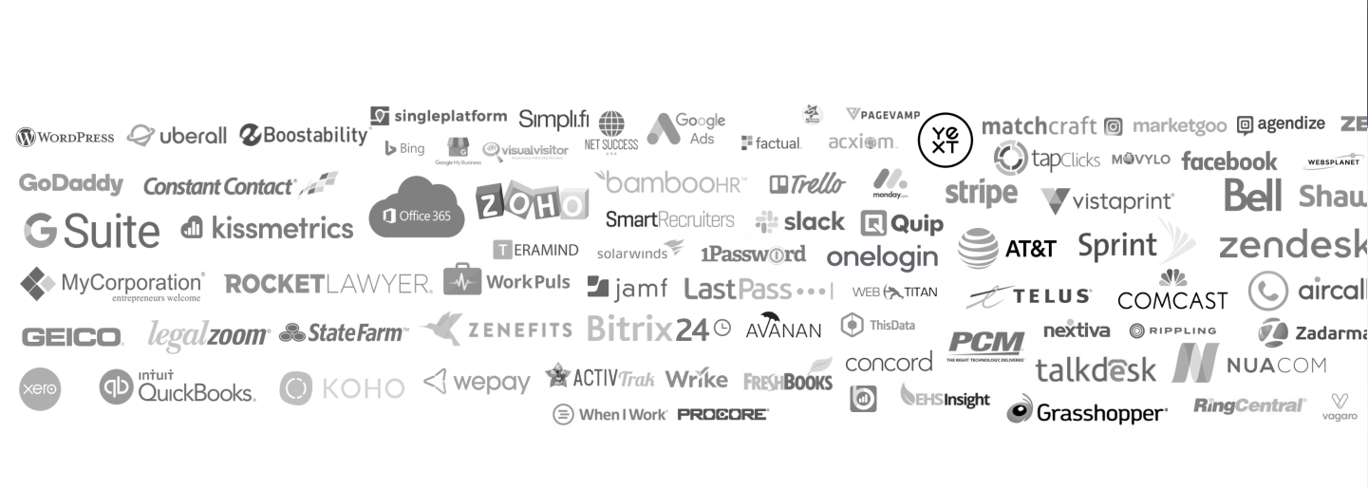

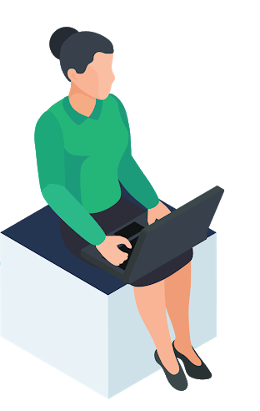
COVID-19 has placed an unimaginable strain on local
“We need to shift into survival mode.”
How do I...
start selling online?
connect with customers on social?
health benefits?
manage my payroll?
get found online?
get started with a switch to digital?
Overwhelmed by Digital
Uncertain of E-commerce
Information overload
Just 56%
of SMBs have claimed their Google listing.
Only 64%
of small businesses have a website.
Where to go?
Uncertainty around who and what to trust.
Notes:
As we know, COVID-19 has changed the world as we know it. As a small business, you likely are feeling the effects in one way or another. We recognize that COVID-19 has put an unimaginable strain on local businesses.
You may feel overwhelmed, or unsure of where to start. There is a sea of solutions in software platforms, technology, and services. You may be unsure of how to communicate with your customers. Many businesses are being forced to offer their solutions online, yet only 64% of small businesses have a website, and even fewer are set-up for e-commerce.
We, as your trusted agency, want to help your business through this difficult time.

Slide 22
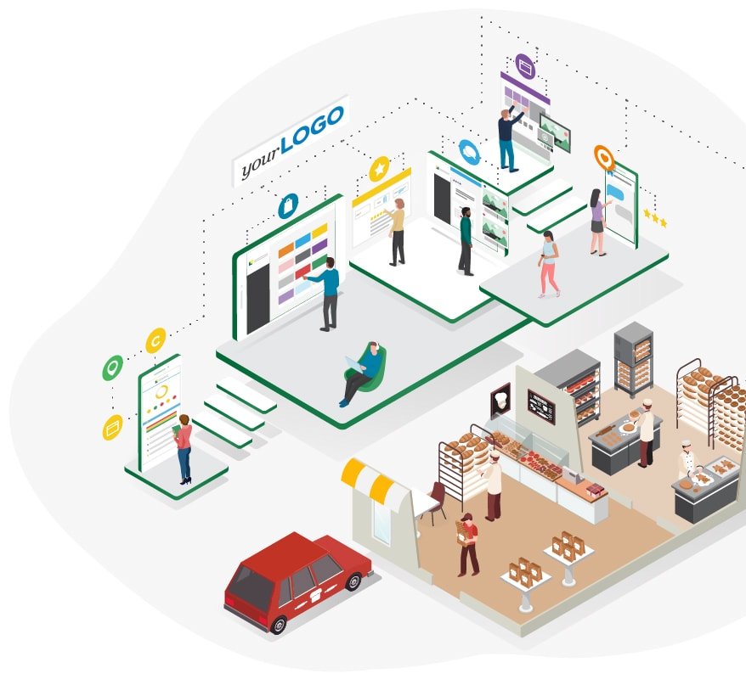
The #1 app for business owners
that offers end-to-end commerce solutions.
Notes:
We offer one app for your business that allows you to manage all of your digital marketing and more.

Slide 23

The #1 app for business owners
that offers end-to-end commerce solutions.
Notes:
And until we’re fully recovered from the COVID-19 pandemic, we are dedicated to Protecting Local.

Slide 24
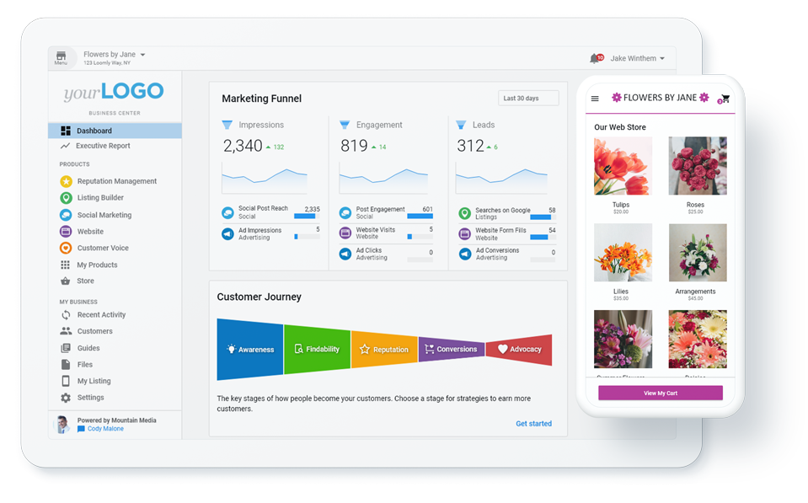
Business App
Your personalized app for managing your online presence
Your business app is where we begin. It provides you with a set of free tools that allow you to conduct business online, all from one app.
Easily transition your business to online with your business app.
Notes:
Your Business App is the gateway to managing your online presence
The Business App dashboard allows you to login and access any products or service. It also allows you to easily connect with your account manager in case you need help. It’s your very own app that allows you to transition your business online!

Slide 25







Local Business Online Toolkit
Build trust and gain future business.
Free or inexpensive tools that help get your client found and transact online.
Includes Reputation Management, Social Marketing, listings and ad reporting
60 day free trial of Constant Contact, leading email marketing software
Automated analytics reporting
Get found
on Google
Get found
on Social
Build Reputation
Build
Loyalty
Advertise to find New Customers
Connect & Nurture
Notes:
Business Center houses a Local Business Online Toolkit: Free or inexpensive tools that help get your client found online.
This includes tools to manage Google My Business, reputation management, social media marketing, advertising reporting, and email marketing. We want you to be in a position to build trust with local businesses in need so you can gain their future business.

Slide 26
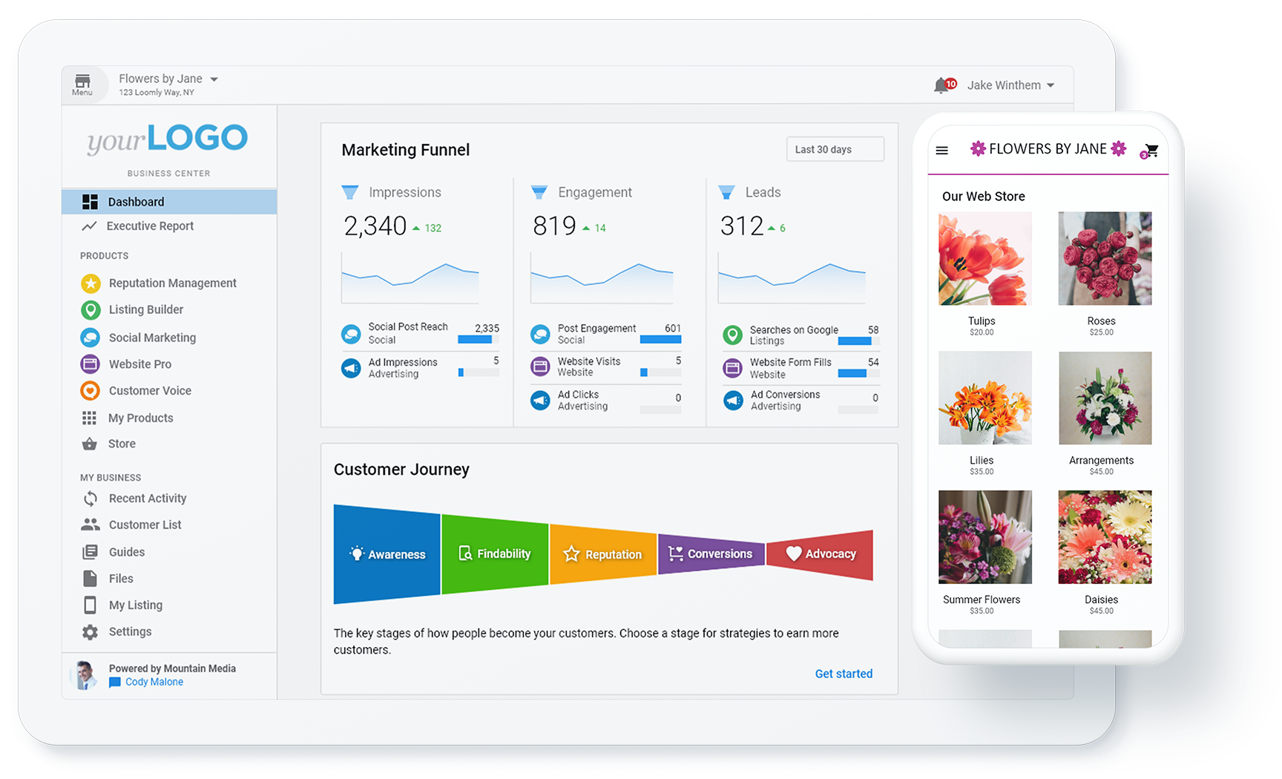





Products
Reputation Management Express, Customer Voice Express, Social Marketing Express, Advertising Intelligence, Listing Builder, and a Constant Contact 60 day free trial.
Online Toolkit
Products & upgrades
Notes:
The express editions of all of our owned and operated products, plus a 60-day trial of Constant Contact (which is email marketing, if you didn’t know) are the products available in the Online Toolkit.

Slide 27
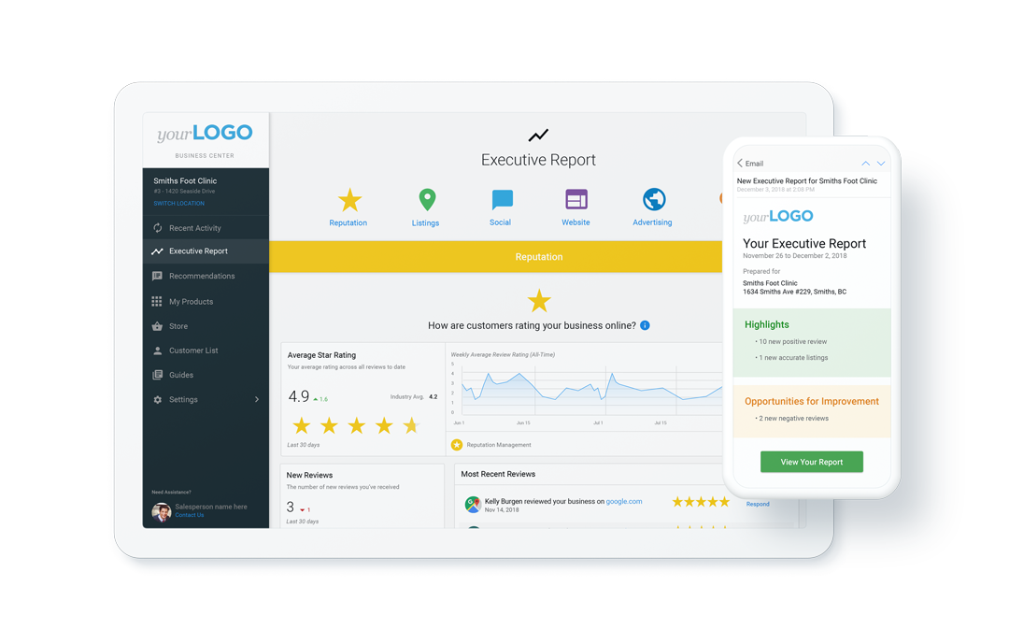
Executive Reporting
Via email and Business Center
Product performance reports
Executive reports
  The complete marketing stack
  Long-term trends
Marketing Services task reports
Notes:
And to tie everything together, you have access to automated proof-of-performance that rolls up into your Business App Executive Report.
You can see metrics with short-term changes and long-term trends, allowing you to see the proof-of-performance of your efforts from the tools you are using.

Slide 28
Surprise!
You have access to your Business App now.
Fully loaded with free tools
Transition your business online
Notes:
Surprise! You have full access now, to your own business app fully loaded with free tools for you to transition your business online, at no cost

Slide 29
Next Actions:
Check out your new app
Connect your GMB and FB Etc
Schedule a Post on your Social
Respond to a Positive review with Thanks
Call me if I can help!

Slide 30

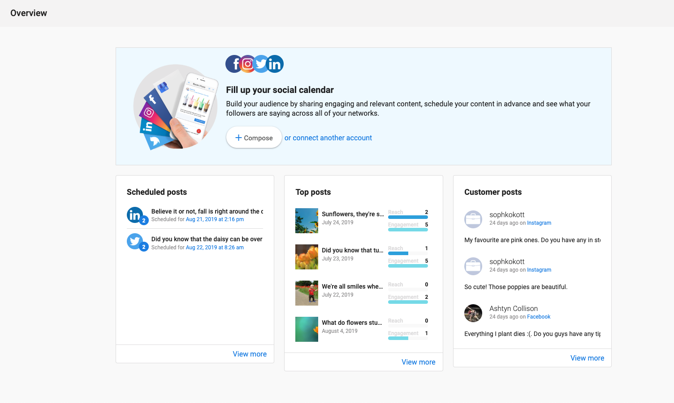
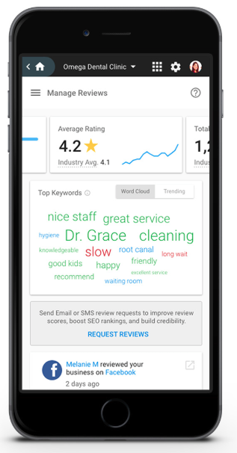
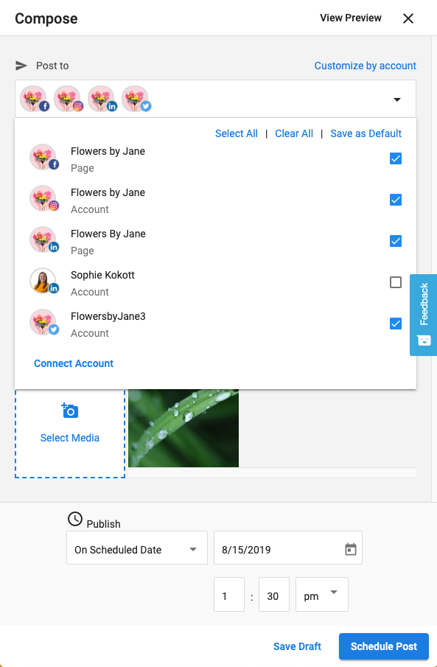



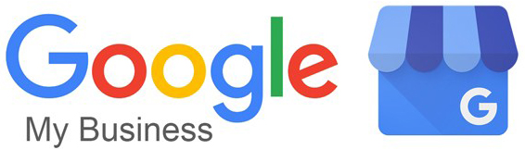


Social Marketing
Social Marketing
Simple & scalable social media management for local businesses
PRO
Schedule and post to everywhere from one place, including:
  Google My Business
  Facebook
  Instagram
  Twitter
  … and more!
Build Fans
Find Customers
Engage with the community
EXPRESS
Facebook & Google My Business
Up to 20 scheduled posts at a time
Notes:
Let’s start with Social Marketing; a simple, scalable social media management product for local businesses.
Social Marketing provides one place for your clients to manage & post to the most important networks, including posting directly to a Google My Business knowledge panel! Schedule posts, engage with followers, and generate new leads; all from one beautiful, mobile-responsive interface.

Slide 31
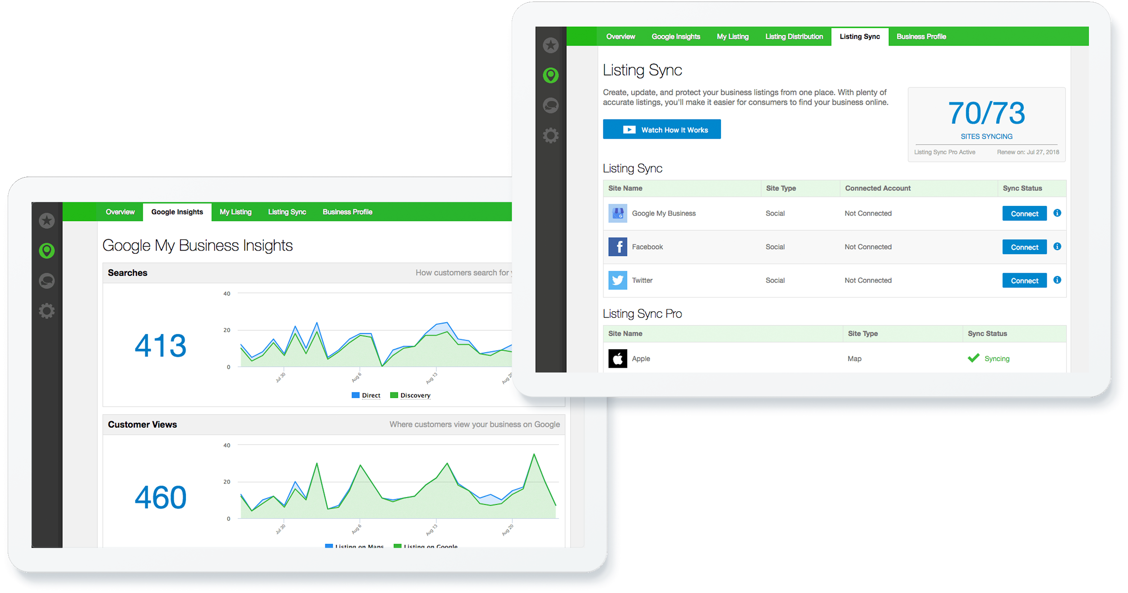


Listing Builder
Listing Builder
Freemium App to kick-start your client’s online presence
Upsell with Add-ons:
Listing Distribution
Build accurate business listings on major data aggregators, which are referenced by hundreds of sites online.
Listing Sync Pro
Quickly establish accurate business listings on 20 to 60+ reputable business listing sites
Notes:
Next is Listing Builder; the perfect way to open the door to online listings management with your clients.
At no cost to Rocket Driver partners, you can easily create and sync your client’s business listings in a handful of places. This leads to natural upsells like Listing Sync Pro and Listing Distribution add-ons that are powered by Yext, Factual, Fourdquare, Infogroup, and Neustar Localeze.

Slide 32
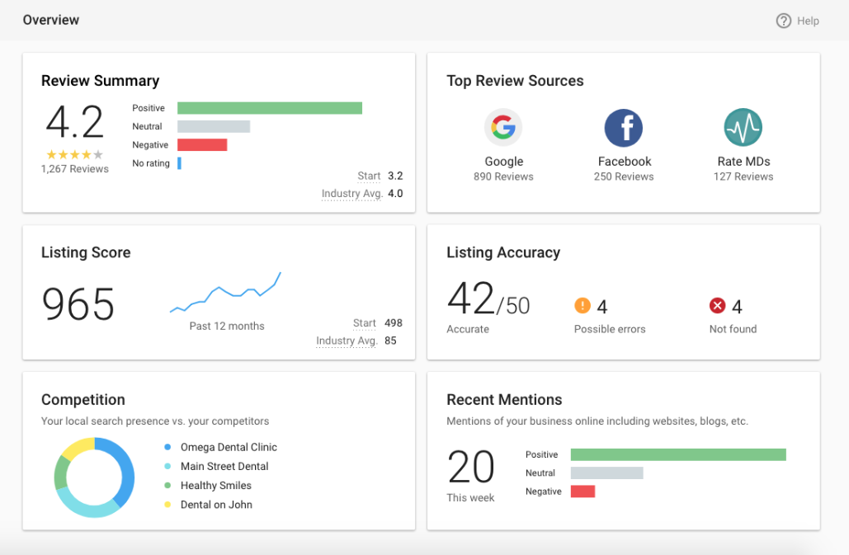
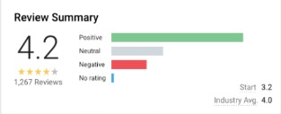
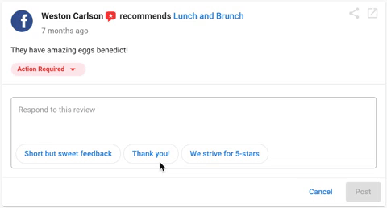
Reputation Management
Reputation Management
Monitor, manage, and improve your online reputation
PRO
Monitor and manage every aspect of a local business’ online reputation, including:
  Reviews
  Listings
  Mentions
  Google Q&A
Timely email notifications
EXPRESS
Monitor reviews and manage listings on Facebook and Google, plus monitor Google Q&A
Notes:
Reputation Management, one of our most popular resellable apps in Marketplace, allows your clients to monitor, manage and get notified of every aspect of their online reputation – including reviews, listings, and mentions.

Slide 33
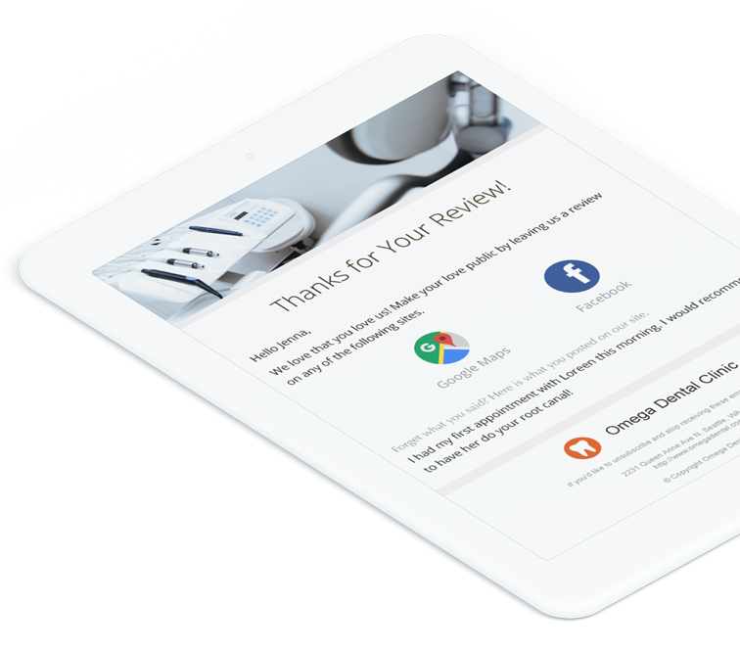
Reputation Management
Customer Voice
Turn customer experiences into stars
PRO
Get more authentic reviews to build a trusted brand:
  Customize all templates
  Option to send SMS review requests
Collect reviews with a website widget
EXPRESS
Request reviews on Facebook, Google, and My Listing
Send up to 15 emails a month

Slide 34
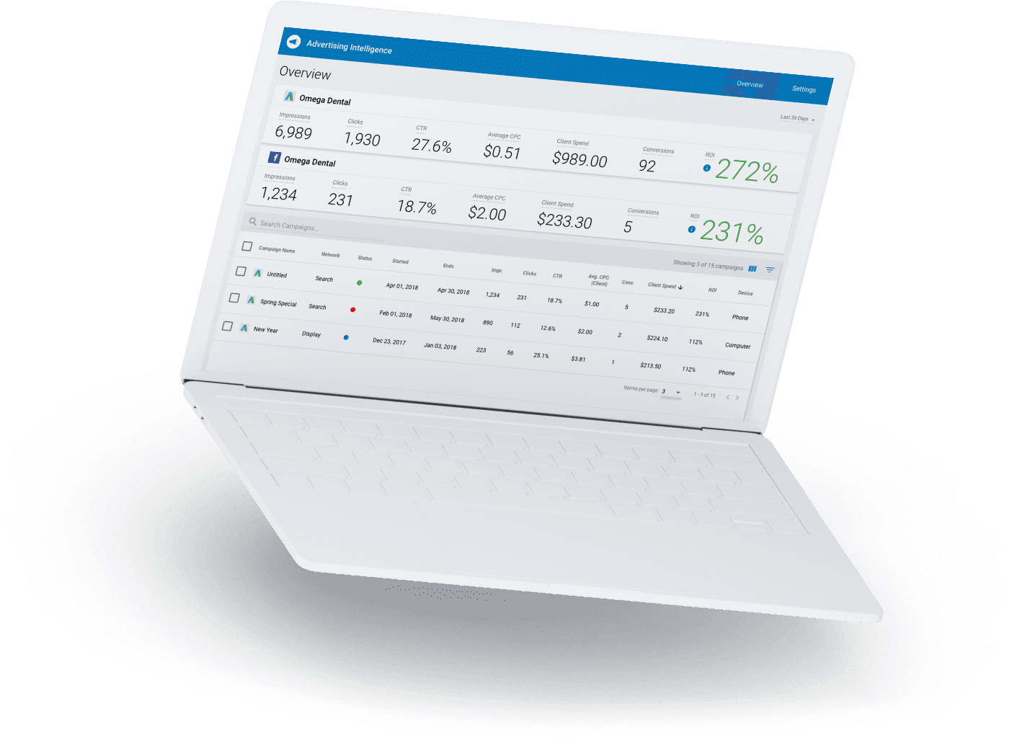
Advertising Intelligence
Advertising Intelligence
Live digital ad reporting and analysis
A digital ads management tool that allows you to:
Compare Google Ads and Facebook Ads side-by-side
See where ad campaigns are making your clients money
Spot trends behind campaigns, making you the expert in digital ads
Automated reporting
Notes:
We also offer ad reporting & analysis through Advertising Intelligence.
At no charge, you can start bringing your client’s Facebook and Google Ad campaign reporting under one roof.
Supports:
Google Search Ads
Google Display Ads
YouTube Ads
Google Shopping Ads
Gmail Ads
Facebook Ads
Instagram Ads
Messenger Ads
Audience Network Ads

