Slide 1
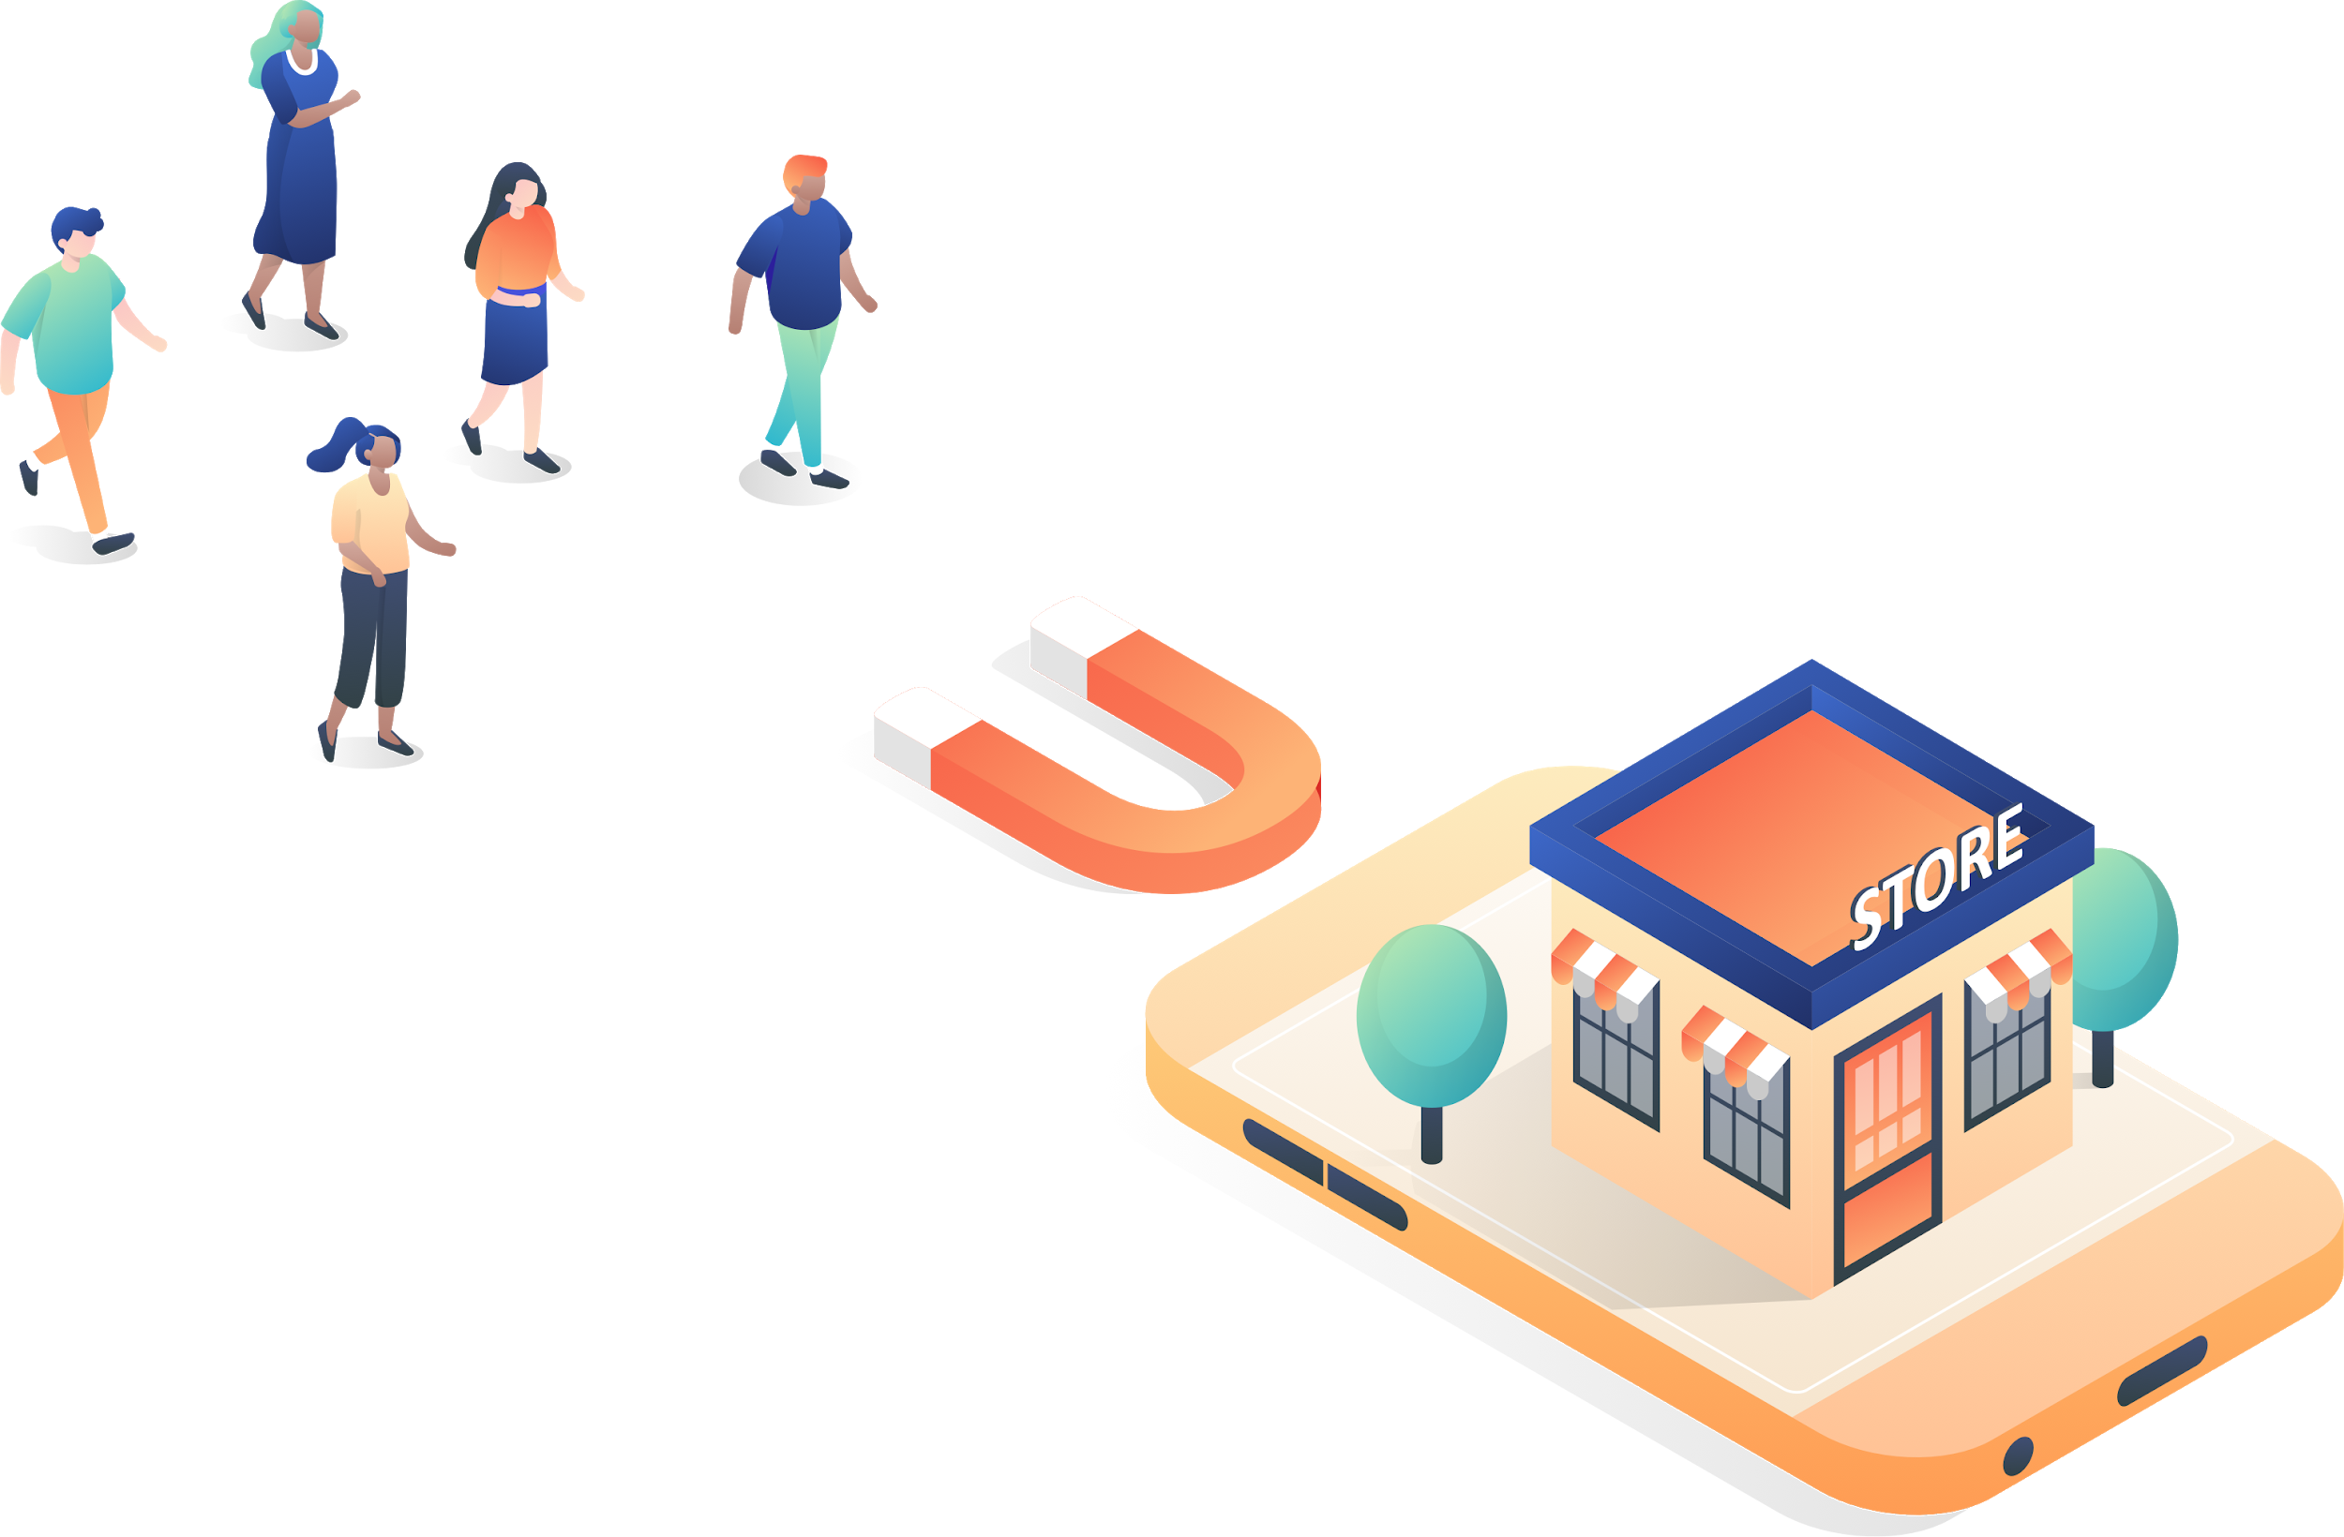
Your Logo
How to Launch and Run a Successful Online Store

Slide 2


Agenda
Your Logo
Why eCommerce
Trends and Stats
Get Your First Sale
Features and Offers

Slide 3
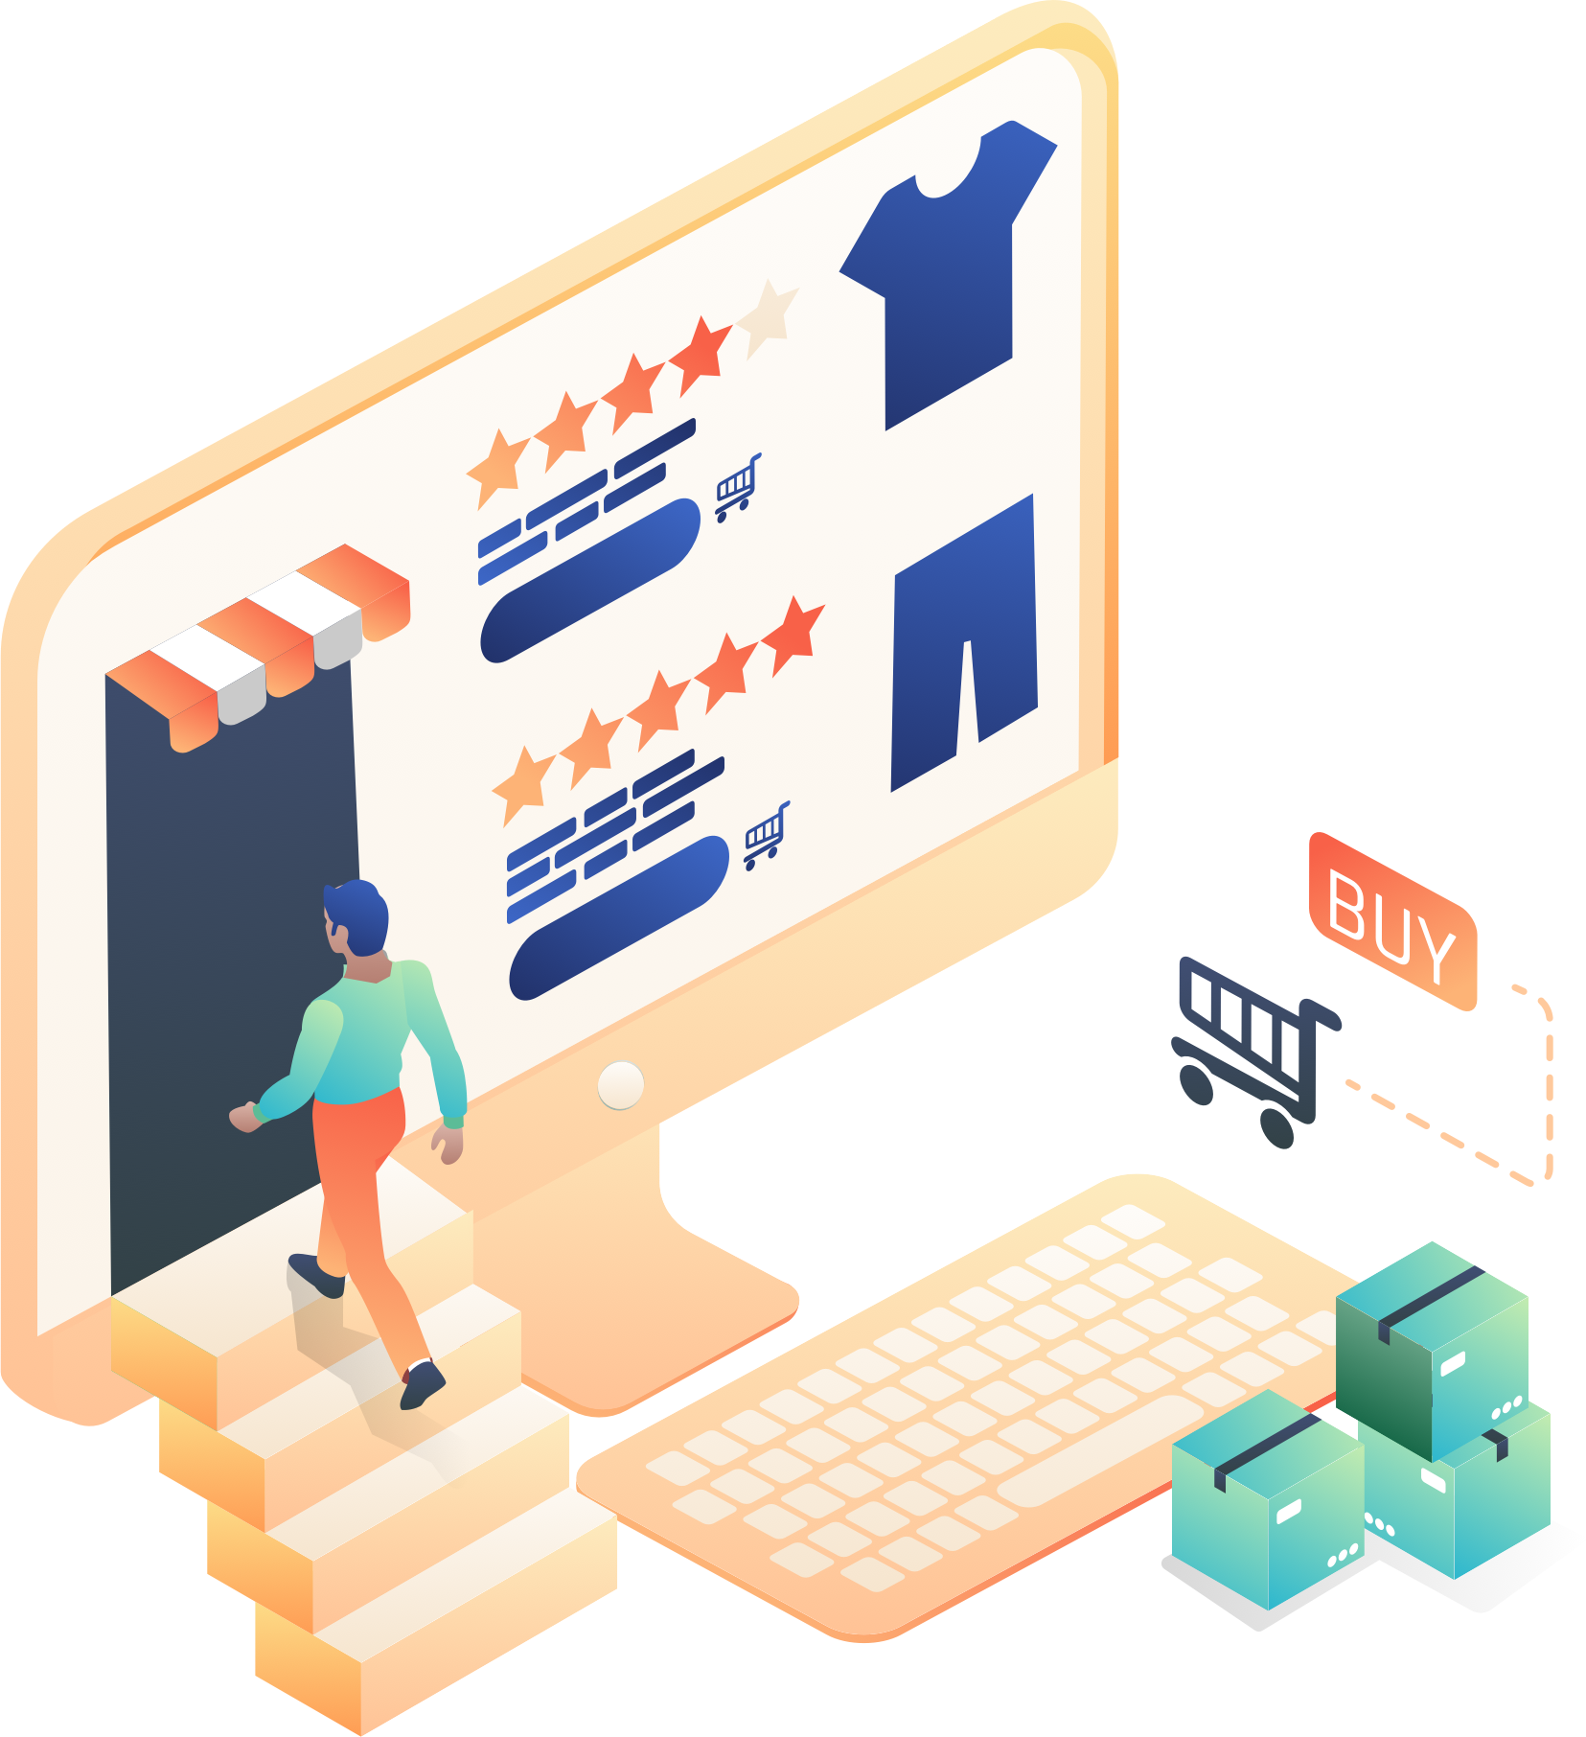
Why eCommerce?
Your Logo
Immense social distancing for the foreseeable future
Digital presence/online stores are a lifeline to customers
More than traditional retail:
  Digital goods
  Professional services
  Restaurants
  Online sessions (yoga, coaching, etc.)

Slide 4
Trends and Stats
Your Logo

Slide 5

eCommerce Trends and Stats
Your Logo
Consumers are using social to discover and purchase
78% of U.S. consumers have discovered new products on Facebook
75% of Instagram users have taken action after seeing a brand’s ad
Stores with a social presence have 32% more sales than stores without
16% of retail in the US in 2019 was online (compared to just 4% in 2010)
→ Your online store will have Facebook Store and Instagram Shopping options
Mobile shopping is taking over
73% of all eCommerce sales are expected to come from mobile by 2021
Mobile accounted for 65% of all 2019 Amazon Prime Day traffic
Mobile sales were up 21% YoY on Black Friday 2019
→ Your online store will be mobile friendly and responsive for any device

Slide 6

COVID-19 Trends and Stats
Your Logo
Customer behaviour is shifting
30% of respondents say they are shopping less frequently in-store
21% of respondents say they are shopping more frequently online
49% are concerned about receiving apparel or other products that were produced in impacted areas
Alternatives for in-store experience are rising
29% are taking advantage of BOPIS services to get products delivered without going in-store
18% using curbside pickup
17% using subscription services
13% opting for auto-ship
* Features: In-store and schedule pickup

Slide 7
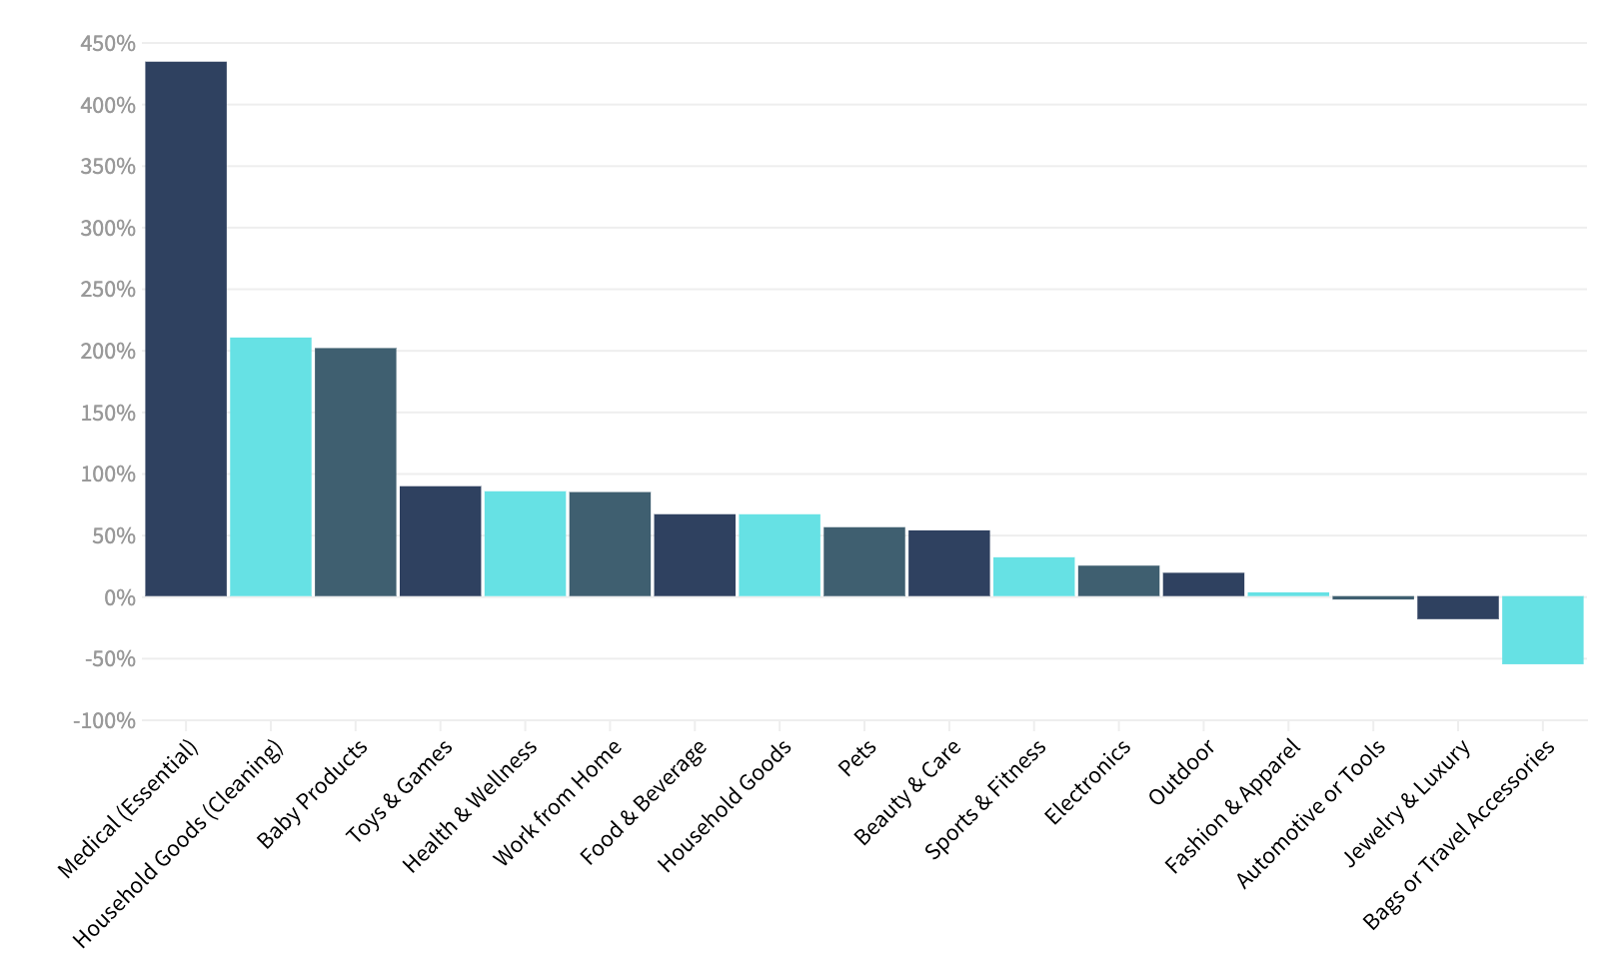
eCommerce Sales by Category
Your Logo
+52.2%
eCommerce
consumer sales
According to Common thread collective, Aggregated via ShipBob, ShipHero, Attentive, Stackline, CTC, Klaviyo & Adobe

Slide 8
Get Your First Sale
Your Logo

Slide 9
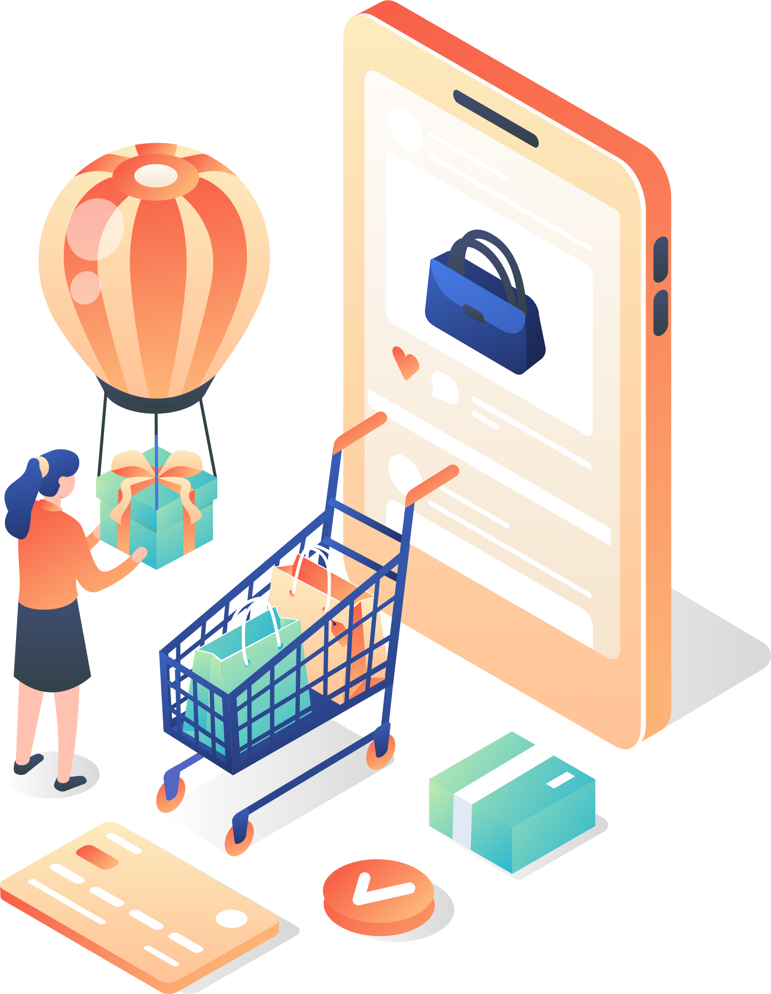
Get Your First Sale: Launch
Your Logo
Launch checklist:
  Add a Store
  Add Products
  Configure Shipping
  Set up Payment Options
  Set up Taxes
See eCommerce: Getting Started

Slide 10

Get Your First Sale: Promote
Your Logo
Create gear that has your online store URL
Facebook and Instagram Shops
Use promotions to create excitement (and put an expiration date on the offer)
Participate in online communities (reach out to bloggers, send free samples to Instagram influencers, use Twitter and LinkedIn, etc.)
Share with family and friends!

Slide 11
Features and Offers
Your Logo

Slide 12
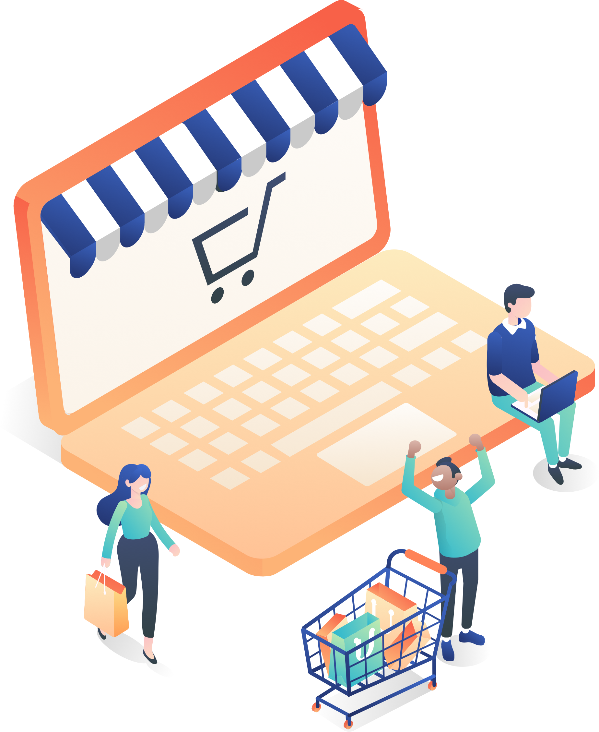
Our Special Offer Store
Your Logo
No transaction fees
Up to 500 products
Facebook and Instagram connection
Gift cards & discount coupons
In-store and scheduled pickup
Square PoS integration
Stripe and Square payment gateways
Store Management App (Android and iOS)
Extended through the end of May!

Slide 13
Store Details
Your Logo
Zero Transaction Fees
We don’t charge transaction fees, so you retain more of the profits
In-Store & Curbside Pickup
While customers are avoiding crowds and shopping online, you can offer convenient in-store or curbside pickup
Social Selling
You can easily publish and announce products on your Facebook and Instagram pages
Gift Cards
A popular way to support small businesses right now. You can set gift cards for any amount and your customers will automatically receive an email with their unique redemption code upon purchase
Discount Coupons
Merchants on premium plans can encourage shoppers with special discounts like a percentage or fixed value off their purchase, free shipping, or a combination of the two
Square Point-of-Sale Integration
As brick-and-mortar stores are moving their business online, Square POS integration lets you easily manage offline and online sales with features like product import, inventory and order sync, and centralized management
Branded Merchandise
Customers can support your brand with branded merchandise. Our integration with Printful means you can upload a logo or design, select products you want to sell, and Printful will print and ship the order

Slide 14
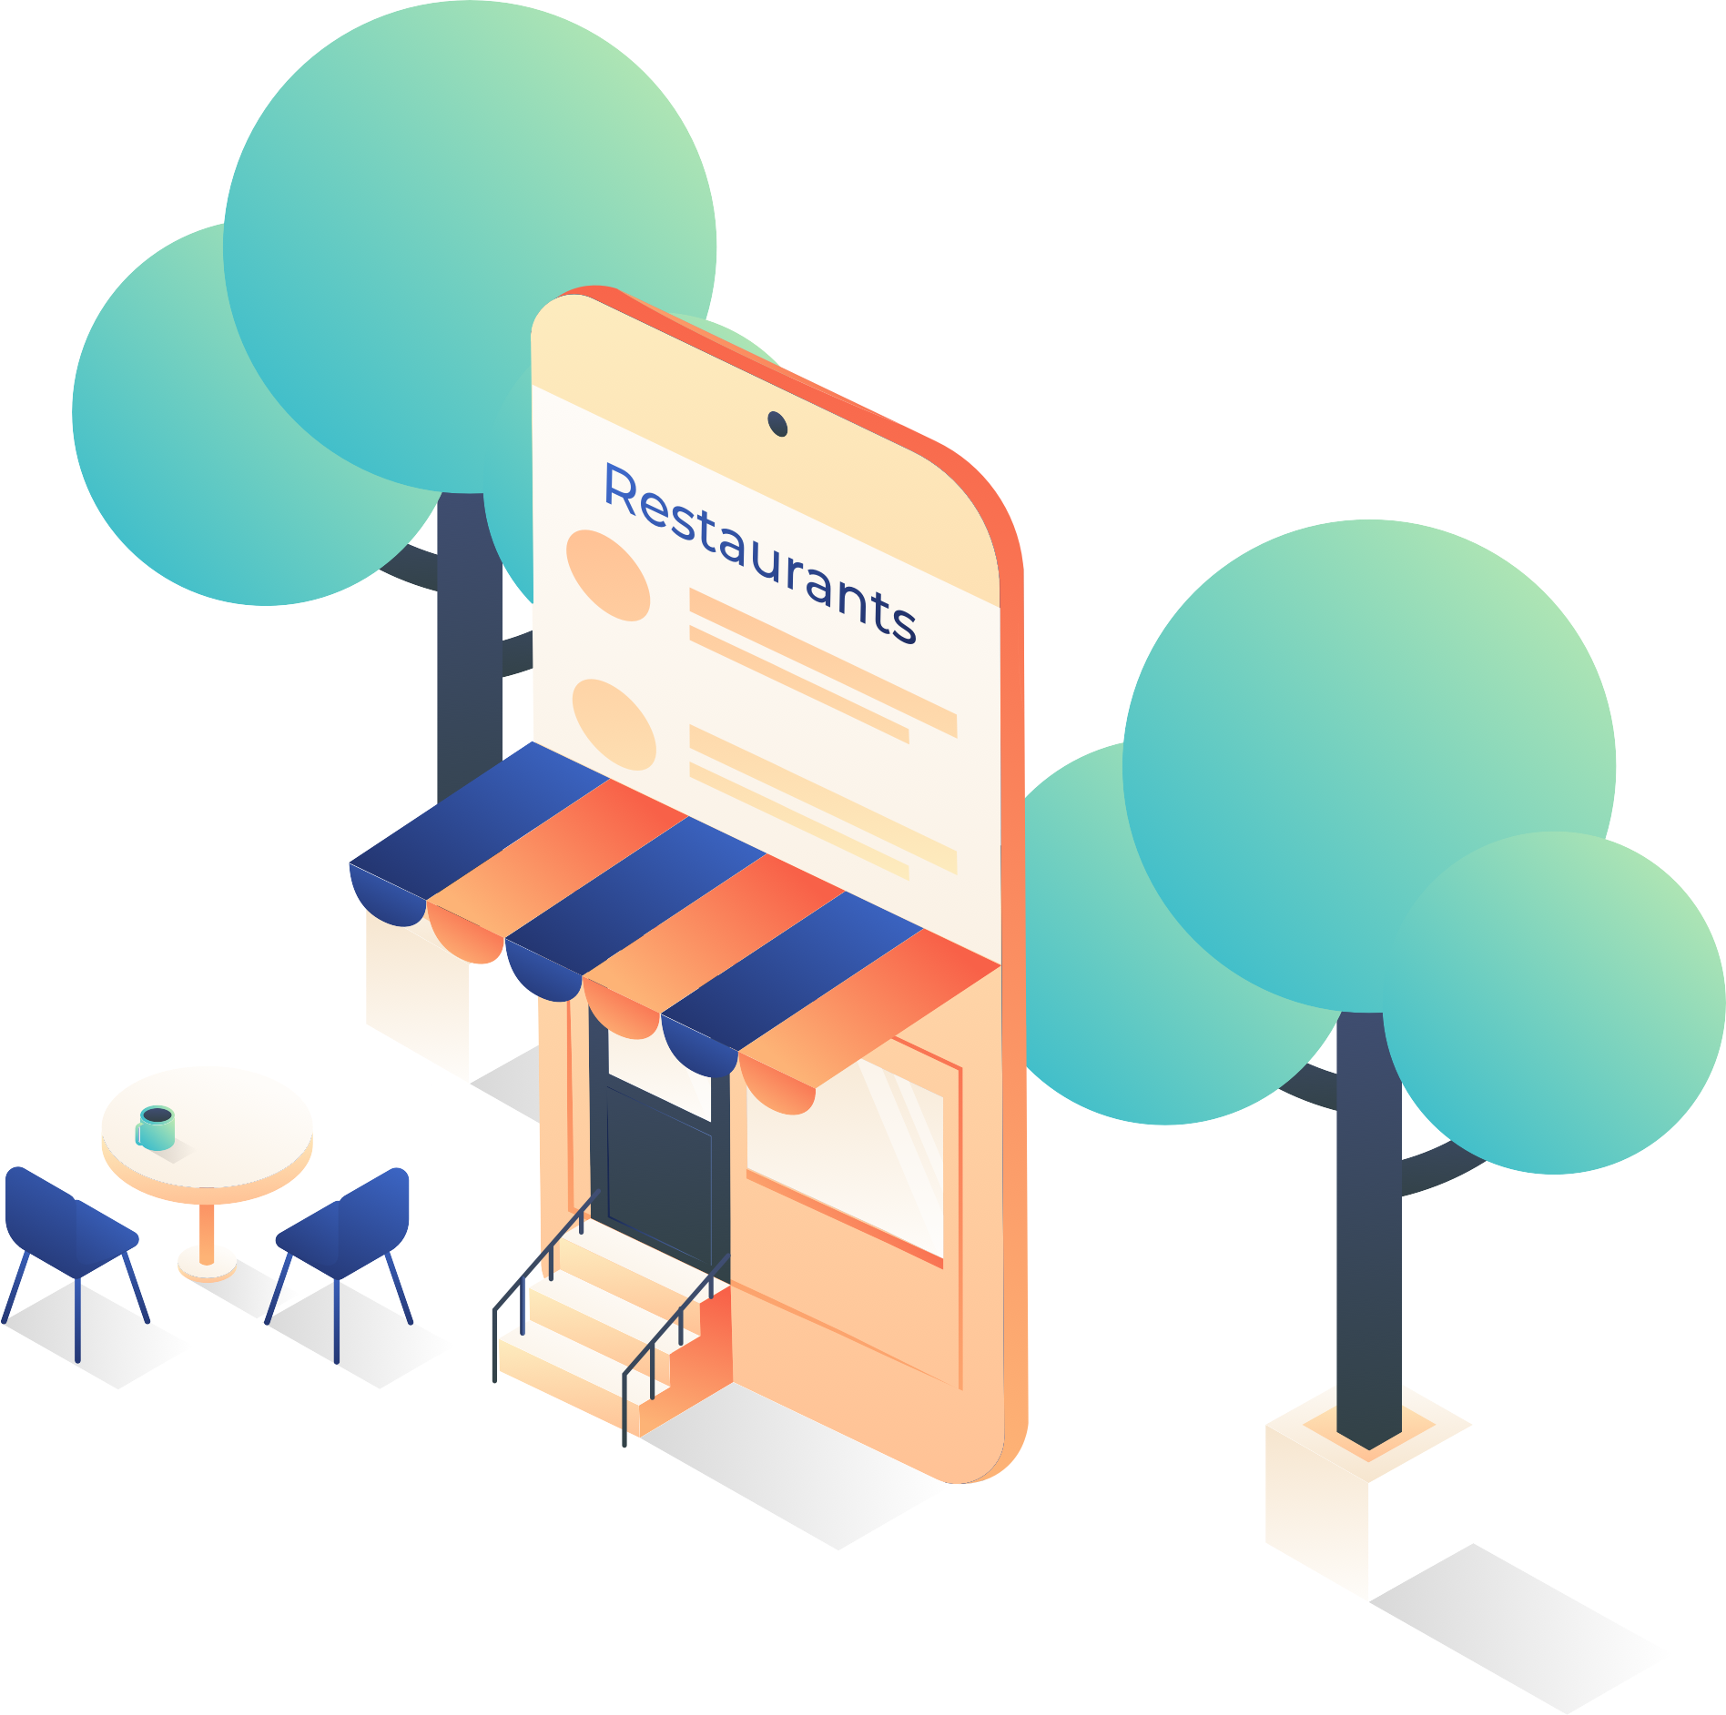
Especially for Restaurants
Your Logo
Pickup and Delivery Options
With delivery and scheduled curbside pickup, restaurants have more options for getting food to their customers - they can even set up pickup options if they have multiple locations
Customizable Menus
Restaurants can display their menu as a single-page catalog, with custom categories and square images

Slide 15
Let’s Talk About It
Your Logo
Your Name | youremail@youremail.com | Your site | +123 456 7890

Slide 16




Appendix
Benefits vs. Shopify
Your Logo
Zero Transaction Fees
Shopify requires merchants to use their payments system, or pay a 2% transaction fee, which can really add up. We don’t charge any transaction fees, and allow merchants to select from over 40 international payment gateways.
Ease of Use
While Shopify is relatively straightforward, it can require more advanced skills to set up, particularly when it comes to design. We’re designed to get merchants set up and selling in minutes, no developer or technical knowledge needed.
Global Selling
Shopify’s language capabilities are limited, reliant on 3rd-party apps and manual translations. With 50+ language translations and multi-language capability, we let merchants sell anywhere.
Core Features
While many features are available on Shopify, a large number are through app integrations at an additional cost. We have all our main features built into the core platform. Apps are available as enhancements, but are not necessary.

