Slide 1
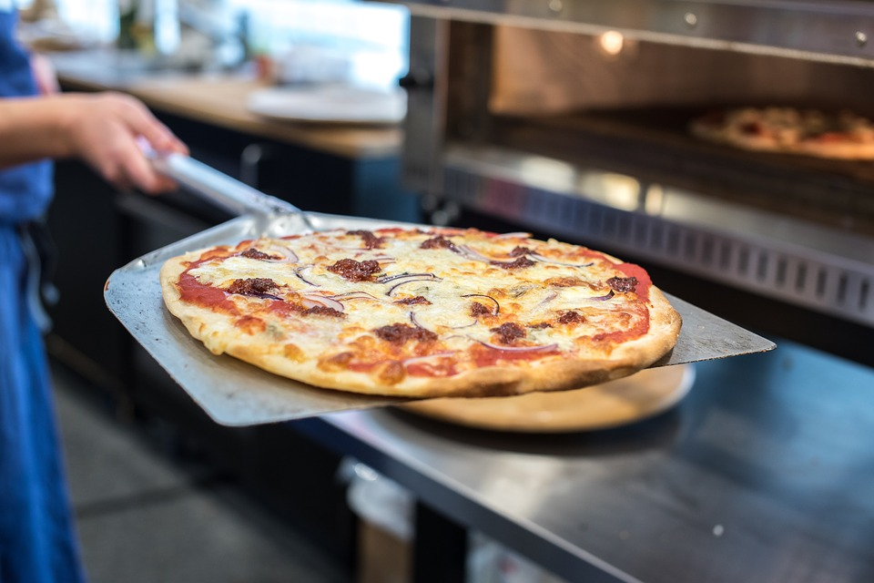
The Power of Review Requests
CUSTOMER VOICE CASE STUDY
How Asking for Reviews Made One Pizza Shop a Star Among the Locals

Slide 2

Who needs customer reviews?
Who needs customer reviews? Local businesses. While 90% of consumers use reviews to make buying decisions, only 36% of small businesses invest in review marketing. This means potential consumers are passing over the businesses that can’t show consistent, timely, and positive reviews. Asking for reviews that appear on a popular and optimized review site will have your business—and your customers—seeing stars! Here is just one example of the power of asking for customer reviews.
The Client
Pizza Pirates is a local pizza shop, specializing in decadent and aptly-named delights such as the Swashbuckler, Cannon Balls, and Buccaneer Pizzas. If the names of the pies didn’t attract customers, then the promise of housemade dough, freshly-cut vegetables, and hand-sliced meats would.
However, the public perception of Pizza Pirates was lacking due to previous ownership. Despite the quality ingredients and affordable prices, Pizza Pirates was unable to achieve high sales and a loyal customer-base.
More than 80% of commerce still occurs within a few miles of home
85% of consumers trust online reviews as much as personal recommendations
57% of consumers will only use a business if it has 4 or more stars
Stats from: BrightLocal (2018)

Slide 3
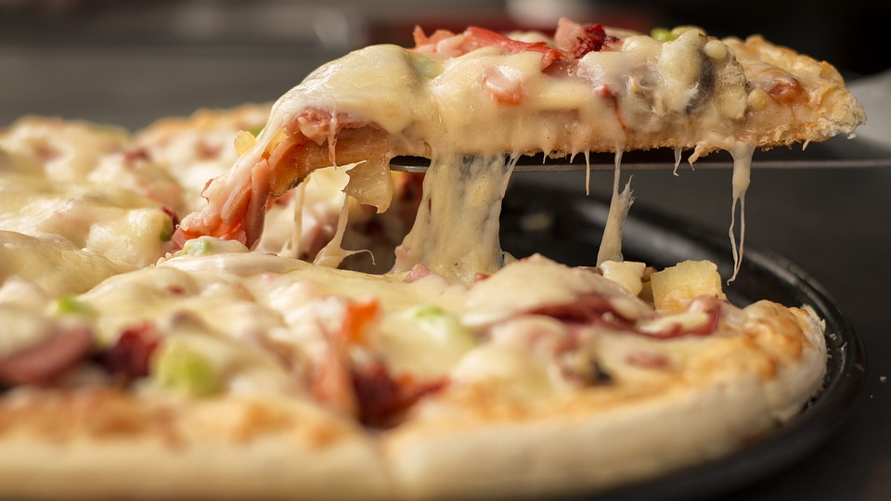
Not only does Pizza Pirates have a largely untapped market to go after, but people are actively seeking local businesses to support. Additionally, consumers are spending more and more time researching their options online and letting reviews influence their purchase decisions.
There was a time when “word-of-mouth” reigned supreme, and businesses did not need to actively manage review sites. People took product and service recommendations from friends. Today, however, social media platforms and review sites allow people to publicly share their opinions about a brand across the web, which could impact the purchase decisions of hundreds, thousands, or millions of other people.
The Goal
With a large opportunity to market themselves, Pizza Pirates wanted to take advantage of its small set of clientele to gain a following. The immediate goals were to:
Improve their online reputation, including increasing star rating
Earn consistently positive reviews online
And ultimately, drive online orders and foot traffic
Preparing for the Plan of Attack
Our team focused on educating the business owners on the holistic importance of customer reviews and their online reputation. Once it was understood how intricately reviews are tied to SEO, Google ranking, and online brand recognition, we built out a Google listing where Pizza Pirates’ reviews would live. Our team created an optimized and accurate Google listing for Pizza Pirates, including all relevant details about the establishment, with accurate business hours and the ability for customers to engage with the business directly from the page. Before generating more customer reviews, this is a must-have component!

Slide 4

Google My Business (GMB) reviews are the reviews displayed by Google next to verified businesses. This rating score is critical because it is the one that shows up on business’ sites in search and on Google Maps. These reviews can display attributes such as star ratings, photos, and comments/testimonials.
The intimidating part of having a public presence on Google is that anyone with a Google account can leave a review for a business. Asking for a review from a customer is one way to get honest (and positive) reviews and encourage a loyal customer to become a brand ambassador.
Using the information the business gathered on their online ordering platform, the staff at Pizza Pirates began sending an average of 6 review requests a day.
Customer Voice
Customer Voice is a powerful tool that has allowed Pizza Pirates to capture customer reviews on their most popular review sites, including Google, Zomato, and Facebook.
Using Customer Voice with these best practices has proven to be the recipe for success for Pizza Pirates:
Frequency
Sends review requests daily, when the customer’s memory is fresh and their experience is vivid
Visability
Links to the most popular review sites for the industry means more impactful and visible reviews
Branding
Customizes the copy of the SMS messages to come from a familiar person at the business, asking for genuine feedback, and wishing to establish a connection of trust with the customer
SMS Review Requests
Target your customers right where they’re looking—their phones—and they’ll be more receptive to your message. In fact, 56% of reviews are left using a mobile device*. Sending SMS review requests to clients takes as little as a name and phone number.
*Review Trackers (2018)

Slide 5

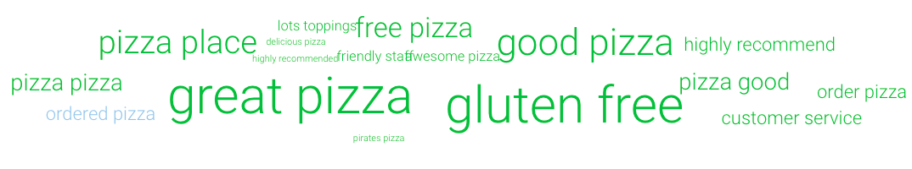
The Results
Prior to using Customer Voice, the business’s reviews had plateaued. After just one month of sending review requests, the number of customer reviews shot up dramatically.
From very few customer reviews and a mediocre star rating to consistently positive reviews and a boosted star rating, consistently sending review requests was proving effective.
Results After One Month
4.9 stars | +35 reviews | +29 actions
Average monthly star rating | Increase in reviews | Taken on Google listing
Progress Over All-Time
80% to 92% | 3 to 5 | 34 to 477
Recommendations On Facebook | Average star rating | Customer reviews
Overall, Pizza Pirates has seen an increase of star rating by 1.2 stars since its conception and can attribute roughly a 20% increase in sales to the increase in customer reviews and improved online presence.
More consistent and positive customer reviews have also been contributing to the business’s online visibility and reputation, evidenced by more searches, views, and clicks to the website from the Google listing. All time results on the Google listing are as follows:
Google Listing Results
+ 3516 | +8029 | +182
Monthly direct searches on Google | Monthly views on Google Maps | Visits to the website from Google listing
Trending Keywords in Customer Reviews

Slide 6

Helping You See Stars
There are three main factors that contributed to the success of Pizza Pirates.
Claimed and optimized listing sites
Claiming the business listing on Google (and other review sites) is step one in taking control of a business’s online reputation. What’s on the page plays a big role as well. We ensure that your Google listing includes vital information about your business including location, hours and a brief description of offerings. Keeping the information up-to-date makes it easy for potential customers to find you and shows your customer reviews in a professional way.
Customer reviews can be automatically published on these public sites for future customers to find.
Timely, consistent, and engaging requests Engage in best practices to ensure that the review requests have the most impact possible. Frequent review requests sent in a timely manner ensures the business is top of mind and the customer is willing and able to give a glowing review.
3. Follow-up and up-keep of customer reviews
Lastly, because getting more customer reviews does contribute to a business’s online reputation, it is important to engage in the follow-up involved in maintaining a positive reputation. Supplement your new positive customer reviews with a friendly and personalized message thanking the customer for their review. If a negative review does appear, take the opportunity to make amends with the customers, and take their feedback to heart.
The bottom line is that increasing the number of customer reviews a business receives can contribute to tangible business results, including boosting brand trust and increasing sales. Using Customer Voice and sending SMS review requests contributes to a healthy online reputation for your business—and that investment goes a long way!

Slide 7
Ninety percent of customers rely on a business’s reviews to make a purchase decision.
What are you waiting for? Use your happy customers to do your marketing for you!
Contact us today to harness the power of review requests and start seeing stars!

