Slide 1

Google My Business Management
Full Name
Job Title
(555) 555-5555
email@email.com
Get found by more online consumers and ensure that your business information is accurate
Notes:
Introduce yourself
Ask why they’re interested in Google My Business Management
Try to understand their needs and goals

Slide 2

How Are Customers Searching for Your Business?
They’ll look up your business on the internet (probably using Google)
Having a complete, accurate profile can help you close more deals
You may lose potential customers if your profile is incomplete or inaccurate
Notes:
The internet completely changed the way that consumers make a purchase.
Before, all you had to do was advertise your products and services to drive more sales.
Now, advertising is still important, but customers will look up your business on the internet before buying from you.
Most likely, they’ll use Google to find more information about your business, such as address, contact information, hours of operation, reviews, and photos.
Having a complete, accurate profile can leave a good impression and help you close deals. On the other hand, you may lose potential customers if your Google My Business is incomplete or inaccurate.

Slide 3
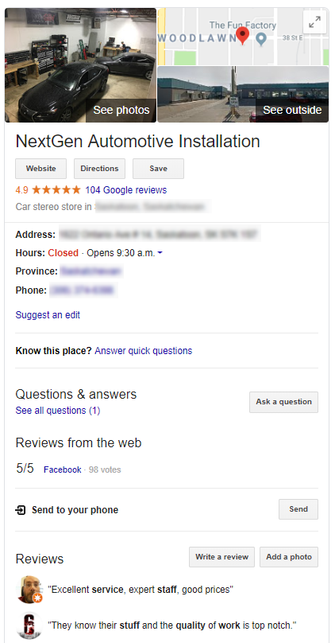
What is Google My Business?
”Google My Business is a free and easy-to-use tool for businesses and organizations to manage their online presence across Google, including Search and Maps. If you verify and edit your business information, you can both help customers find your business and tell them your story.”
Source: Google
Notes:
Google My Business is an online listing tool that shows essential information about your business.
This information is visible to anyone who looks your business up on the internet.
It’s very important that you have a claimed and verified Google My Business listing. That’s how Google knows that you’re the business owner, which allows you to edit your profile and make any changes that you need.
Once your Google My Business is claimed and verified, on-going maintenance is key to ensure accuracy and engage with potential customers.
-----
Google article: https://support.google.com/business/answer/3038063

Slide 4



Benefits of Google My Business
Manage your information
Interact with your customers
Understand and expand your presence
Notes:
Here are some of the benefits of Google My Business:
1. Manage your information
You can edit your business information and control what people see. For example, you can update your phone number or set holiday hours.
2. Interact with your customers
You need a verified Google My Business in order to respond to reviews from your customers and upload photos.
3. Understand and expand your presence
You’ll have access to insights on how online customers search for your business and how they interact with your Google My Business.

Slide 5

Challenges for Business Owners
Time
Technical experience
Focus
Notes:
Business owners could manage their Google My Business themselves. However, the vast majority of them prefer to pay someone else do to the job, and this is mainly because of the challenges they face:
1. Time
Business owners are often busy managing other aspects of their business. It’s hard for them to find time to manage their online presence.
2. Technical experience
Digital Marketing is an ever-changing industry. It’s hard to know exactly what to do and how to measure results if you’re not an expert in online listings.
3. Focus
Even if you have the time and technical experience, this is not your core business. Naturally, business owners want to give more attention to other aspects of their business instead of worrying about updating their Google My Business.

Slide 6

The Solution
Enhance your business’ online presence with our Google My Business Management service!
Notes:
Fortunately, we have the solution!
Our Google My Business Management service can boost your business’ online presence.
We’ll help you get found by potential customers on Google by ensuring that your Google My Business listing is accurate and up-to-date.

Slide 7
Included With This Service
Google My Business verification and claim
Listing setup
Monthly NAP data verification
1 Google My Business post every month
Upload photos provided by you
Notes:
This is what’s included with this service:
Google My Business Verification & Claim
This will let Google know that you’re the business owner and allow us to make edits to your Google My Business
Listing Setup
We’ll update your business’ basic information: Name, address, phone number, hours of operation, and industry
Monthly NAP data verification
NAP stands for Name, Address, and Phone Number. It’s very important that this information is always accurate
1 Google My Business Post
Every month, we’ll publish 1 Google My Business post that is visible on your Google My Business profile. These posts will promote your products and services to anyone who searches for your business on Google. Please, note that Google My Business posts automatically expire after 7 days as per Google’s guidelines.
Upload photos provided by you
It’s always a great idea to keep your Google My Business listing up-to-date with fresh content. People will definitely pay attention to the images in your profile. Whenever you want to add a new image to your Google My Business, let us know and we’ll do it for you.

Slide 8
How does it work?
A Marketing Strategist will contact you to verify, claim, and get access to your Google My Business.
We’ll review your business information every month to make sure it’s always accurate.
You can send us images that you want to add to your Google My Business.
You’ll have access to reports that show how online consumers interact with your Google My Business profile.
Notes:
Go through the process with them

Slide 9
Google Stats
The average Google listing that has been well-maintained with Google My Business gets 5X more views than listings which haven’t been claimed by their owners.
Customers are 2.7x more likely to consider a business reputable if they see a complete listing on Google Search and Maps.
Consumers are 38% more likely to visit and 29% more likely to consider purchasing from businesses with more complete listing information.
Notes:
And this is the last thing that I want to show you.
Here I have some stats from Google that speak about the importance of having a well-maintained Google My Business.
In a nutshell, you’ll get more views and will be perceived as a reputable business, which leads to more visits and sales.

Slide 10
?
Notes:
Ask if they have any questions

