Slide 1
Google & Bing Ads
How to use Google and Bing to
reach your customers online
Full Name
Job Title
(555) 555-5555
email@email.com
Notes:
Before starting a presentation, make sure to:
Run a snapshot report
Prepare a Business Center login for the person you’re seeing, so you can live demo their account and train them on how to log in.
Thanks for joining me on today’s presentation! I promise to stick to our time limit of [x minutes]. Set timer.

Slide 2

What are Digital Ads?
Digital ads are the best way to reach potential customers because you can communicate with your ideal target audiences when they are looking for your business or services you provide.
Notes:
Digital advertising is one of the best ways to reach your ideal audience online. It allows you a high level of targeting and sophistication, so you can control when you serve the ads and who sees them.
From impressions to conversions, everything is trackable, meaning that you can easily measure your ROI (Return on Investment).

Slide 3






Benefits of Digital Ads
Increase brand awareness
Drive more sales
Target a specific audience
Measure your results
Get higher ROI
Adapt your strategy
Notes:
Here are some of the benefits of Digital Ads:
1. Increase brand awareness. Digital ads can help you expand your online presence by targeting the right people with the right message.
2. Drive more sales. Campaigns can give online customers an incentive to buy from your business.
3. Target a specific audience. We love the fact that digital ads allow us to communicate to your ideal audience.
4. Measure your results. With digital ads, you can see the real value in your campaigns.
5. Get higher ROI. More often than not, digital ads can generate positive ROI in a short amount of time.
6. Adapt your strategy. Digital advertising is never set and forget. We’re always making changes to optimize your campaign and drive better results.

Slide 4

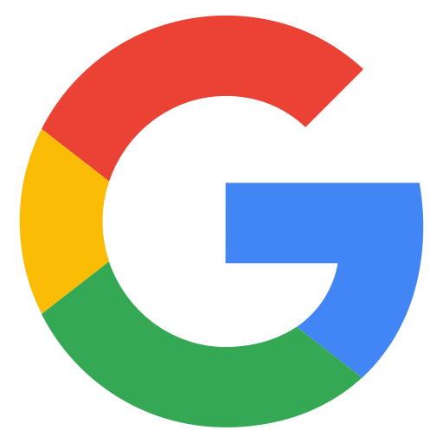

The Power of Google
3.5 billion searches per day.
79% of all searches happen on Google.
70% of online customers buy from a business they find online.
Notes:
Google is the most popular search engine in the world. Here are a few interesting facts about it:
Every day, Google processes 3.5 billion searches.
79% of all online searches happen on Google.
70% of online customers buy from a business they find online.

Slide 5
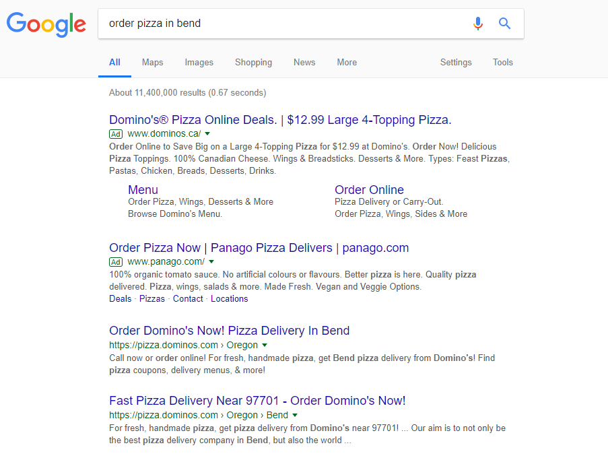
Organic Results vs Paid Ads
Paid ads
SEM - Search Engine Marketing
Organic results
SEO - Search Engine Optimization
Notes:
To understand search ads, we first need to understand the main difference between paid ads and organic results.
Paid ads are like renting a house. You have the place until you stop paying for it, whereas organic results are more like owning a house: It’s a long-term strategy that relies on SEO to increase your website exposure on Google.
We know that many users click on organic results when they’re just researching, but the majority of them click on paid ads when they’re ready to make a purchase.
That’s why Google & Bing Ads would be a great service for driving more sales to your business!

Slide 6
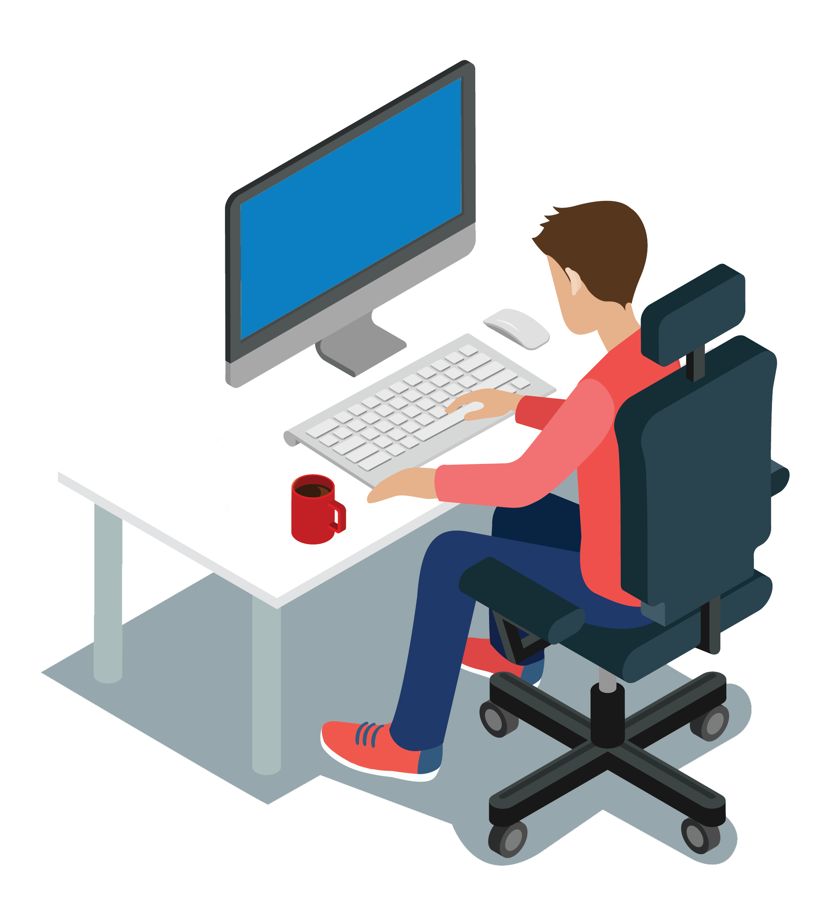
Measuring Your Campaign
S
Specific: What do you want to accomplish? (who, what, where, why)
M
Measurable: How will you measure the results?
A
Achievable: It’s good to dream, but are the goals realistic?
R
Relevant: How does the goal tie into your business?
T
Time-bound: Set 1 or more target dates
Notes:
So, how do you know if your campaign is working or not? Our team will work with you to set SMART goals.
SMART stands for Specific, Measurable, Achievable, Relevant, and Time-Bound.
You have to ask yourself a few questions:
What do you want to accomplish with your campaign? E.g.: Do you want new customers or drive more sales?
Is your goal measurable? Let’s define the metrics we’ll use to measure your results.
Is your goal achievable? Most of our campaigns deliver a high return on investment (ROI), but you have to consider the ramp-up period.
Is your goal relevant for your business? You have to think about what you need and how it can help you grow your business.
Lastly, do you need to see results in a week, a month, or three months? It all depends on what you’re trying to accomplish and how much you want to spend on ads.

Slide 7
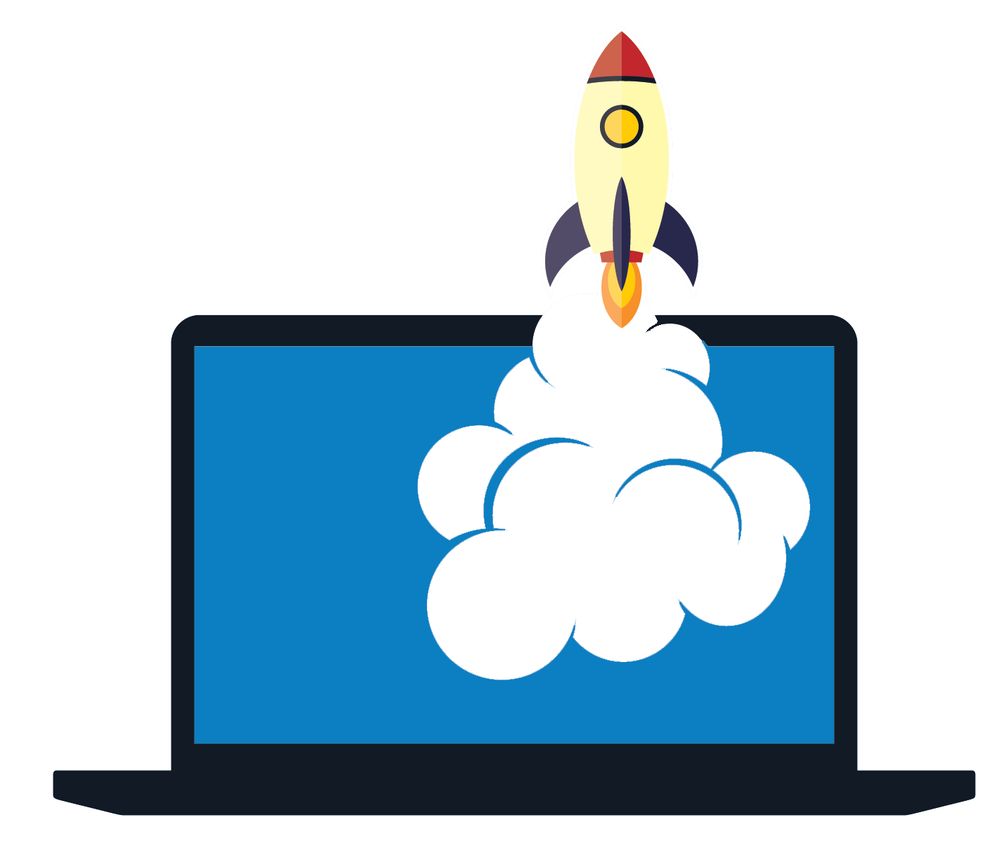
What’s Included?
A team of experts in Google & Bing ads.
Campaign setup and optimization.
Automated bid and budget management.
Customized strategy for your business.
Google Analytics integration.
Monthly reports.
Notes:
Here’s what is included in our service:
A team of experts in Search Ads and trained by Google will be in charge of your campaign setup and optimization.
We’ll use specialized software to manage your budget and make the most out of your money.
We’ll develop a customized advertising strategy for your campaign based on your goals.
And last but not least, this service includes Google Analytics integration and monthly reports, so you can keep track of your campaign results.

Slide 8
?
Notes:
Ask if people have they any questions

