Slide 1
Facebook & Instagram Ads
Harness the power of Facebook and Instagram
with highly-targeted ads
Full Name
Job Title
(555) 555-5555
email@email.com
Notes:
Before starting a presentation, make sure to:
Run a snapshot report
Prepare a Business Center login for the person you’re seeing, so you can live demo their account and train them on how to log in.
Thanks for joining me on today’s presentation! I promise to stick to our time limit of [x minutes]. Set timer.

Slide 2
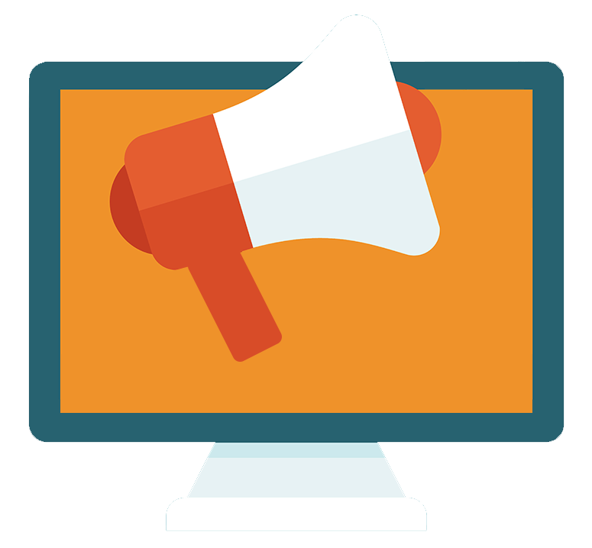
What are Digital Ads?
Digital ads are the best way to reach potential customers because you can communicate with your ideal target audiences when they are looking for your business or services you provide.
Notes:
Digital advertising is one of the best ways to reach your ideal audience online. It allows you a high level of targeting and sophistication, so you can control when you serve the ads and who sees them.
From impressions to conversions, everything is trackable, meaning that you can easily measure your ROI (Return on Investment).

Slide 3

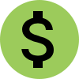


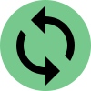

Benefits of Digital Ads
Increase brand awareness
Drive more sales
Target a specific audience
Measure your results
Get higher ROI
Adapt your strategy
Notes:
Here are some of the benefits of Digital Ads:
1. Increase brand awareness. Digital ads can help you expand your online presence by targeting the right people with the right message.
2. Drive more sales. Campaigns can give online customers an incentive to buy from your business.
3. Target a specific audience. We love the fact that digital ads allow us to communicate to your ideal audience.
4. Measure your results. With digital ads, you can see the real value in your campaigns.
5. Get higher ROI. More often than not, digital ads can generate positive ROI in a short amount of time.
6. Adapt your strategy. Digital advertising is never set and forget. We’re always making changes to optimize your campaign and drive better results.

Slide 4
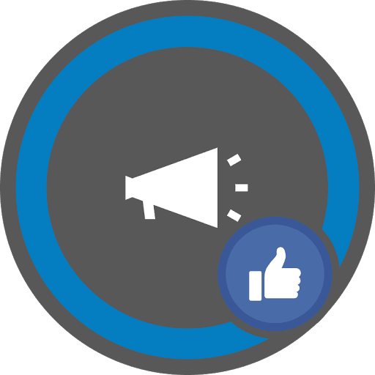
Facebook & Instagram Ads
Use Facebook and Instagram to keep your customers engaged, increase brand awareness, and drive sales.
Facebook ads can be highly targeted. Education, relationship status, and life events are some of the available targeting options.
Combine organic and paid efforts to grow your business’s presence on social media.
Get customer feedback on your products and services.
Notes:
Why choose Facebook & Instagram ads?
Today there are approximately 3.5 billion people using social media, and your business has to be where your customers are.
Having an active social media profile is vital to attract potential customers and retain the existing ones, but that’s not enough. With the popularity of Facebook and Instagram on rise, social media is becoming a “pay to play” field, forcing businesses to combine organic and paid efforts to achieve desired results.
Social media advertising is very cost-effective because advertisers have a wide variety of targeting options at their disposal. You can build your target audience based on demographics, interests, location, relationship status, education, household income, and life events. Ultimately, it means high ROI (return on investment) because you have better chances to earn the attention of potential customers.

Slide 5
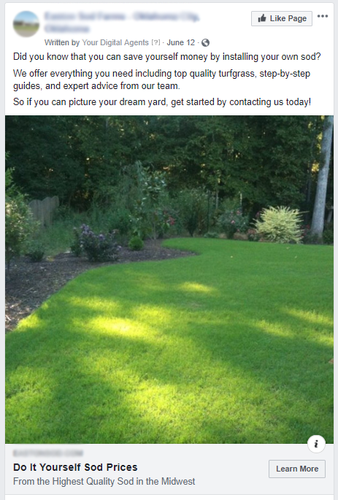
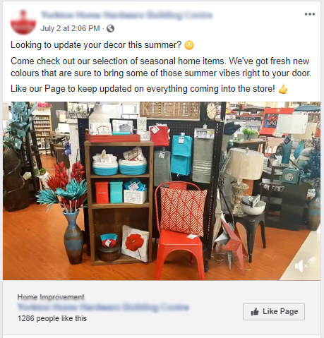
Ad Examples

Slide 6
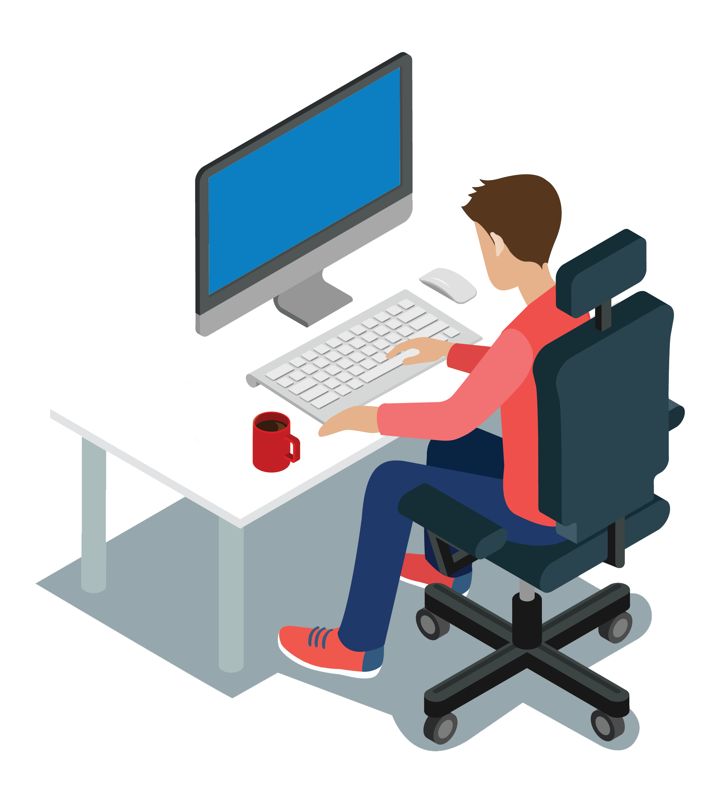
Measuring Your Campaign
S
Specific: What do you want to accomplish? (who, what, where, why)
M
Measurable: How will you measure the results?
A
Achievable: It’s good to dream, but are the goals realistic?
R
Relevant: How does the goal tie into your business?
T
Time-bound: Set 1 or more target dates
Notes:
So, how do you know if your campaign is working or not? Our team will work with you to set SMART goals.
SMART stands for Specific, Measurable, Achievable, Relevant, and Time-Bound.
You have to ask yourself a few questions:
What do you want to accomplish with your campaign? E.g.: Do you want new customers or drive more sales?
Is your goal measurable? Let’s define the metrics we’ll use to measure your results.
Is your goal achievable? Most of our campaigns deliver a high return on investment (ROI), but you have to consider the ramp-up period.
Is your goal relevant for your business? You have to think about what you need and how it can help you grow your business.
Lastly, do you need to see results in a week, a month, or three months? It all depends on what you’re trying to accomplish and how much you want to spend on ads.

Slide 7
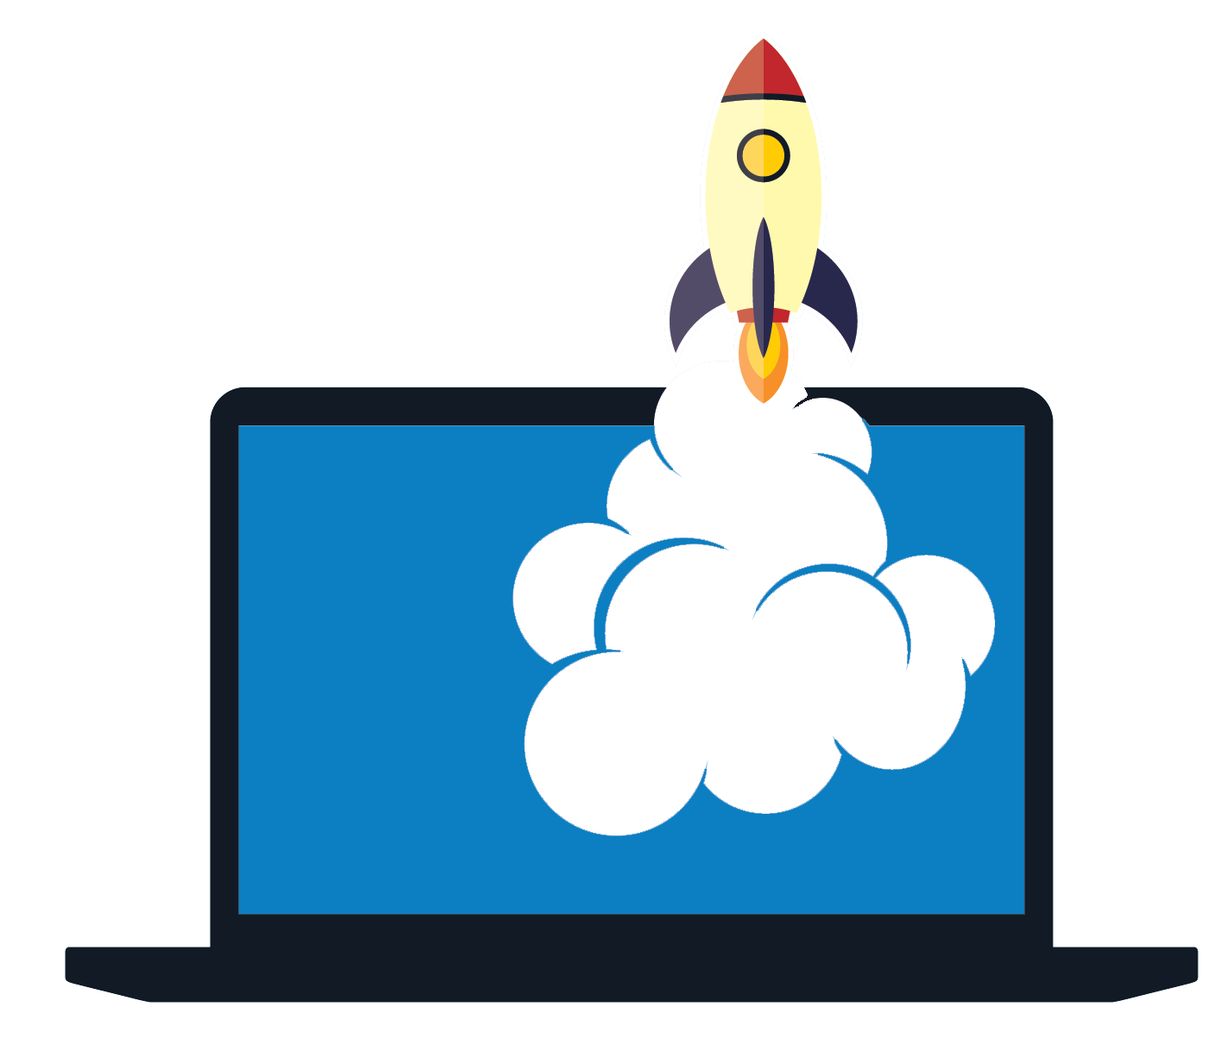
What’s Included?
A team of experts in Facebook & Instagram ads.
Campaign setup and optimization.
Automated bid and budget management.
Customized strategy for your business.
Google Analytics integration.
Monthly reports.
Notes:
Here’s what is included in our service:
A team of experts in Facebook & Instagram ads will be in charge of your campaign setup and optimization.
We’ll use specialized software to manage your budget and make the most out of your money.
We’ll develop a customized advertising strategy for your campaign based on your goals.
And last but not least, this service includes Google Analytics integration and monthly reports, so you can keep track of your campaign results.

Slide 8
?
Notes:
Ask if people have they any questions

