Slide 1

Consumers Start the Buying Process Online
Are They Finding Your Website?
[PARTNER NAME]
V2018.1.9

Slide 2
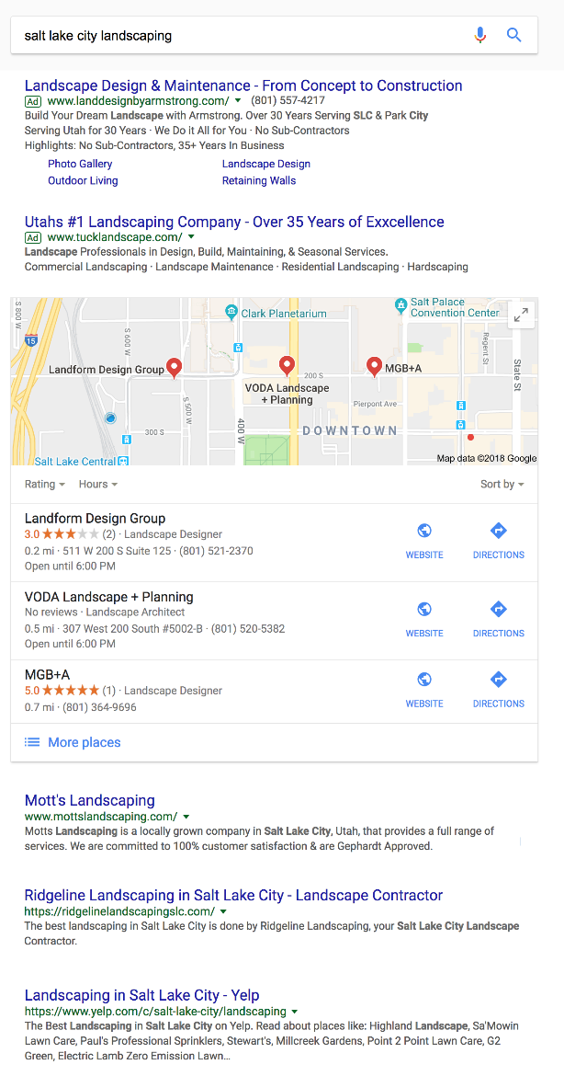

PAID
ADS
Why Do You Need to Be on Page 1 of Google?
LOCAL
& MAPS
81% of consumers search online before buying. Purchases begin with search. Prospective buyers search online for helpful product information, price comparisons, and trustworthy reviews. – Adweek
84% of clicks are organic. Searchers skip advertisements and click on organic search results to find what they’re looking for.
ORGANIC
Notes:
81% of consumers search online before buying. Purchases begin with search. Prospective buyers search online for helpful product information, price comparisons, and trustworthy reviews. – Adweek
84% of clicks are organic. Searchers skip advertisements and click on organic search results to find what they’re looking for.
Why do you need to be on the 1st page of search engines like Google? Because nearly every customer out there who is looking for local products and services starts the buying process online. Think about how huge that is! And they skip past the paid advertisements and go straight for the organic search results. That means if your businesses isn’t on the 1st page of search results, you’re out of the race before it even starts. Potential customers may never even know you exist.

Slide 3

So How Do You Get To Page 1 of Google Organically?
SEO
YOU
SEO stands for Search Engine Optimization and it is the WORK that goes into a website to get it on the first page of Google.
1.
2.
3.
a
Notes:
The most basic way to describe SEO is this: It’s the work that goes into a website to get it on the first page of Google. It’s about making sure that search engines like Google place you on the first page of results when potential customers are searching for your product or service.
Work is the key word. Some small business have the time for this extra work and don’t need outside help. But the reality is that SEO is complicated and most people don’t have the knowledge or the time to do it on their own. That’s why

Slide 4

How Does SEO Get You to Page 1 of Google?
Does Google think your site is RELEVANT?
Does Google TRUST your site?
Notes:
Google is the most important visitor that your site will ever have. If Google doesn’t like your site, or can’t even find your site, then you will never be on page 1 of their search results. With SEO you can make sure that Google puts your site high in the rankings for the right keyword searches.
There are two major factors that Google looks at when trying to decide who the best answer is for a search: Relevance and Trust.
Relevance has everything to do with your website. Things like correct code on the back-end and the right content on the site itself. “Relevance = Onsite”
Trust is measured by the number of OTHER websites that talk about or link back to your website. The more websites that talk about you and link back to your site, the more trusted you become. “Trust = Offsite”
The most relevant and most trusted source = best answer and first page rankings. Ranking on the first page means more traffic and more customers!
If Google doesn’t consider your site RELEVANT, or if it doesn’t TRUST your site, you’ll never show up on the 1st page of search results.

Slide 5
Relevance = Onsite SEO
HERE IS WHAT GOOGLE LOOKS FOR ON YOUR WEBSITE
Source Code
Content
Site Speed
Mobile Friendly
Google Analytics
Google Maps
Videos/Images
Notes:
Relevance is the ONSITE portion of SEO.
Most small business owners think that their website is effective because it looks good! But it’s important to understand how Google views a website.
Google looks at your website’s code; it doesn’t care how pretty the site looks. If the code isn’t optimized then Google will either keep you off the 1st page, or may not even see them at all.
Another new factor that a lot of sites overlook is mobile devices. If your site isn’t mobile-friendly then Google will move you down in search rankings.
It’s also critical that you have relevant content on your site that integrates the keywords local buyers are searching for.
The speed of your website is important too. Google checks to see how quickly your site loads when considering who to rank first.
Posting great content regularly is one of the best things you can do to get ranked by Google and keep potential customers interested in your business.
Our SEO teams manage all of these onsite items to help Google see that you’re relevant to local buyers.

Slide 6
Trust = Offsite SEO
HERE IS HOW GOOGLE DECIDES TO TRUST YOUR SITE
Custom Articles
Article Engagement
Blog Posts
Site Bookmarking
Infographics
Business Directories
Notes:
Trust is the OFFSITE portion of SEO.
Now there are a lot of websites that have the right content and are relevant. Google will sift through the relevant websites and determine who it trusts the most. The most basic way that Google determines trust by how many other websites have links that point back to you.
Building trust with Google is similar to real-life relationships. It takes time and it’s done through a variety of small yet meaningful things that build up to greater and greater trust. It can’t be bought! And just like personal relationships, quality is more rewarding that quantity.
We build different types of quality links in a natural way on sites that Google already trusts so that your site attains a diversified link portfolio from quality sources. Some of our methods include:
Article Engagement
Website Bookmarking
Business Directory Submissions
Custom Blog Publication
Custom Article Publication
Infographic Syndication
Offsite Content Marketing
Our SEO teams manage all of these offsite items to help Google see that you’re a trusted resource for relevant keyword searches.

Slide 7
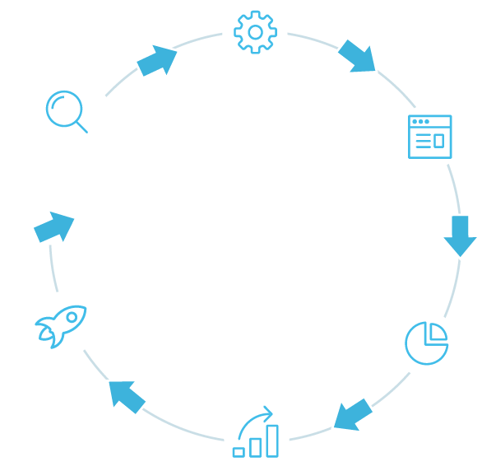

What Does the Whole SEO Process Look Like?
Onsite Optimization
Website Audit & Keyword Selection
Offsite Optimization
First Page of Google
Increased Sales
Real-time Reporting
Improved Rankings
Notes:
Website Audit & Keyword Selection: The process starts with an audit of your current website and keyword selection. Our SEO specialists will perform an audit of your site to determine which keywords on Google will be the most beneficial for you.
Onsite Optimization: We make sure that all of the onsite components of your website are correct. This will help visitors and search engines easily understand what you do and why you are relevant.
Offsite Optimization: We promote your business online through high quality content, online business profiles and other time tested online marketing tactics. This will show your website visitors and the search engines that you are a trusted source for the product or service that you provide.
Real-time Reporting: Our reporting is what sets us apart. You’ll have real-time access to your metrics, stats, and reporting so you can see the work that is being done and the progress your campaign is making.
Improved Rankings: Our goal is that your website reaches the first page for the keywords that we selected. As we continue to optimize your site and build more links from trusted sources, your own site begins to rise in the rankings on Google and other search engines.
Increased Sales: By increasing your rankings, you’re increasing your traffic, which will ultimately lead to an increase in leads and sales for your business.

Slide 8
How Long Does the SEO Process Take?
45 Days: Site build, onsite optimization, and start building trust
3-4 Months: You can see significant improvement in your rankings
z
6 Months: First page rankings within 6 months
6+ Months: Ensure you grow and stay on top of competition
and don’t drop off page 1
Notes:
In the early days of Google it was possible to reach the 1st page very quickly. But Google is smart and doesn’t let people cheat their way to the top anymore. Effective SEO takes time. You have to truly earn trust from Google. If someone has promised you 1st page rankings in a very short time, they’re either not being honest or their SEO methods are not on the up-and-up.
Doing SEO the right way also builds equity in your website. While pay-per-click and AdWord campaigns can get results, that traffic stops as soon as your ads expire. With SEO you own that relevancy and trust that has been built with Google and it provides long-lasting results.

Slide 9


How Much Does SEO Cost?
1
2
Two main factors:
Market Competitiveness
Industry Competitiveness
Small market, smaller budget
Big market, bigger budget
Notes:
There are 2 main factors that determine the cost of SEO.
Market Competitiveness: Larger markets (bigger cities) have a larger population, which means more people searching. SEO in smaller markets is generally cheaper than in larger markets.
Industry Competitiveness: Larger markets (bigger cities) have more businesses in the same industries, so there is more direct competition for search rankings. SEO in crowded industries are generally more expensive than niche industries.

Slide 10
How Much Does SEO Cost?
We select the body of SEO work that will get you the best results at a budget you can afford.
Keyword Page Code Enhancements
  Title and H1 tags
  Image alt tags
  Meta descriptions
Keyword Page Copy Enhancements
  Integrate keywords in copy
  Keyword page readability
Link Development
  Article Engagement
  Website Bookmarking
  Business Directory Submissions
  Custom Blog Publication
  Custom Article Publication
  Infographic Syndication
  Offsite Content Marketing
Notes:
Most small businesses have been faced with 2 choices in SEO services.
Specialty agencies that charge over $100/hour for SEO work without proving tangible results.
Or bottom-dollar, low-quality SEO providers that outsource their work to other countries.
We’re changing that by offering effective, customized SEO plans that are tailored to each individual customer.
All of our SEO work is calculated at an hourly rate well below this industry average and all of our work is done right here in the U.S.
How does this work? All of the SEO tasks we perform are assigned an hourly value. For example, Website Bookmarking may take 1 hour, while a Custom Blog Post may take 6 hours. The number of hours that you dedicate to SEO each month determines the number of SEO activities we can perform.
Regardless of your budget, we focus on the keywords and SEO activities that will have the greatest impact on your search results.

Slide 11
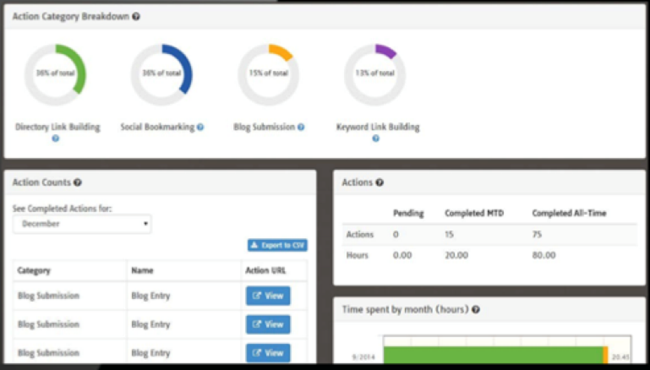
Better Technology = Better SEO
1
High Quality Work
2
Full Transparency Into the Work
3
Full Service Offering:
Offsite and Onsite SEO
4
24/7 Performance Auditing
Notes:
The key to our quality and affordable SEO is our in-house technology, Launchpad. Our system shows and tells our SEO experts exactly what needs to be done at every phase of an SEO campaign. This allows us to perform all SEO work in an assembly line manner, which keeps quality and efficiency high while keeping costs low.
Launchpad also allows for complete transparency into every action being performed for our clients. You get access to your own dashboard where you can track where every SEO dollar is going for both onsite and offsite work, as well as the results it provides.
Our system is so good that it’s even auditing websites automatically and if something is wrong (page goes down or text has been edited and a keyword removed), then LaunchPad will create a ticket and the account manager can’t do other work until they have fixed it.

Slide 12

Q & A

