Slide 1



5 Reputation Management Tips for Local Businesses
Notes:
Type your notes

Slide 2




Reputation Management for Local Businesses
What is reputation management?
“Reputation management is the process of identifying what other people are saying or feeling about you or your business, and taking steps to ensure that the general consensus is in line with your goals.”
Notes:
What is reputation management?
“Reputation management is the process of identifying what other people are saying or feeling about you or your business; and taking steps to ensure that the general consensus is in line with your goals.”
You might be the best in their industry, but in today’s marketing landscape, this is not enough.
It doesn’t matter if you you’re the best. You need OTHER people saying that.
And a good reputation management strategy has the power to grow your customer base.

Slide 3

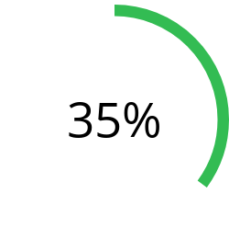
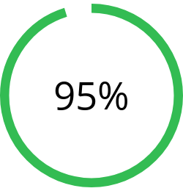
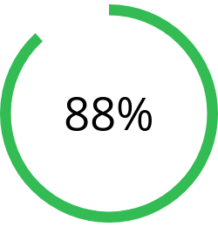

Reputation Management Stats
Reputation Management for Local Businesses
Mobile Search
Online Shoppers
Influence
Searches for reviews on mobile have increased by more than 35% over the past two years.
Nearly 95% of shoppers read online reviews before making a purchase.
88% of buyers are influenced in their buying decision by online reviews.
Sources: Think with Google, Spiegel Research Center, and Zendesk
Notes:
Here are a few stats that showcase the importance of reputation management for your businesses.
You’ll notice that reputation management is more than just answering to reviews. Today, it’s becoming part of the customer journey.
Probably you have already made a purchase decision after reading online reviews.
Let’s say you want to try a new restaurant. You search for restaurants on Google and you see tons of options. How do you pick one? For most people, reviews are the go-to.

Slide 4






Benefits of Reputation Management
Improve your brand awareness
Build authority and trust
Foster stronger customer relationships
Notes:
Companies are starting to realize the impact of reputation management on their businesses. Here are some of its benefits:

Slide 5



Benefits of Reputation Management
Attract better
employees
Generate traffic to your website
Drive more
sales
Notes:
Ty

Slide 6



Reputation Management Tips
Monitor your online reviews
01
Make sure your business category is correct
02
Filter your mentions
03
Take feedback constructively not negatively
04
Automate the process
05
Notes:
#1 Monitor your online reviews
It takes time to build a positive reputation, which is why taking a proactive approach to reputation management is essential. Platforms like Yelp, Facebook, and Google are teeming with customer activity. Monitoring these and the many other review websites is an essential element of managing and maintaining a business’s reputation.
Businesses that don’t monitor customer feedback on these and other crucial platforms may miss marketing opportunities and damage their reputation because nowadays, customers base their decision on who they are going to give their business to by online reviews.
Customers are looking for responses to reviews, both positive and negative, they’re looking for star ratings, they’re looking for that feedback. If there are no reviews, no answer to reviews, or badly responded reviews, customers will most likely make the decision to go to a different business.
#2 Make sure your business category is correct
Categories are used to describe your business and connect you to customers searching for the services you offer.
Choose a primary category that describes your business as a whole and don’t add multiple categories to list all of your products and services. If your business is a Book Shop that includes a cafe, don’t add the category “cafe”. Instead, the operator of the cafe should create their own listing with “Cafe” as their primary category.
Be specific when choosing a category. For example, choose “Nail salon” instead of “Salon”
Make sure this information is specific as possible. If this information is inaccurate, your listing score will be inaccurate, because your businesses is graded against other businesses in the same category.
#3 Filter your mentions
When using a review management software or platform, don't be too broad when setting up your mentions - you'll pull in so many mentions that aren't relevant which will lead to you missing ones that are important!
You want to ensure that the mentions you pull in are relevant to your business. Mentions are a great way to see what people are saying online about your business.
#4 Take feedback constructively not negatively
Review sites are a safe place for your customers to leave their feedback regarding their experience.
Of course, you want positive reviews and nothing but positive reviews every day all day but occasionally someone feels that they have had a negative experience.
When responding to reviews, you need to remember that these sites are public facing forums and future customers may be basing their decisions on using your business on your reviews and review responses. If you do receive a negative comment, you want to address the review apologetically and encourage the review to contact you offline.
#5 the process
Due to the volume of mentions that can happen across the thousands of review websites, social platforms, blogs, forums, and beyond, manually monitoring and managing your online reputation is nearly impossible.
Businesses can instead take advantage of solutions that automate the process and allow them to track everything from one platform.

Slide 7



Our Services
Notes:
Type your notes

Slide 8

Review Responses
Why do you need it?
What is this?
We’ll monitor, manage, and respond to all the reviews your business receive online.
Why do you need it?
You don’t have time to read and answer reviews.
You might not know how to address negative reviews.
You don’t know how to measure your brand’s reputation.
Benefits:
Build customer loyalty and humanize your brand.
Turn happy customers into brand advocates.
Turn negative reviews into opportunities.
Notes:
Add note to this slide

Slide 9

Review Requests
Why do you need it?
What is this?
We’ll reach out to your customers and gently ask them to leave a review
Why do you need it?
You might not know how to get more reviews.
You don’t have a quick way to ask for reviews in bulk.
Businesses without reviews struggle to improve their SEO
Benefits:
Improve your relationship with your customers.
Find out what your customers think about your business.
Improve your SEO.
Notes:
Add note to this slide

Slide 10

THANK YOU
Your Contact Info
PHONE:
212-555-1212
MAIN OFFICE:
Your address
Notes:
Type your notes

