Slide 1
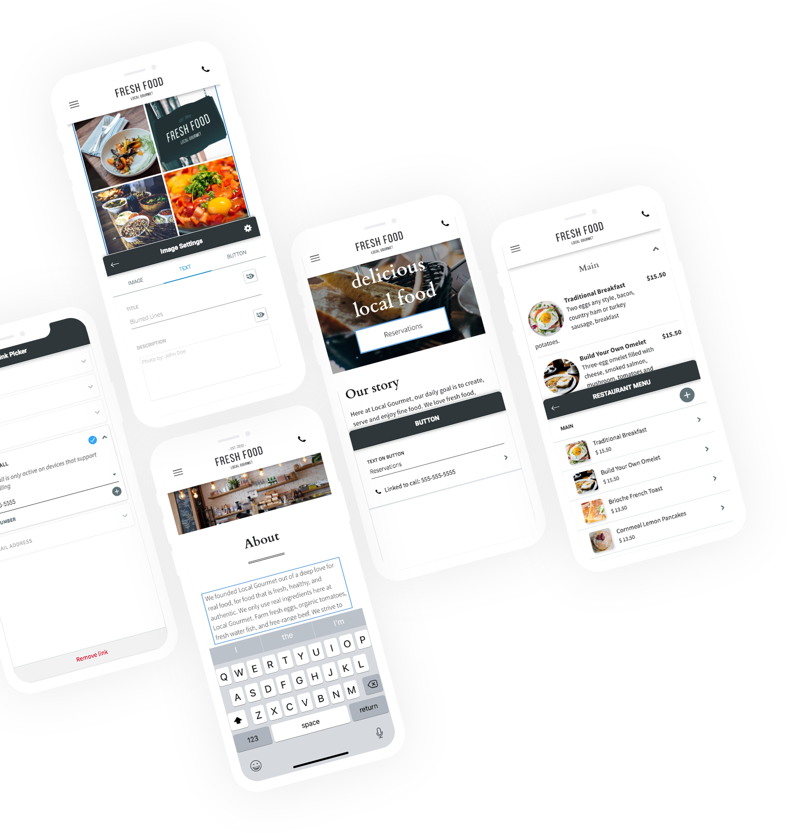
Your Logo
When it’s Time to Go,
Keep Editing.
With our new editing service, you now can edit your site from the convenience of your mobile device.
No matter if you're here or there, feel free to keep going… and keep editing too.

Slide 2
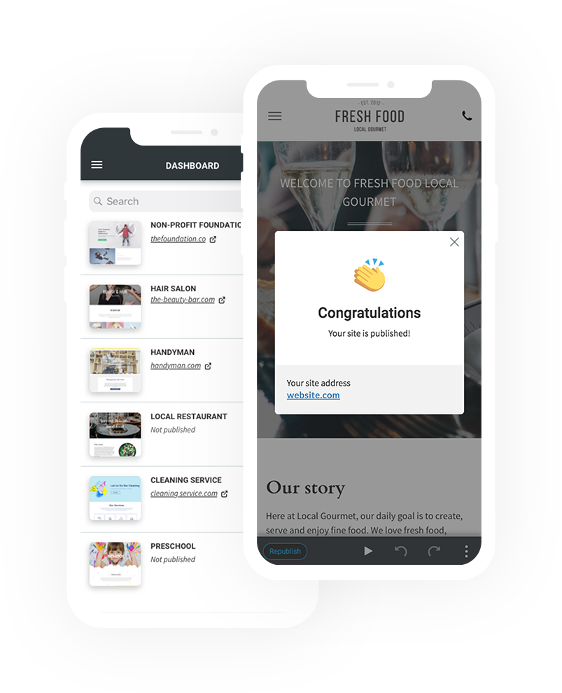
Edit on the Run
Have to run? No problem. You can access
our editor’s dashboard, edit your content, preview changes, and republish – all from
your mobile device.

Slide 3
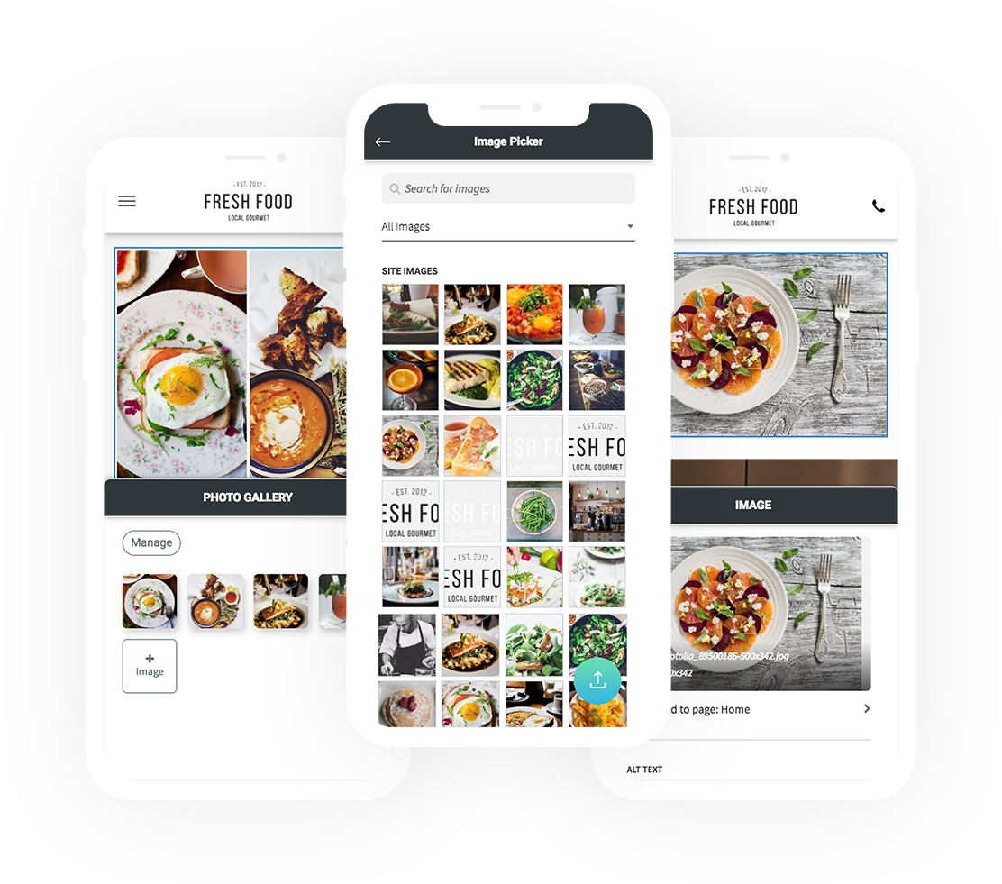
Pick Your Pics
Add pictures directly to your site from your phone, or select images from our gallery.
Feel free to add, sort, and edit your pics anytime, anywhere.

Slide 4

Rework Your Widgets
Your frequently-used widgets are editable too – and you won’t have to stay put to edit them. Just use your mobile device to change images, text, and more.

Slide 5
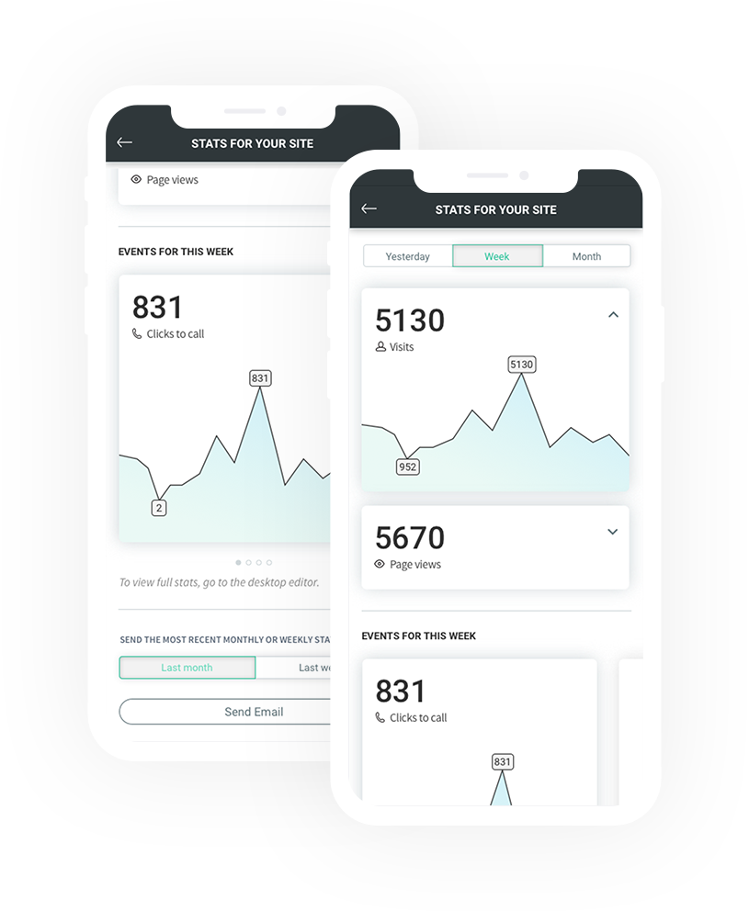
Track Your Stats
Keep up on your site visits, page views, and events like clicks-to-call while you’re out and about. You can also generate weekly or monthly stat reports to send out via email.

Slide 6
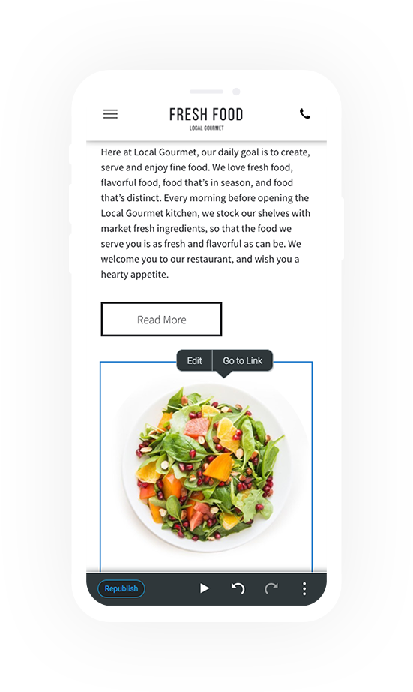
Touch Friendly Design
Your fingertips are all you need. Our whole editor is designed to be touch-friendly, intuitive, and easy to use.
Give it a Go
Discover how great editing from mobile can be.
Business Name | +123 456 7890 | yourmail@yourmail.com | www.yoursite.com

