Slide 1

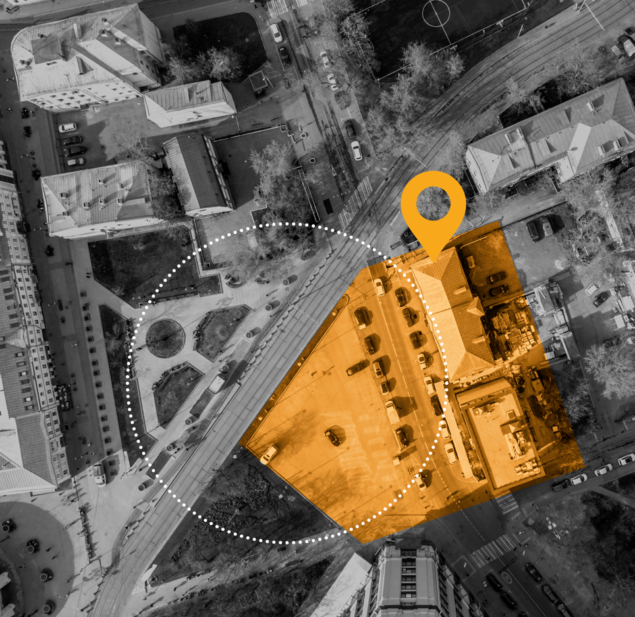

Advertise with LocalAds
A powerful technology that allows advertisers
to target potential customers based on
their online and offline behaviors.
While other advertising technologies can target a specific location, LocalAds analyzes sequenced physical locations to establish a link between them, learn how your potential customers behave,
and improve your campaign’s performance while tracking every important conversion.
LOCATION TARGETING
Precise targeting using GPS coordinates. Accurate to exact store, lot and retail block. This is the technology used by LocalAds.
MULTIPLE PLATFORMS
LocalAds display campaigns can be expanded to other platforms such as search, social, and video to reach your target audience anytime, anywhere.
Notes:
INSTRUCTIONS:
Replace the logo placeholder with your company’s logo
Remove the blue bar or change its color if it clashes with your logo.
Save this document as a PDF

