Slide 1


~ ADVERTISING
LocalAds
Recommended Tactics

Slide 2

Automotive Sales
Audience & Location Targeting
IDENTIFY auto buyers by using a sequence of LOCATION based behaviors to target those in market for a new auto.
CONNECT with intenders via MOBILE DISPLAY ads at the moments they are most likely to purchase.
INFLUENCE the buyer with an OFFER redeemed by a visit by remarketing across DISPLAY and/or VIDEO.
CONVERT intenders into customers by measuring conversions from VISITS to the dealership.

Slide 3

Automotive Service
Audience & Location Targeting
IDENTIFY auto service needs by historical LOCATION data to predict the next time a service will be needed.
CONNECT with car owners via MOBILE DISPLAY ads when a service date range is approaching.
INFLUENCE car owners with an OFFER redeemed by a visit by remarketing across DISPLAY and/or VIDEO.
CONVERT into customers by measuring conversions from service by VISITS, CALLS, and ONLINE.

Slide 4
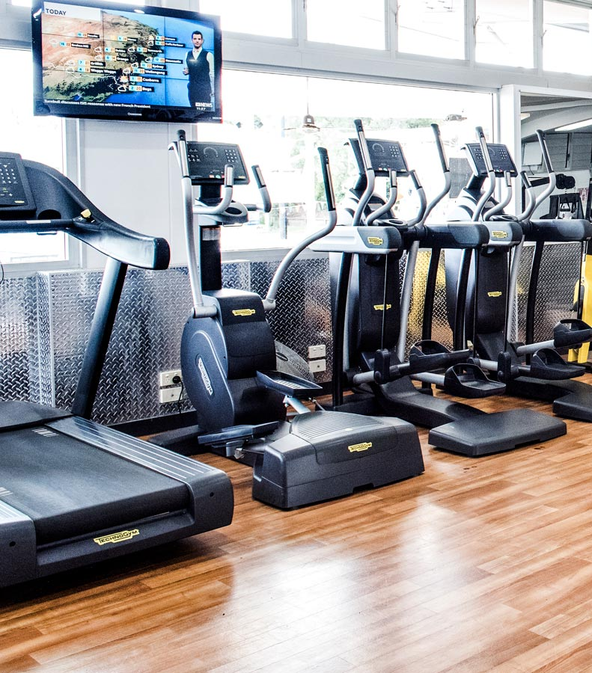
Gym & Fitness
Audience & Location Targeting
IDENTIFY fitness enthusiasts by using a sequence of LOCATION based behaviors and competitors.
CONNECT with gym goers via MOBILE DISPLAY ads who are commuters or exhibit daily activities.
INFLUENCE with a new customer OFFER redeemed by a visit by remarketing across DISPLAY and/or VIDEO.
CONVERT into customers by measuring conversions from VISITS to the gym.

Slide 5
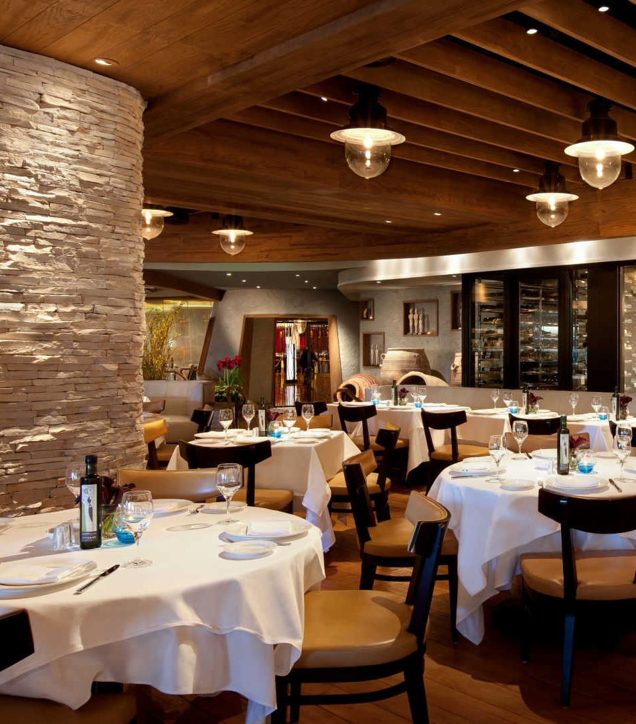
Restaurants
Audience & Location Targeting
IDENTIFY casual or fine diners by categorizing LOCATION data to match interests by physical visits.
CONNECT with diners via MOBILE DISPLAY ads to influence the next choice for a dining experience.
INFLUENCE to dine with an OFFER (or menu item) and remarket across DISPLAY and/or VIDEO.
CONVERT into customers by measuring conversions from VISITS while also tracking CALLS and ONLINE orders.

Slide 6

Furniture / Mattress
Audience & Location Targeting
IDENTIFY market for furniture using LOCATION data to target new movers or active furniture shoppers.
CONNECT with shoppers via MOBILE DISPLAY ads to influence a store visit.
INFLUENCE to shop with a limited time OFFER and remarket across DISPLAY.
CONVERT into customers by measuring conversions from VISITS while also tracking CALLS and ONLINE orders.

Slide 7

Cannabis / CBD Oil
Audience Targeting
IDENTIFY potential customers (US) using LOCATION to target behavior categories for pharmacies and health stores.
CONNECT with shoppers via MOBILE DISPLAY ads to influence a store visit and repeat visits.
INFLUENCE to shop with a limited time OFFER and remarket across DISPLAY.
CONVERT into customers by measuring conversions from VISITS while also tracking CALLS and ONLINE orders.

Slide 8

Urgent Care
Audience & Location Targeting
IDENTIFY potential need for urgent care using LOCATION to target behavior categories for urgent care and pharmacies.
CONNECT with patients via MOBILE DISPLAY ads to present relief for symptom or injury.
INFLUENCE to visit with a value proposition OFFER and remarket across DISPLAY.
CONVERT into patients by measuring conversions from VISITS while also tracking CALLS and ONLINE appointments.

Slide 9

Bank / Credit Union
Audience & Location Targeting
IDENTIFY potential customer by using LOCATION to target behavior categories for frequent bankers or recently moved.
CONNECT with customers via MOBILE DISPLAY ads to present services.
INFLUENCE to open an account with an OFFER and remarket across DISPLAY / VIDEO and SEARCH.
CONVERT into customers by measuring conversions from VISITS while also tracking CALLS and ONLINE applications.

Slide 10

Loan / Mortgage
Audience & Location Targeting
IDENTIFY by using LOCATION to target behavior categories for frequent bankers and in market intenders.
CONNECT with customers via MOBILE DISPLAY ads to present services.
INFLUENCE to apply with an OFFER and remarket across DISPLAY / VIDEO and SEARCH.
CONVERT into customers by measuring conversions from ONLINE applications while also tracking CALLS and VISITS.

Slide 11

HVAC / Plumbers
Audience & Location Targeting
IDENTIFY potential clients by using ONLINE DATA to target in market and psychographics for service needs.
CONNECT with customers via MOBILE DISPLAY ads to present heating and cooling services.
INFLUENCE to make an appointment with an OFFER and remarket across DISPLAY / VIDEO and SEARCH.
CONVERT into clients by measuring conversions from CALLS and ONLINE forms.

Slide 12

Home Buyers
Audience & Location Targeting
IDENTIFY potential customers by using ONLINE DATA and LOCATION to target in market for new or custom homes.
CONNECT with customers via MOBILE DISPLAY ads to present house plans and showings.
INFLUENCE to schedule an appointment with an OFFER and remarket across DISPLAY.
CONVERT into customers by measuring conversions from VISITS and CALLS and ONLINE appointments.

Slide 13
~ ADVERTISING
Questions?

