Slide 1


~ ADVERTISING
LocalAds
Notes:
Introduce yourself

Slide 2

What Is LocalAds?
Improve your advertising campaign results with LocalAds!
Premium advertising technology
Highly-sophisticated targeting
Location-based ads
Multiple platforms
Live reports
Great ROI
Notes:
LocalAds is powered by sophisticated advertising technology that predicts both offline and online user behaviors to serve ads more efficiently.
It makes this happen by examining your audience’s location data and the devices they’re interacting with.
While other advertising technologies can target a specific location, LocalAds analyzes sequenced physical locations to establish a link between them, learn how your potential customers behave, and improve your campaign’s performance while tracking every important conversion.

Slide 3
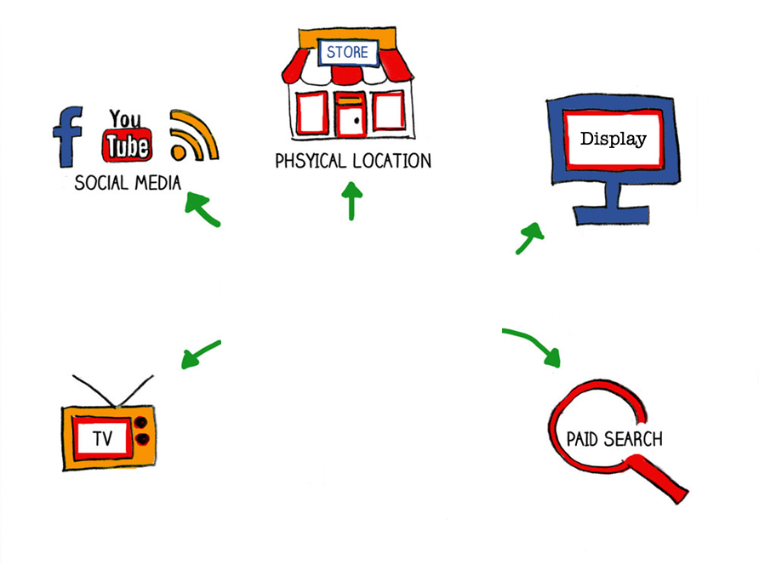

Multiple Platforms
PHYSICAL LOCATION
Notes:
All LocalAds campaigns are display campaigns, but you can purchase additional spend to expand your campaign to other platforms.
Based on your campaign goals and ad spend, our team can combine LocalAds display with other platforms such as search, social, and video.
The technology we use makes the information easily flow from one platform to another.

Slide 4




The I.C.I.C. strategy
IDENTIFY
CONNECT
INFLUENCE
CONVERT
We use sequenced location data to identify and build your target audience.
We use mobile display ads to target your potential customers.
We serve ads with a special offer and a
call to action.
We measure visits, calls, and online appointments to generate new customers.
Notes:
With Local Ads, we often use the I.C.I.C. approach:
Identify
Connect
Influence
Convert

Slide 5
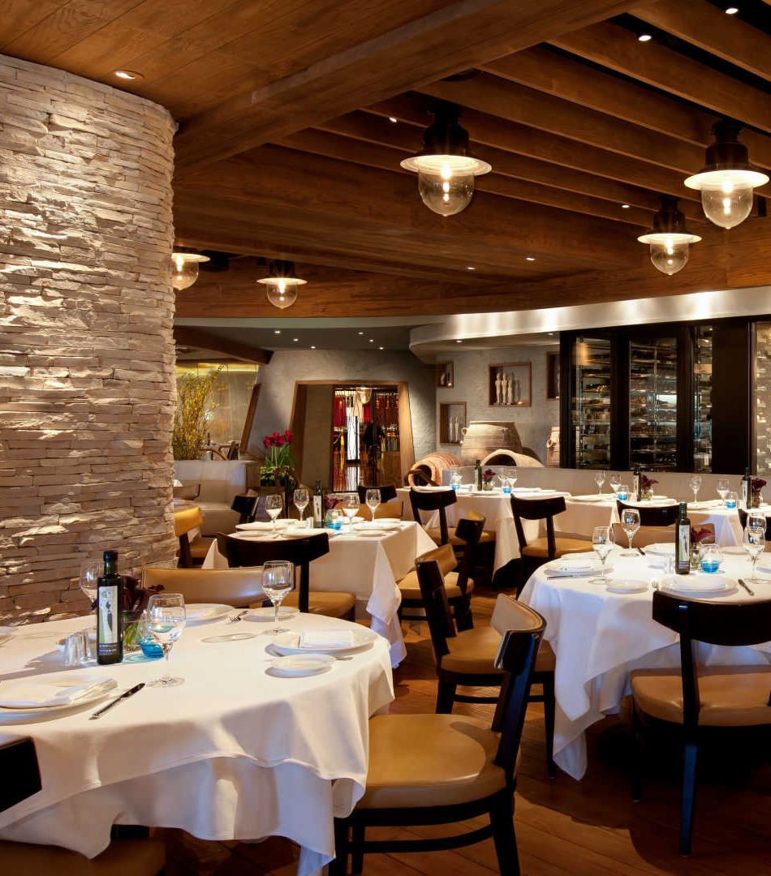
Restaurants
Audience & Location Targeting
IDENTIFY casual or fine diners by categorizing LOCATION data to match interests by physical visits.
CONNECT with diners via MOBILE DISPLAY ads to influence the next choice for a dining experience.
INFLUENCE to dine with an OFFER (or menu item) and remarket across DISPLAY and/or VIDEO.
CONVERT into customers by measuring conversions from VISITS while also tracking CALLS and ONLINE orders.
Notes:
This is an example of how LocalAds can be used by restaurants

Slide 6
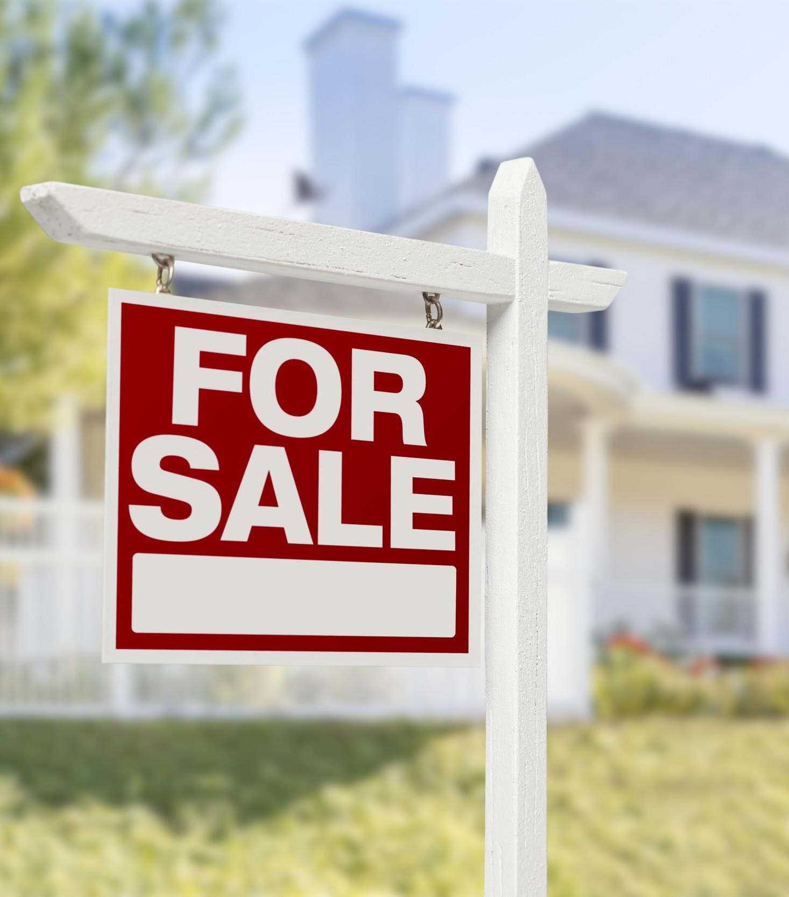
Home Buyers
Audience & Location Targeting
IDENTIFY potential customers by using ONLINE DATA and LOCATION to target in market for new or custom homes.
CONNECT with customers via MOBILE DISPLAY ads to present house plans and showings.
INFLUENCE to schedule an appointment with an OFFER and remarket across DISPLAY.
CONVERT into customers by measuring conversions from VISITS and CALLS and ONLINE appointments.
Notes:
Just another example, here are a few tactics for targeting home buyers with LocalAds

Slide 7
~ ADVERTISING
Questions?
Notes:
Ask your prospect if they have any questions about LocalAds

