Slide 1
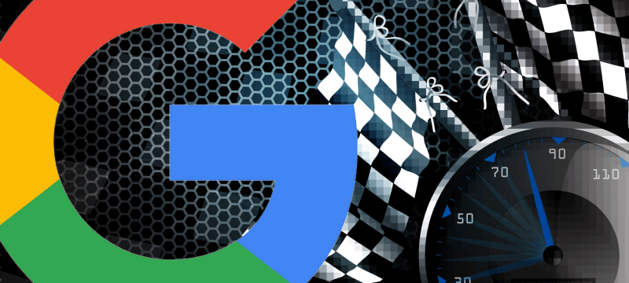
Google page speed ranking factor

Slide 2
Google page speed ranking factor
Gary Illyes from Google said that Google will be updating the page speed ranking factor to specifically look at the page speed of mobile pages when it comes to the mobile-friendly algorithm.

Slide 3
Google page speed ranking factor
When Google updates their mobile-friendly algorithm, they will add mobile-specific page speed as a factor and not rely on the desktop version anymore.

Slide 4
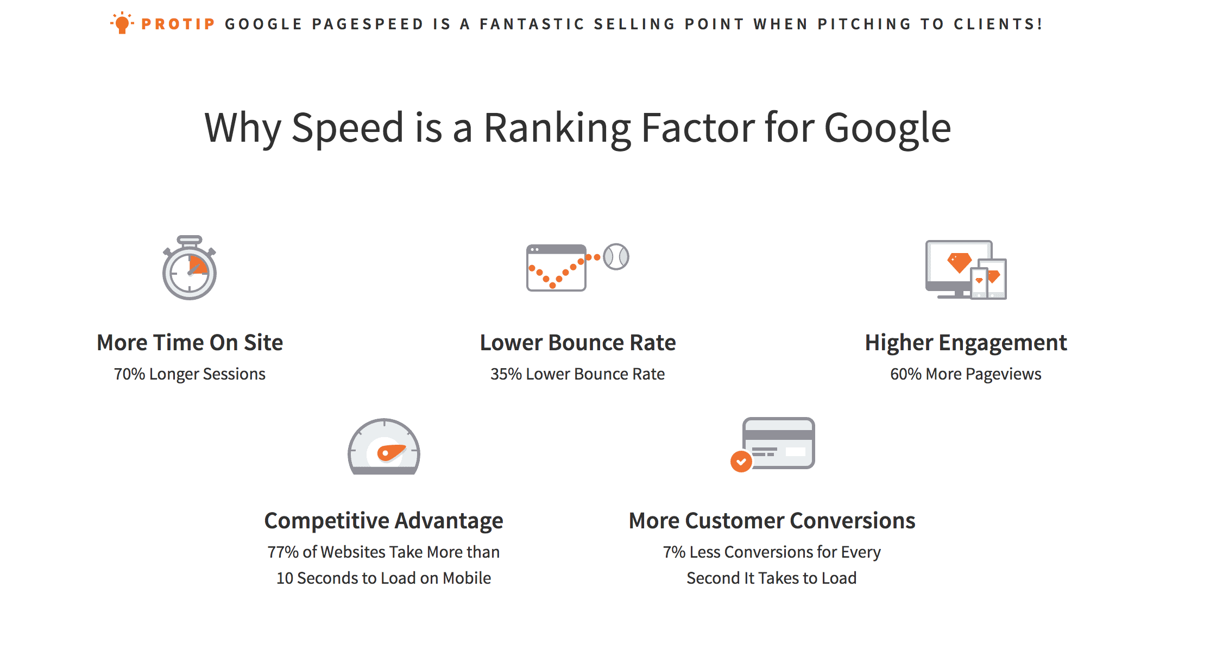

Google studied over 10,000 mobile web domains. Using data generated from Webpagetest.org, Google Analytics and DoubleClick, they looked for what makes mobile sites slow and determined the impact speed has on user engagement and revenue.

Slide 5

What is changing with the mobile-first index?

Slide 6
What is changing with the mobile-first index?
As more and more searches happen on mobile, Google wants its index and results to represent the majority of their users — who are mobile searchers.
Google has started to use the mobile version of the web as their primary search engine index. A search engine index is a collection of pages/documents that the search engine has discovered, primarily through crawling the web through links.
Google has crawled the web from a desktop browser point of view, and now Google is changing that to crawl the web from a mobile browser view.

Slide 7
Is this a mobile-friendly ranking boost?
Google has previously said that content that’s not deemed mobile-friendly will not rank as well. That remains the case with this new index.
In the current index, which most people will continue to get results from, desktop content is indexed and used for showing listings to both desktop and mobile users. A special mobile-friendly ranking system is then used to boost content for Google’s mobile listings. Content that’s not mobile-friendly doesn’t perform as well.
In the new mobile-first index, which some people will get results from as Google rolls it out, mobile content is indexed and used for showing listings to both desktop and mobile users. Then the mobile-friendly ranking boost is applied, as with the current system, to mobile-friendly pages.

Slide 8
Ranking signals will come from your mobile, not desktop version
Google has ranked responsive websites based on many signals from desktop sites, as we covered before. That is going to flip, and Google will rank the mobile and desktop sites based on signals they get from crawling your site from a mobile view.
So the page speed of your responsive websites will determine the rankings of your responsive websites in Google. Google will also likely look at your title, H1s, structured data and other tags and content generated from your responsive website.
Doesn’t this just flip the issue the other way to where Google is ranking its desktop results based on how it sees the desktop website? Yes, but Google knows that, and the trend is that mobile keeps growing and more and more searchers will use mobile over desktop to search.

Slide 9
Will Google have different indexes for mobile and desktop?
Eventually, Google plans to have only one index, one which is based on mobile content, to serve listings for both mobile and desktop users. During this rollout period, there will be two: desktop-first and mobile-first. A smaller group of users will get results out of the mobile-first index. It’s not something that anyone will be able to control. People will likely have no idea which index they’re actually using.
As Google grows confidence in the mobile-first index, eventually that will be the only index used.
Google said in their blog post, “Our search index will continue to be a single index of websites and apps, our algorithms will eventually primarily use the mobile version of a site’s content to rank pages from that site.”
Paul Haahr from Google reiterated it by saying, “Index of mobile pages for mobile users and index of desktop pages for desktop users won’t happen.”

Slide 10
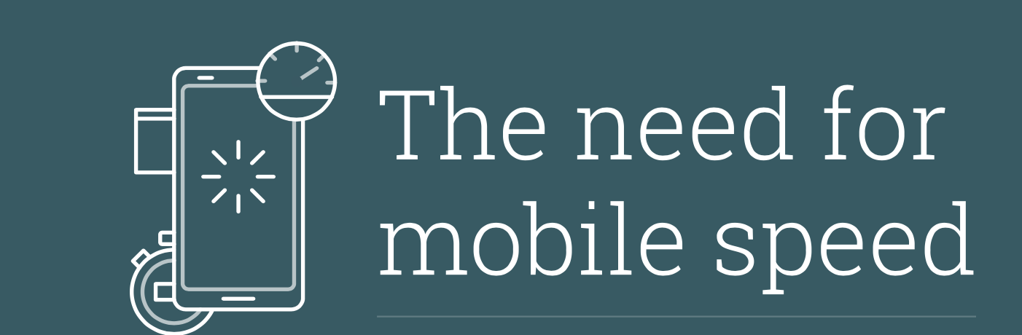
Introduction
We depend on our mobile phones for just about everything — finding information when we need it, booking flights and even enjoying our favorite TV shows.
We don’t just expect to have all the world’s information at our fingertips — we expect to get it the instant we’re looking for it. Unfortunately, websites and even mobile sites don’t always live up to this expectation, despite major advancements in network speed and device processing power.
Slow loading sites frustrate people with bad user experiences and negatively impact businesses.

Slide 11
Google studied over 10,000 mobile web domains. Using data generated from Webpagetest.org, Google Analytics and DoubleClick, they looked for what makes mobile sites slow and determined the impact speed has on user engagement and revenue.

Slide 12
Over half of all mobile site visits are abandoned if the page doesn’t load within 3 seconds. 1.
3 out of 4 mobile sites take longer than 10 seconds to load and the average time to load is 19 seconds. 2.
While there are several factors impacting revenue, our model projects that publishers whose mobile sites load within 5 seconds earn up to 2X greater mobile ad revenue than those whose sites load within 19 seconds. 3.
1.Google Data, Aggregated, anonymized Google Analytics data from a sample of Mobile Web sites opted into sharing benchmark data, n=3.7K, Global, March 2016.
2. Webpagetest.org, Sampled 11.8K global mobile Web homepage domains loaded using a fast 3G connection timing first view only (no cached resources), February 2016
3. Google Data, Aggregated, anonymized Google Analytics and DoubleClick AdExchange data from a sample of Mobile Web sites opted into sharing benchmark data, n=4.5K, Global, June 2015 - May 2016

Slide 13
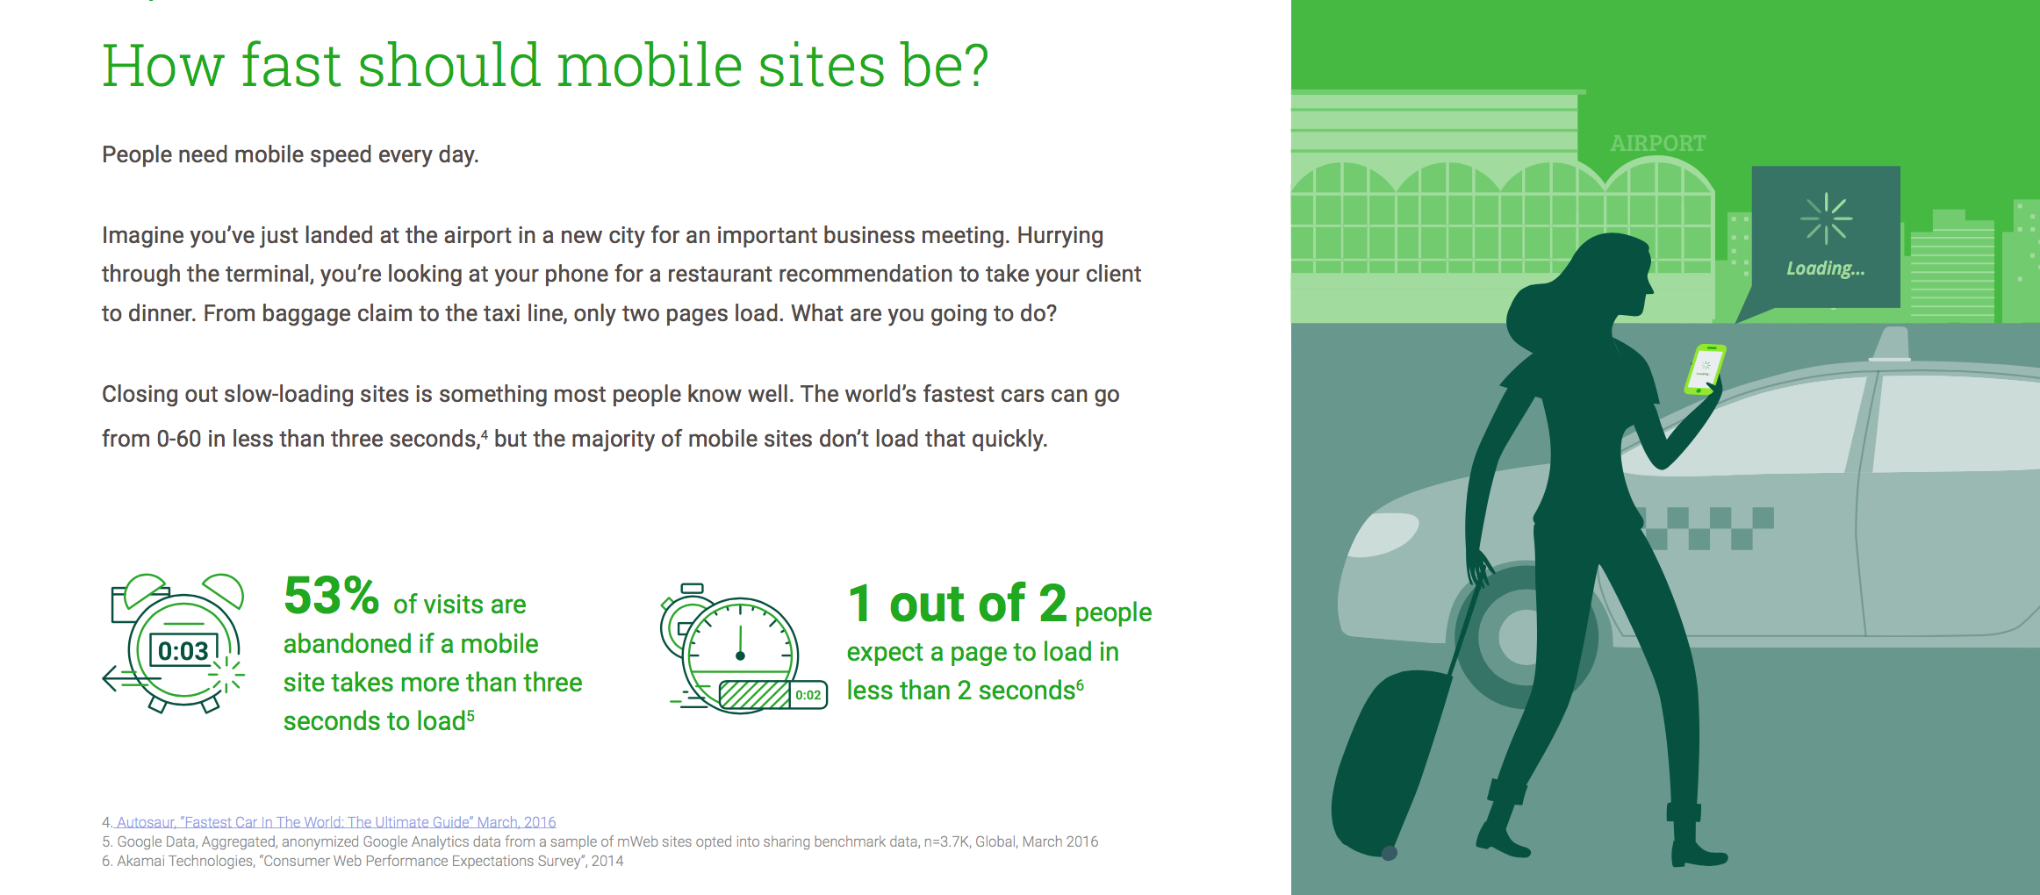

Slide 14
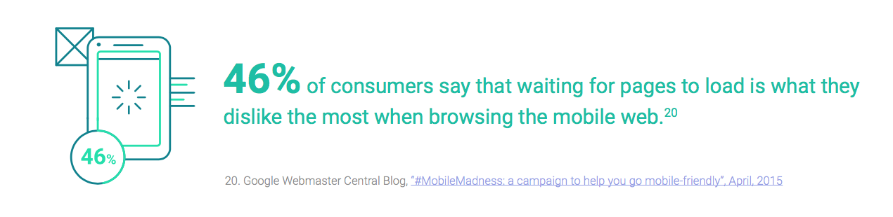

Mobile speed is good for everyone, everywhere!
When sites are fast, users engage more with content and ads. The net result: publishers can monetize their content and advertisers can achieve their brand goals.

Slide 15

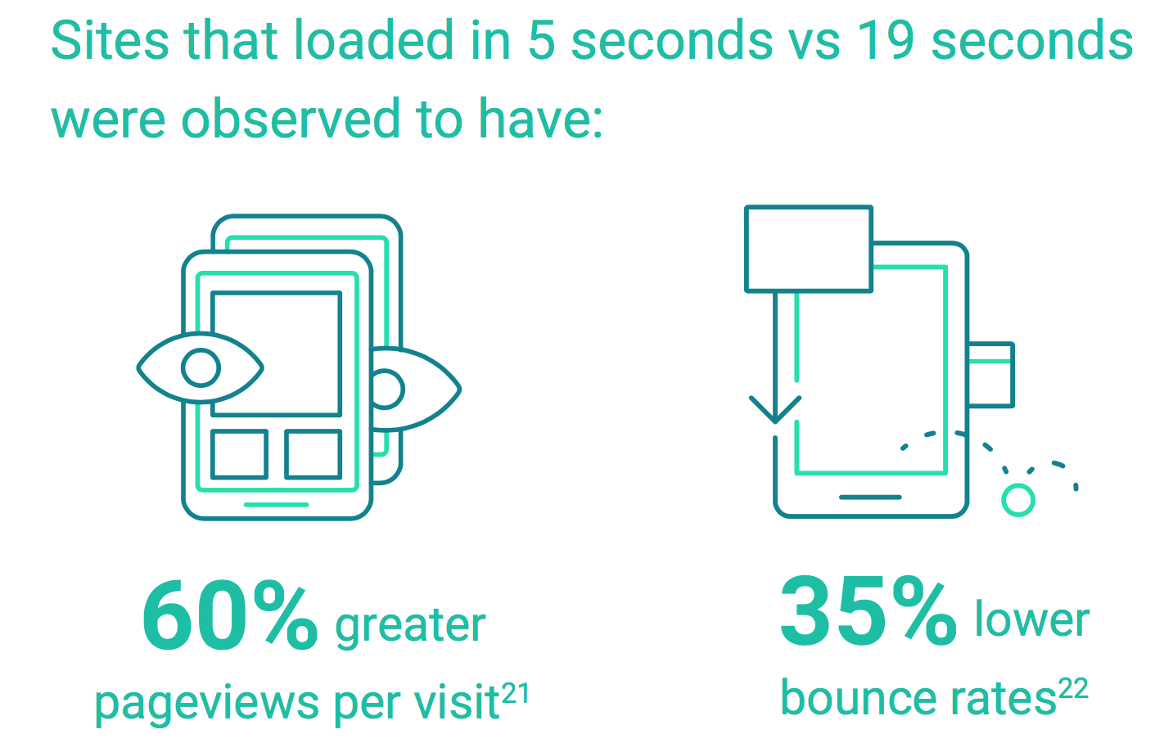

Slide 16
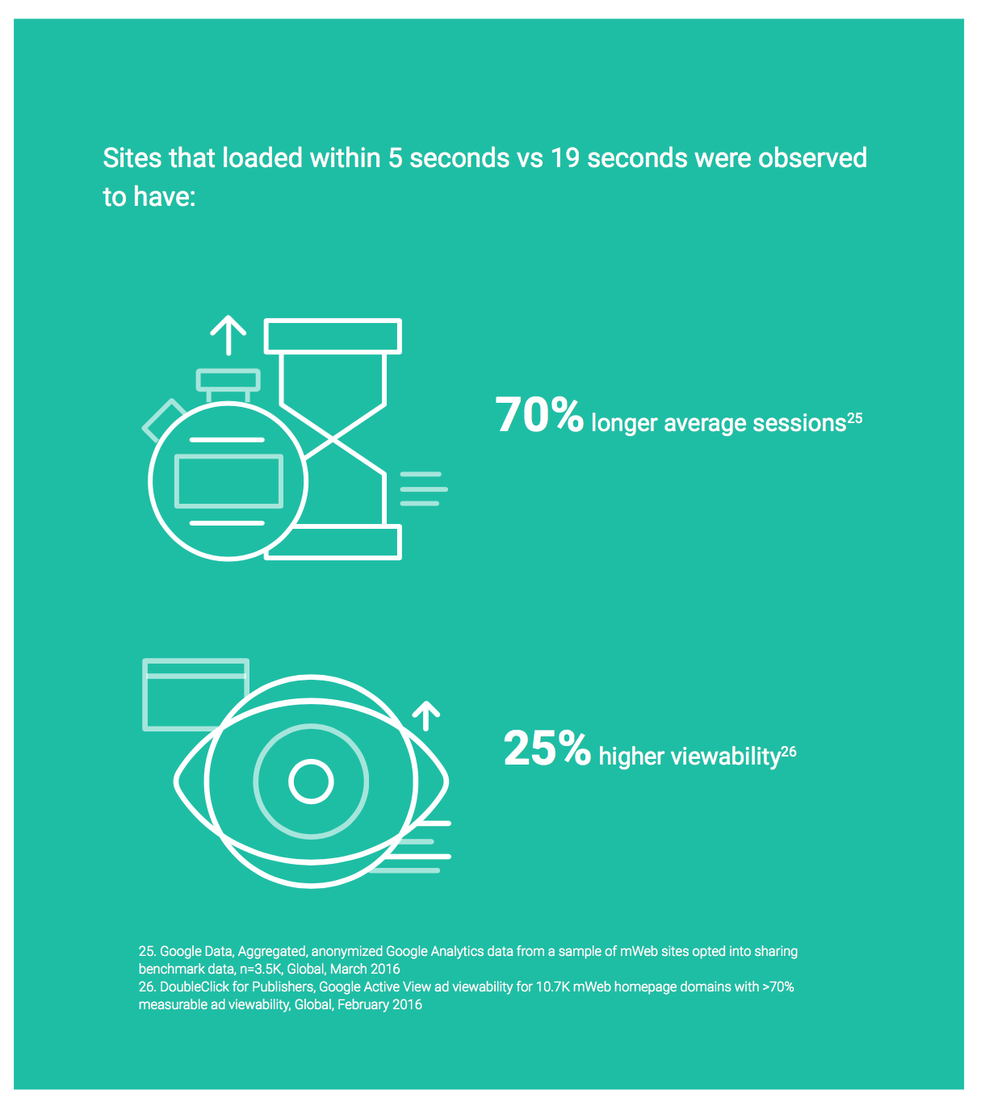

Businesses that advertise ultimately care about revenue.
While there are several factors impacting revenue, Google’s model projects that advertiser’s whose mobile sites load within 5 seconds earn up to 2X greater mobile ad revenue than those whose sites load within 19 seconds.

Slide 17


