Slide 1

SEO Presentation
Name and logo of Agency

Slide 2

Agenda
Why is SEO important?
What does SEO consist of?
What is your opportunity?
Why do SEO with us?
What to expect.
www.YourCompanyName.com
Company Logo

Slide 3
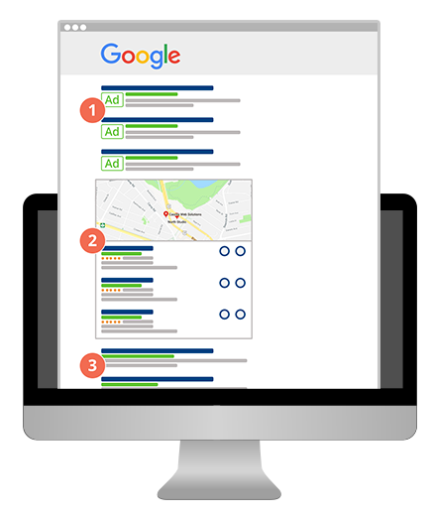
Why is SEO important?
More than 80% of consumers research online before buying.
Nearly 92% of organic clicks to sites come from Google’s page 1 results.
Organic SEO traffic is the largest form of traffic to a website and SEO directly impacts this.
Good SEO practices improve the user experience and usability of a web site, which leads to higher conversions.
SEO helps make your Google My Business listing more visible.
SEO impacts Voice Search, enhances your Mobile Rankings, and helps your business dominate the competition!
www.YourCompanyName.com
Company Logo

Slide 4
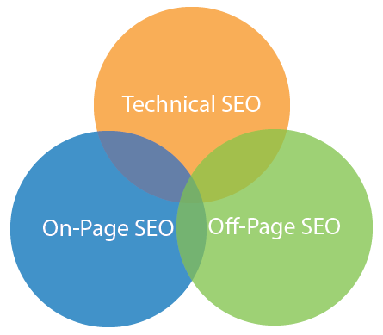
What does SEO consist of
In layman's terms, SEO consists of 3 main things.
Technical SEO
This ensures your website is visible to Search Engines and they can crawl and index your website.
Onsite SEO
This ensures your site is Search Engine friendly and includes various components such as Titles, Schema, Content, H1’s, Architecture, and more. They get optimized with a focus on your main keywords and geographies.
Offsite SEO
This consists of activities such as targeted link building, which is done to enhance the relevance and reputation of your site to help it gain credibility and higher rankings.
www.YourCompanyName.com
Company Logo

Slide 5
SEO opportunity for (clients name)
On this slide cut and paste relevant snips of the prospects current rankings, snips from the audit report, or competitors rankings, based on prior research or knowledge.
If not able to do so, delete this slide.
www.YourCompanyName.com
Company Logo

Slide 6
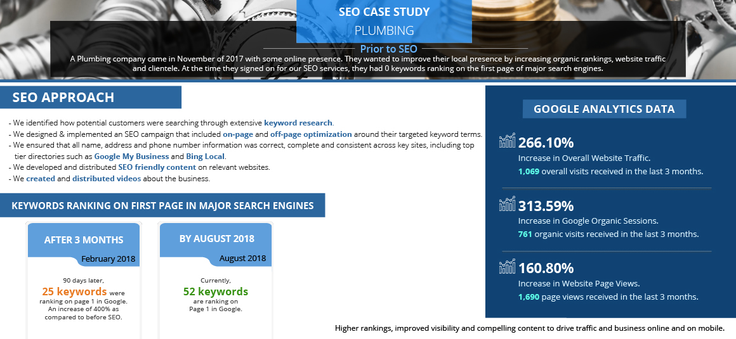
Why should you be doing SEO with us?
www.YourCompanyName.com
Company Logo

Slide 7
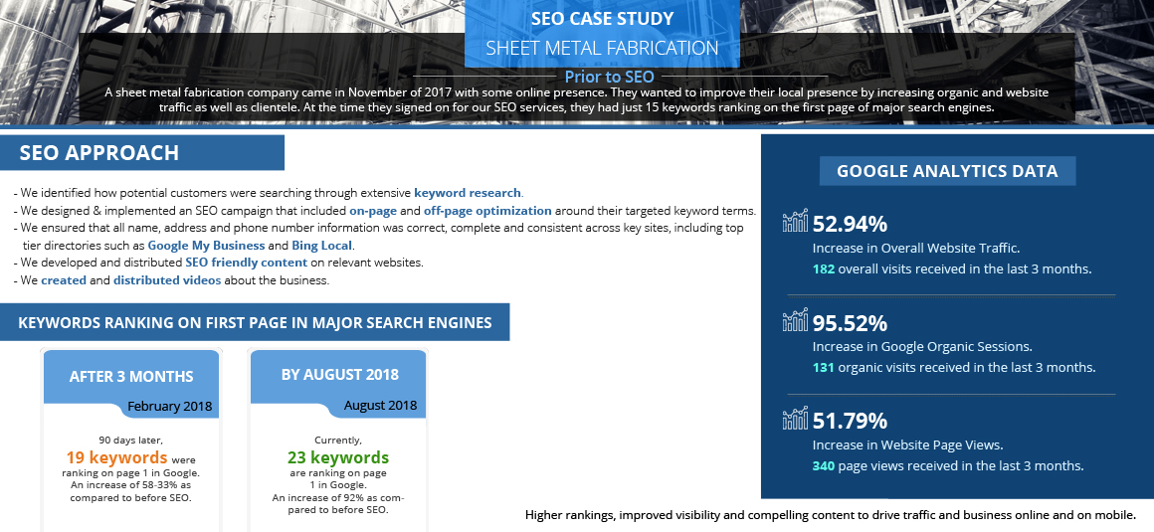
Why should you be doing SEO with us?
www.YourCompanyName.com
Company Logo

Slide 8

Why should you be doing SEO with us
Monthly reporting
Comprehensive Dashboard that shows work being done, improvements in rankings, and much more
www.YourCompanyName.com
Company Logo

Slide 9
What should you expect?
www.YourCompanyName.com
Company Logo

